Slide 1

Land Cover and Biometry Measurements
GLOBE expedition 2015
Meelis Välba, Alex Zernov, Jako Aimsalu, Helen Uibu, Vadim Mihhailov, Marie Johanna Univer, Henri Hirv, Heli Salundi, Svetlana Gostiseva, Rasytė Gaidienė, Elijas Palionis, Alina Mokliak, Kateryna Cheban, Yelyzaveta Borodynia, Piia Liisa Künnapas, Lii Sepp, Ülle Reier, Imbi Henno

Slide 2
Main purposes
To determine the major land cover type at a Land Cover Sample Site.
To measure and classify the plants at a Land Cover Sample Site to help determine the MUC classification.
To compare the satellite picture (one pixle at a time) with real nature

Slide 3
Research questions
Compare the different Land Cover Sample Sites
What are the dominant and co-dominant species?
Are the dominant and co-dominant species common in this area?
Can the same types of land cover have different size and amount of trees, shrubs or grasses?
If you compared a Landsat image from ten years ago to one from today how do you think they would differ?

Slide 4
Methodology
Select the 30 m x 30 m area
Record data(latitude, longitude, elevation)
Identify plants or land cover
Take some photos
Biometry measurements(canopy and ground cover)

Slide 5
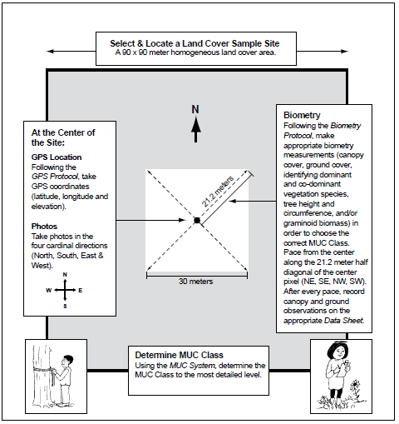

Slide 6
Tools and materials
GPS receiver
Camera
Pencil or pen and Data Sheet
Landsat TM images of your GLOBE Study Site
Local and topographic maps (if available)
Aerial photos (if available)
MUC Field Guide
Biometry Protocol materials as needed
50 m tape measure
Calculator (optional)
Tubular densiometer
Rope
Markers for sites
Clipboard

Slide 7
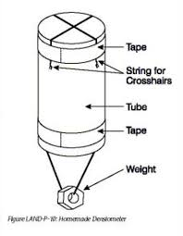
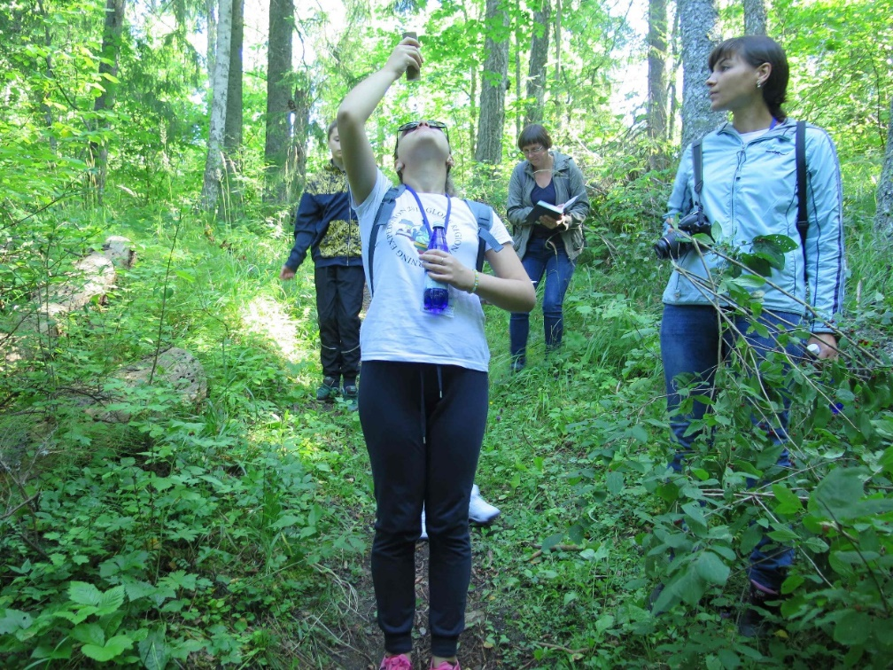
Densiometer

Slide 8
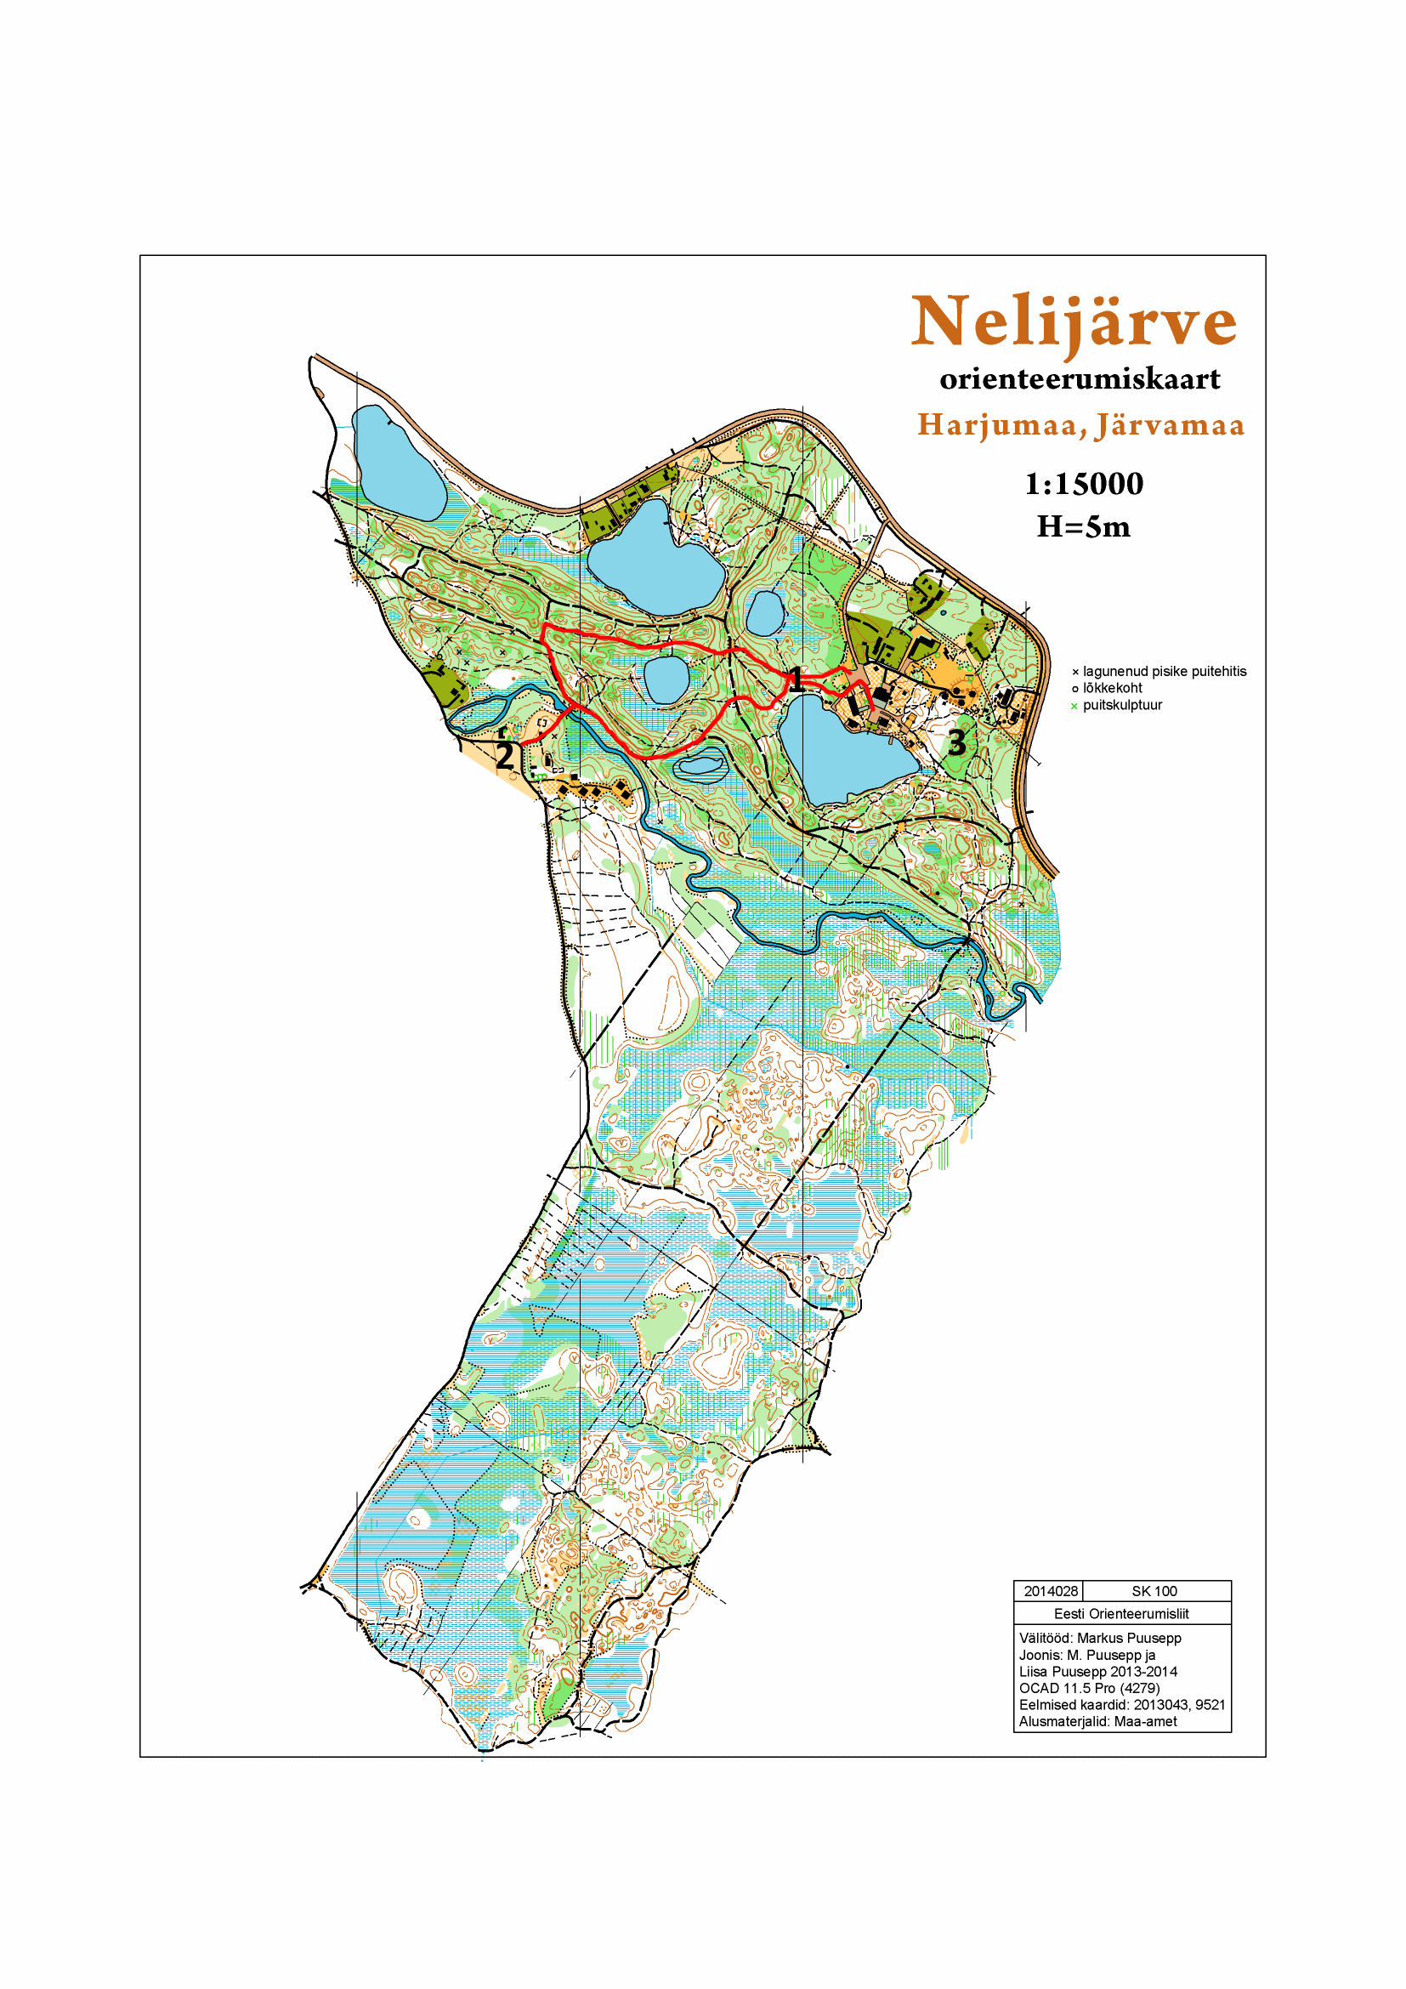

Slide 9
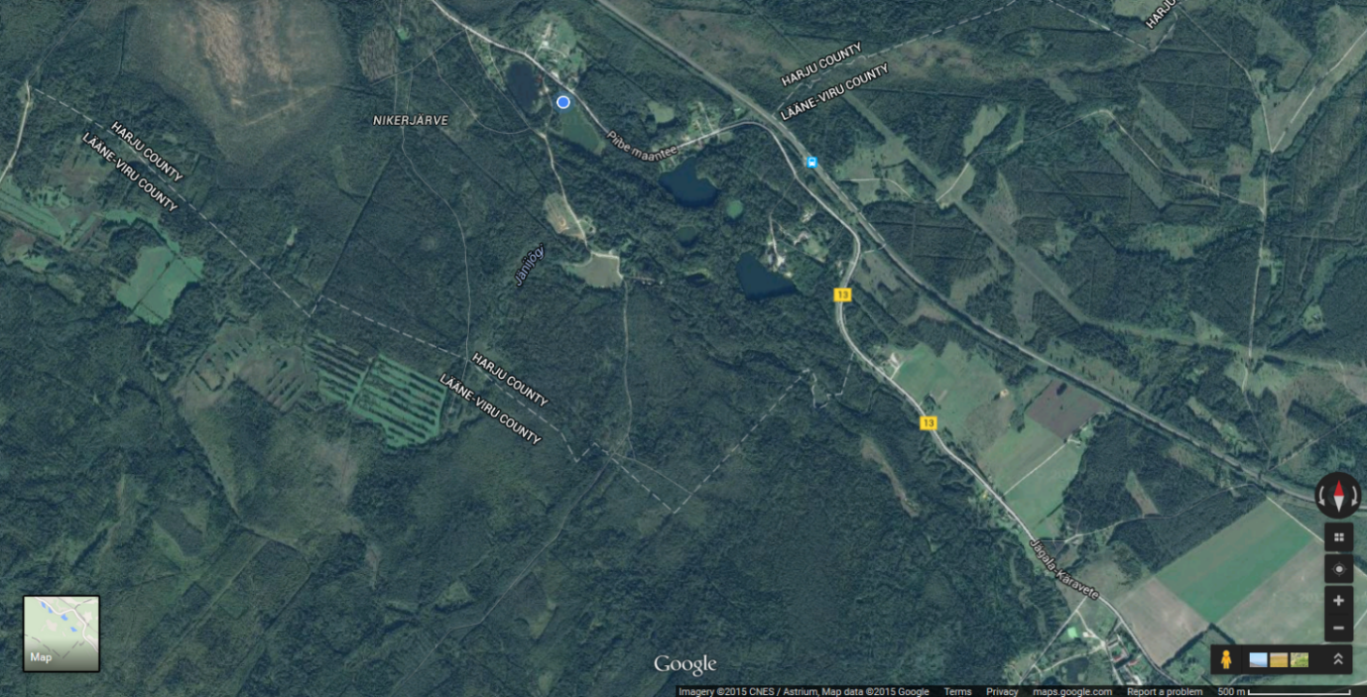
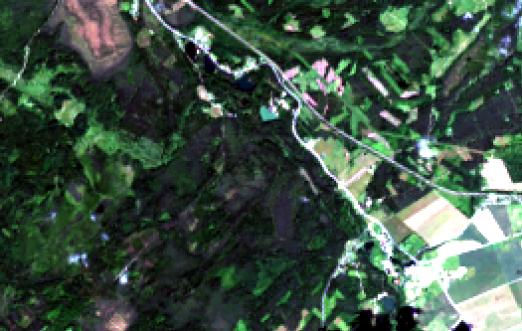
Measured area by
Google earth
Landsat-8 July 21, 2015 natural colours image

Slide 10
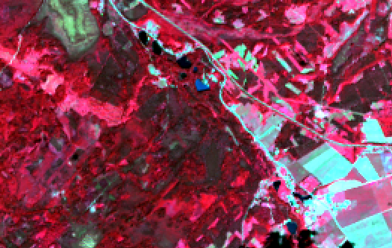
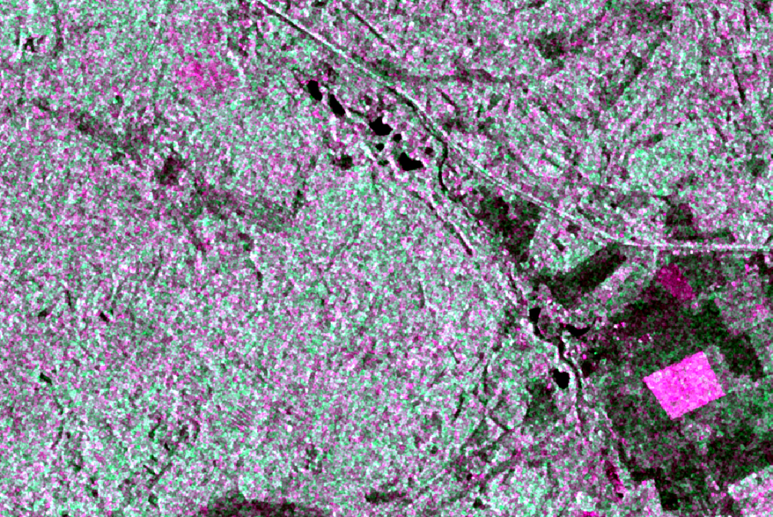
Measured area by
Landsat-8 July 21, 2015 false colour composite
Sentinel-1 radar image on July 31, 2015

Slide 11
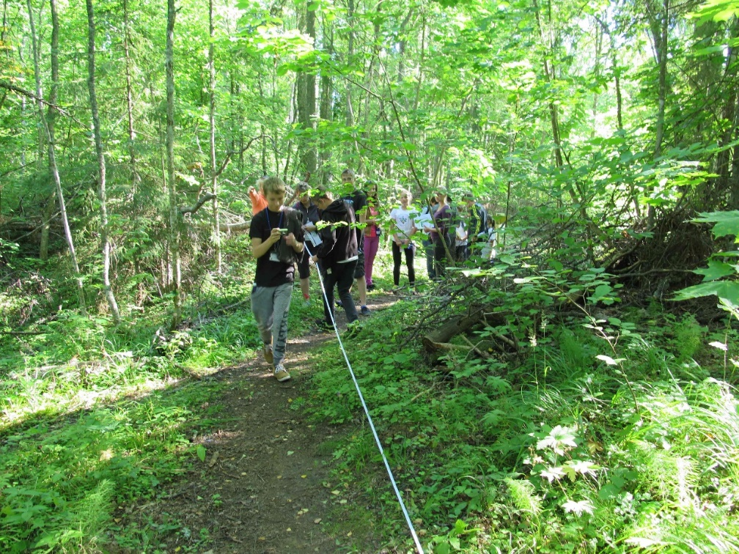
Site 1 forest
Lat. 59⁰15’59,66’’ N
Long. 25⁰38’40,7’’ E
Elevation 109m
Tree canopy cover 64%
MUC code 0231

Slide 12
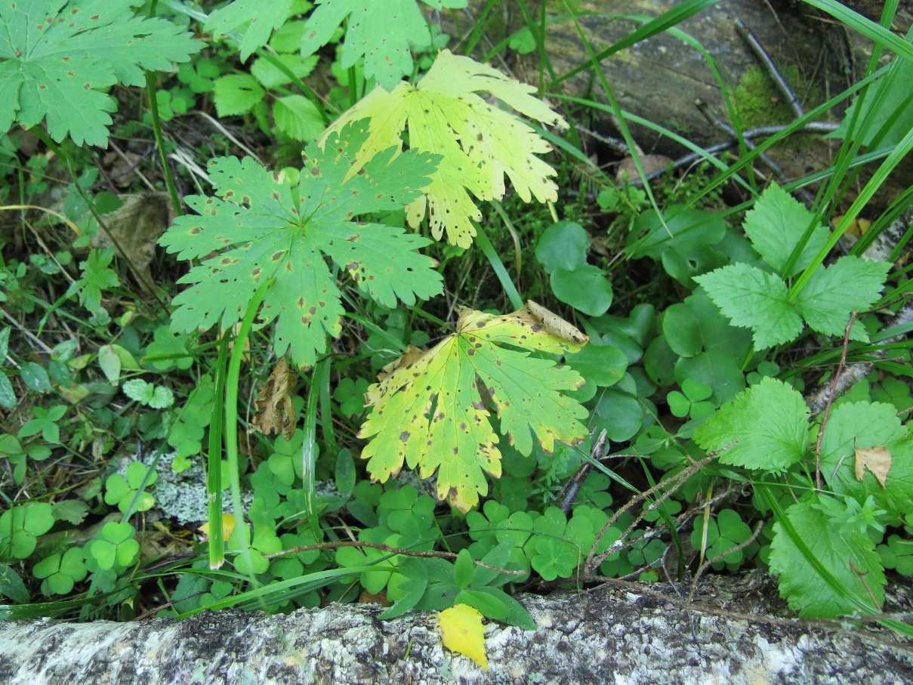
Dominant species
Germanium sylvaticum
Dryopteris filix-mas - Maarja sõnajalg
Rubus saxatilis - lillakas
Pteridium aquilinum - kilpjalg
Hepatica - sinilill
Melampyrum - mets-härghein
Pleurozium schreberi - harilik palusammal
Carex pallescens - kahkjas tarn
Viola riviniana - võsakannike
Deschampsia flexuosa - võnk-kastevars
Geranium sylvaticum - mets-kurereha
Corylus avellana - harilik sarapuu
Acer platanoides - harilik vaher

Slide 13
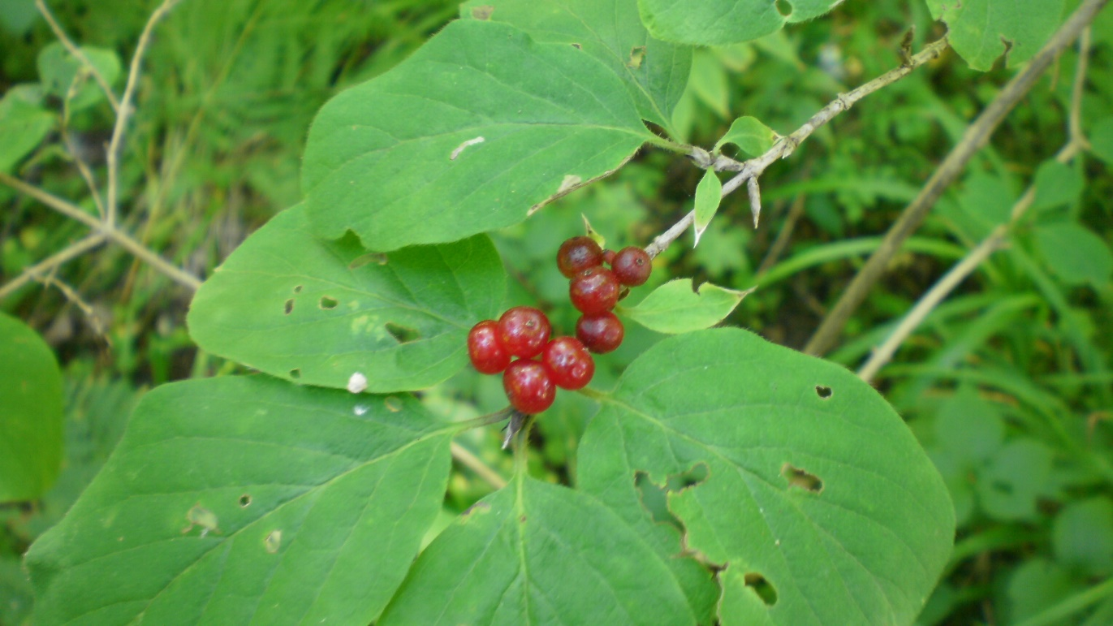
Salix caprea - raagremmelgas
Lonicera - kuslapuu
Ribes alpinum - mage sõstar
Calamagrostis arundinacea – metskastik
Poa nemoralis – salunurmikas
Lonicera

Slide 14
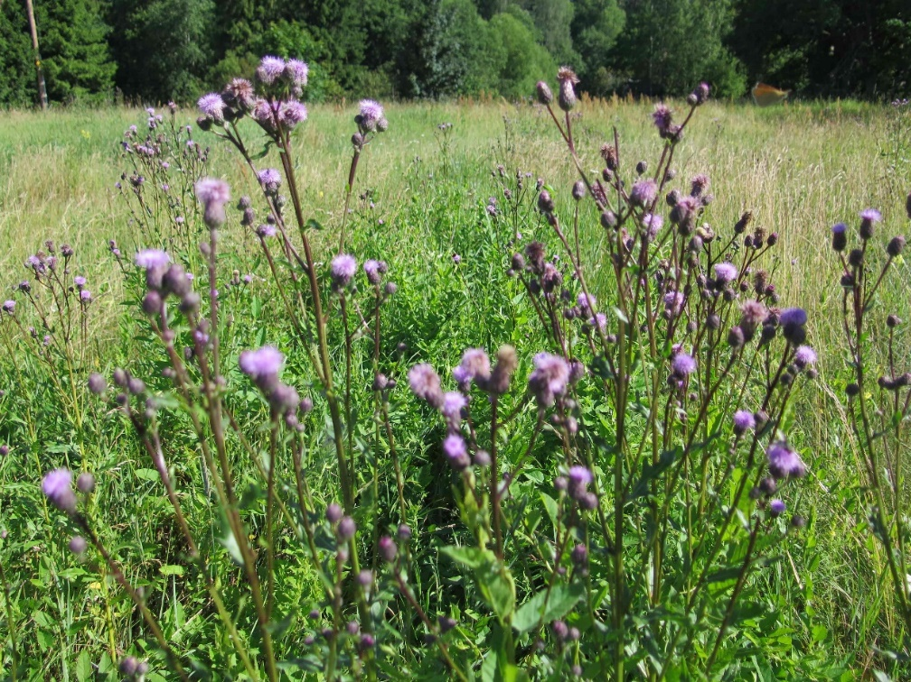
Site 2 the old field (meadow)
Lat. 59⁰15’56,82’’ N
Long. 25⁰38’07,91’’ E
Elevation 91m
MUC code 442
Cirsium arvense

Slide 15
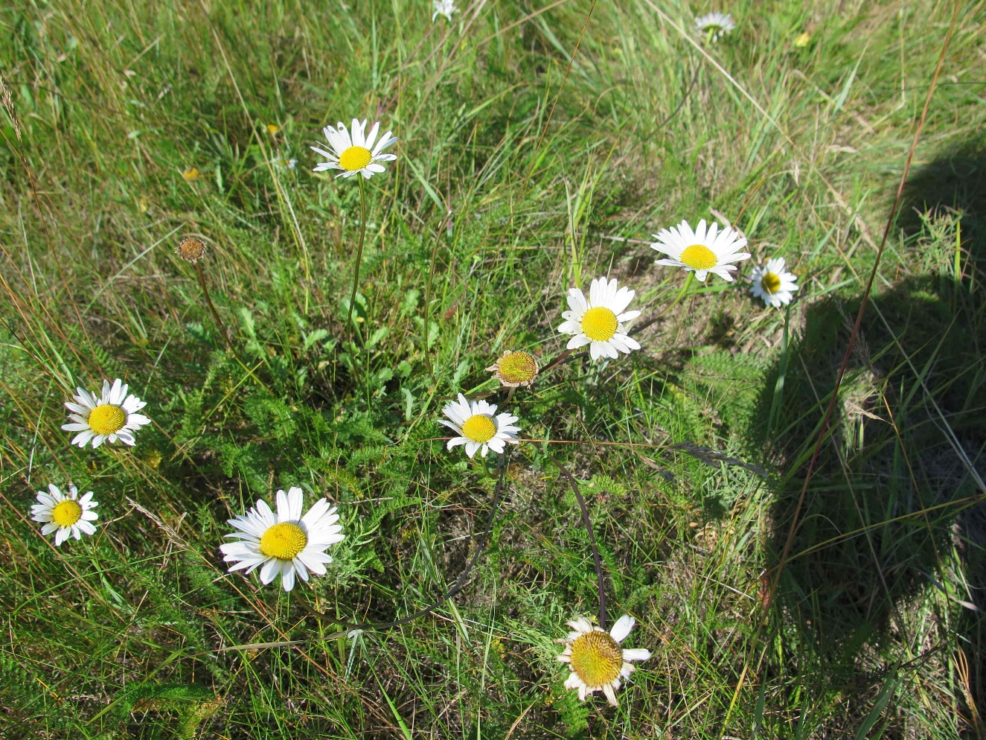
Dominant species
F for common field species and M for common meadow species
Cirsium arvense – põldohakas F
Silene latifolia - valge pusurohi
Convolvulus arvensis - kassitapp
Galium album - valge madar
Rumex thyrsiflorus - aasoblikas
Achillea millefolium - harilik raudrohi
Linaria - käokannus
Phleum pratense – põldtimut M
Festuca rubra - punane aruhein
Leucanthemum vulgare - harilik härjasilm
Campanula patula - harilik kellukas M
Pilosella officinarum - harilik karutubakas
Leucanthemum vulgare

Slide 16
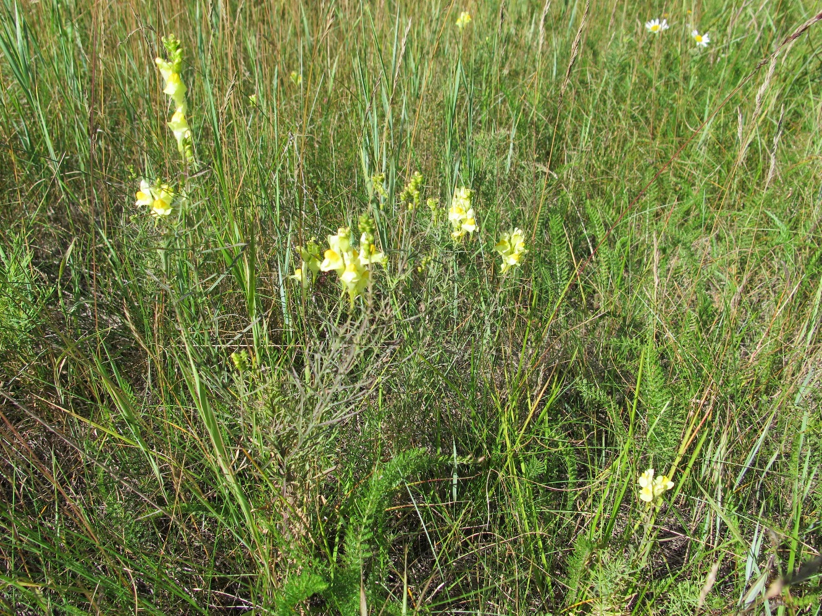
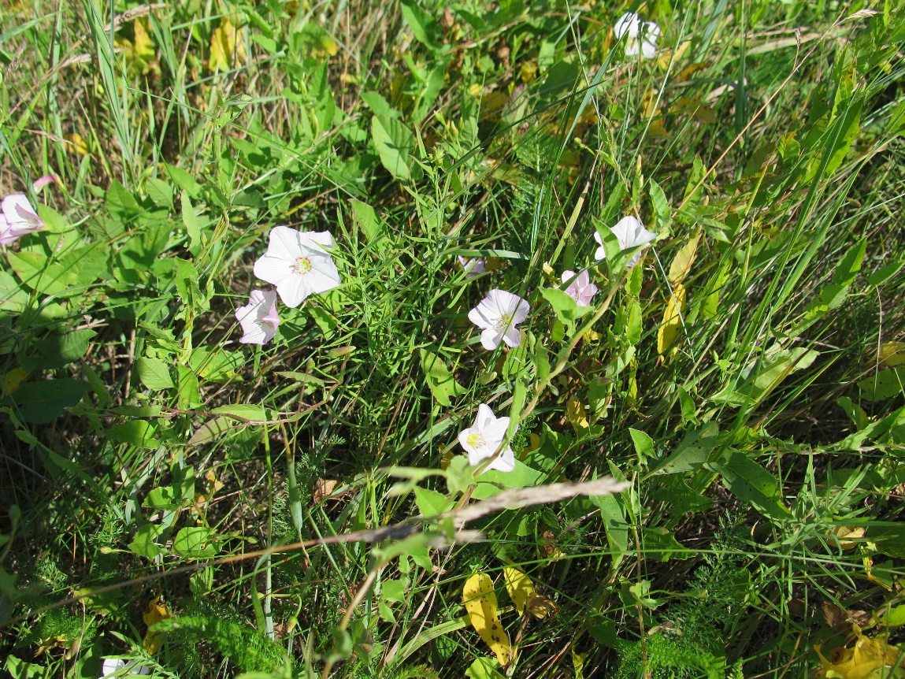
Centaurea scabiosa – põldjumikas M
Rumex crispus - kärnoblikas
Rhytidiadelphus squarrosus – niidukäharik M
Potentilla argentea - hõbemaran
Convolvulus arvensis
Linaria

Slide 17
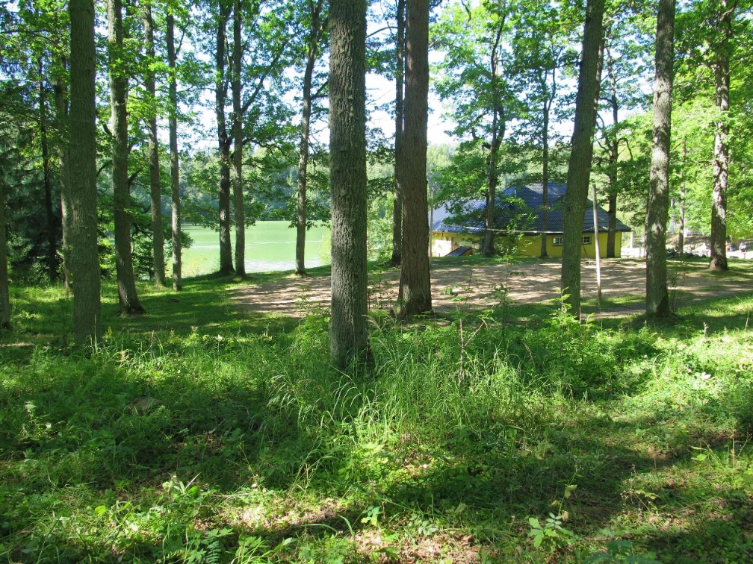
Site 3 near Purgatsi lake
Lat. 59⁰15’54,08’’ N
Long. 25⁰39’07,49’’ E
Elevation 113 m
Tree canopy cover 62%
MUC code 821 (parks and sporting areas)

Slide 18
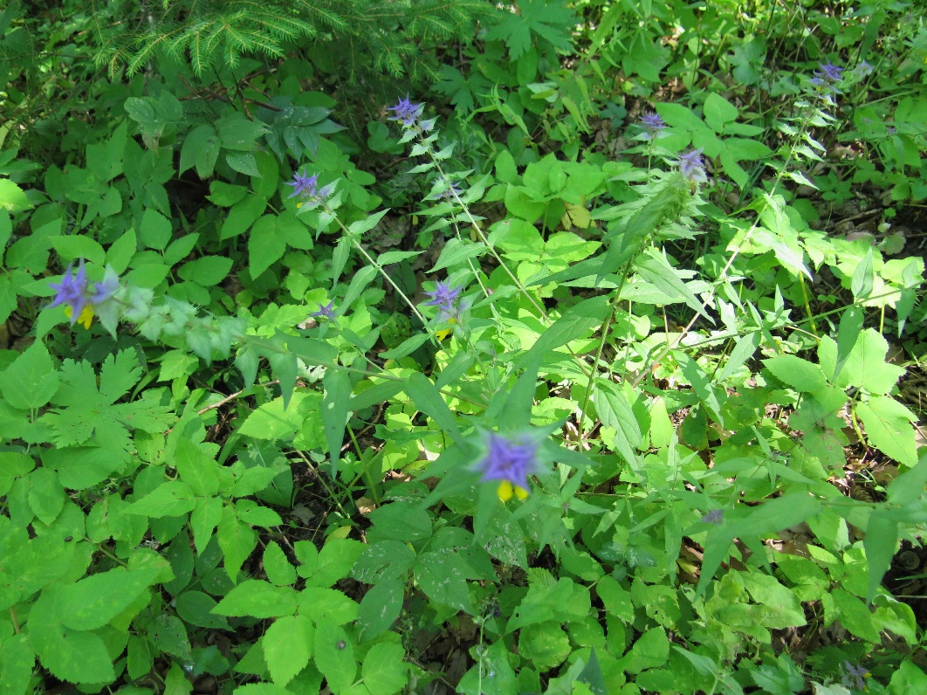
Dominant species
Melampyrum nemorosum
Quercus robur - tamm
Picea abies - kuusk
Sorbus - pihlakas
Melampyrum nemorosum - härghein
Calamagrostis - kastik
Fragaria vesca - metsmaasikas
Oxalis acetosella - harilik jänesekapsas
Veronica chamaedrys - külmamailane
Vicia sepium - aed-hiirehernes
Lathyrus vernus - kevadine seahernes

Slide 19
Conclusions
The three measured sites were the same as the satellite pictures
Dominant species can be the same if the sites are similar (site 1 and 3)
The dominant species are usually common in this area
The same type of land cover can have different amount and size of land cover (for example if there is a human impact)
The meadow in site 3 was a field 10 years ago

Slide 20
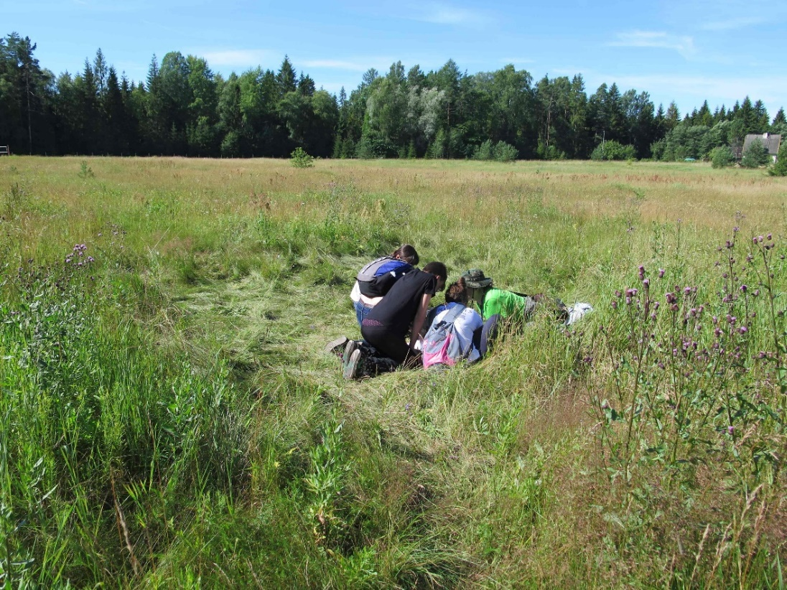
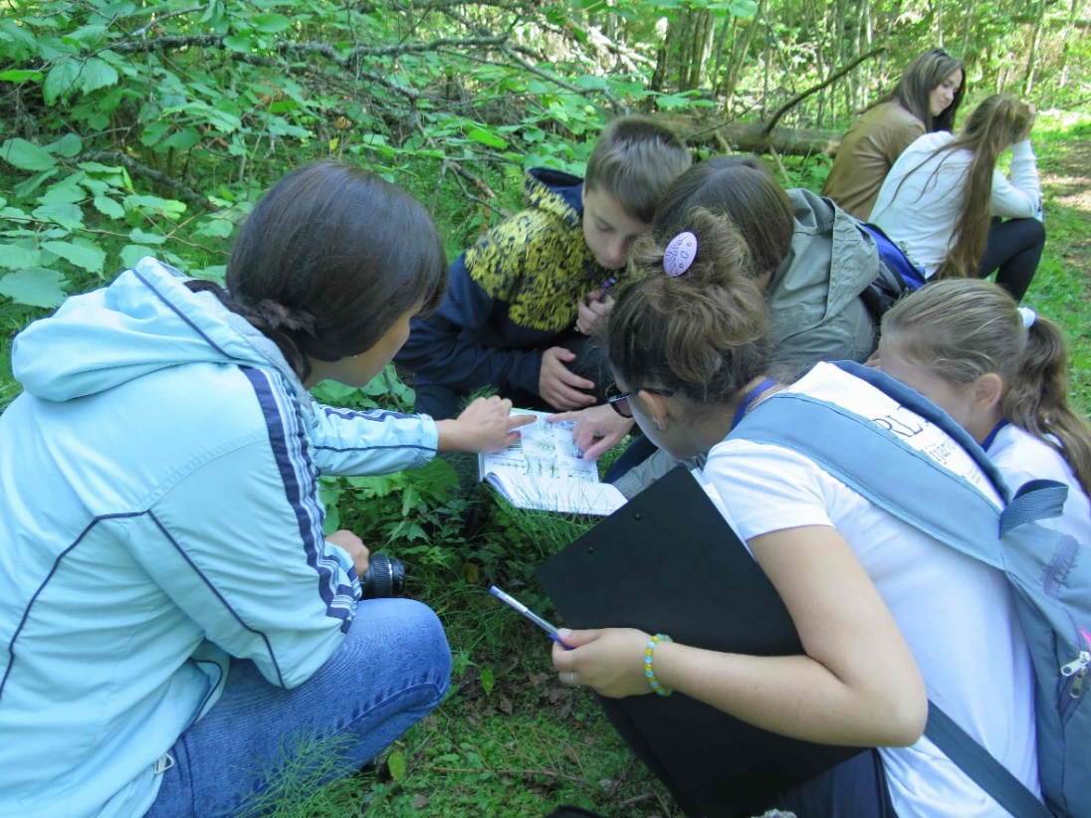
Extras 1
On the meadow
In the forest

Slide 21
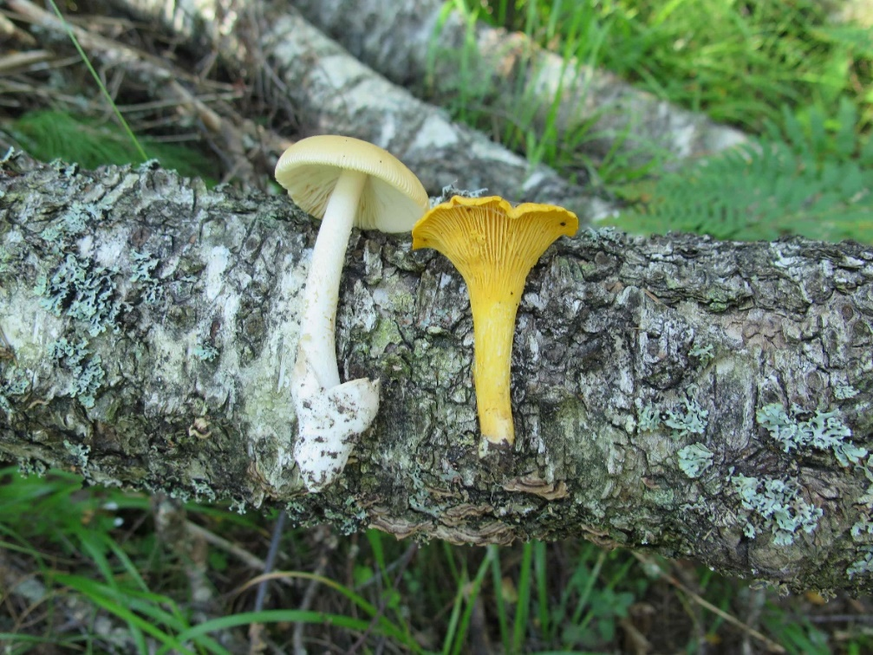
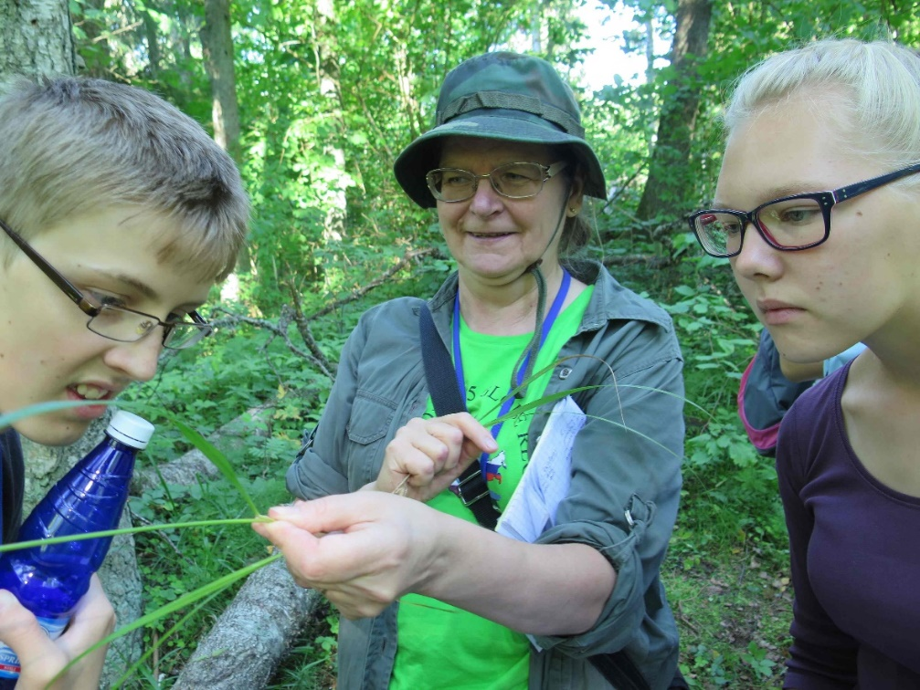
Extras 2
Mushrooms
Our supervisor

Slide 22
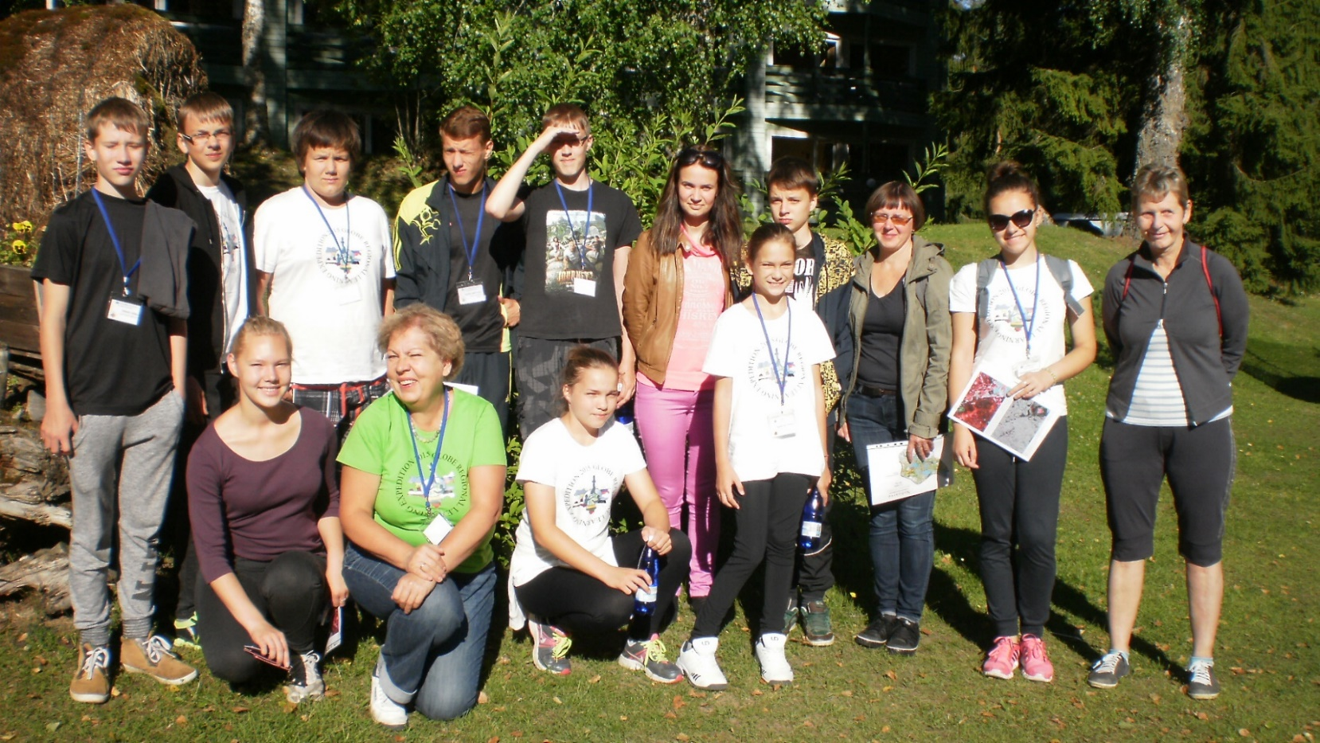

Thank you for your attention

