Slide 1
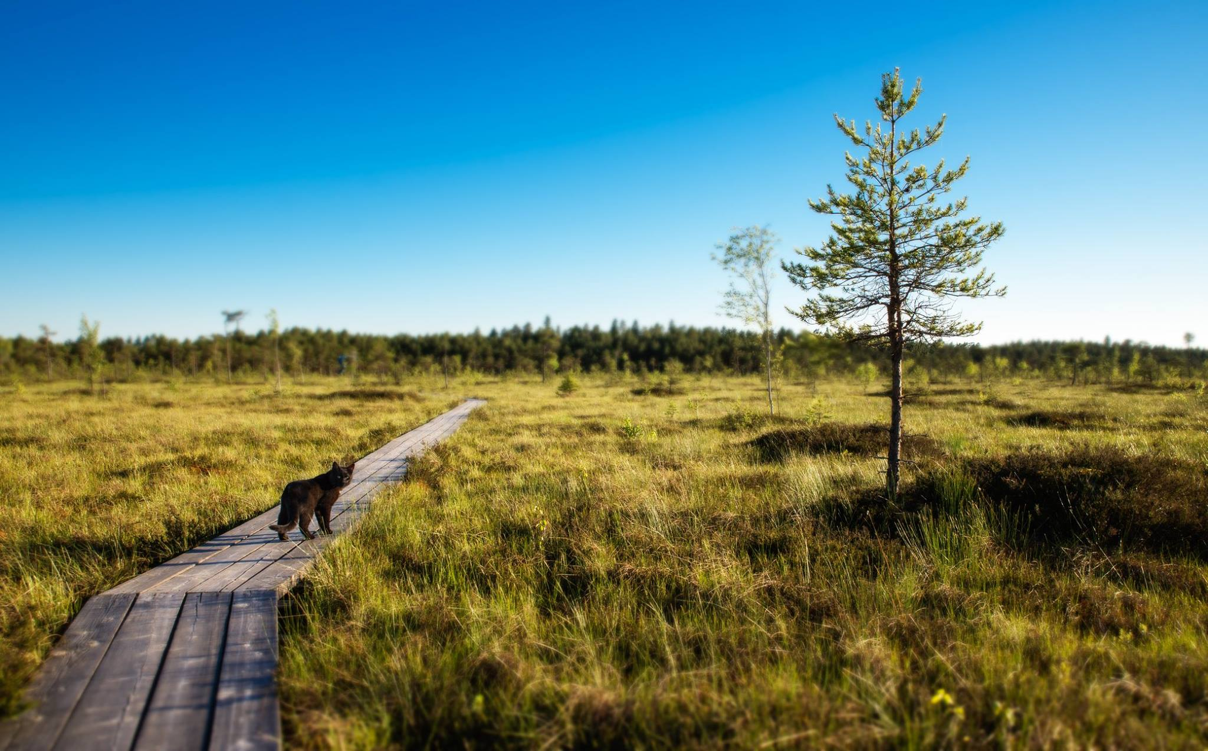
Mire ecology
GLOBE expedition 2015
Team Cats

Slide 2
Objective
To analyse interactions between vegetation and environmental factors in the Koitjärve raised bog.

Slide 3
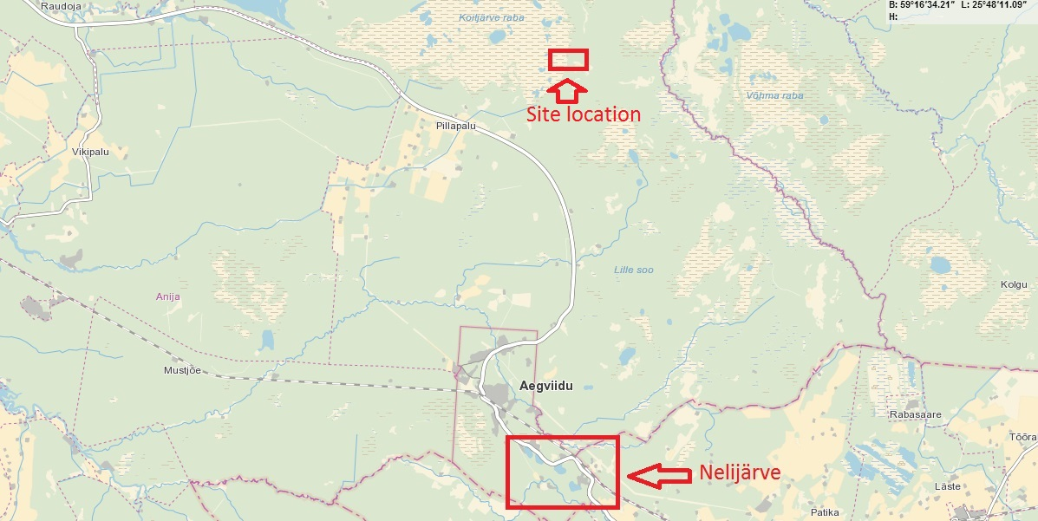

Slide 4
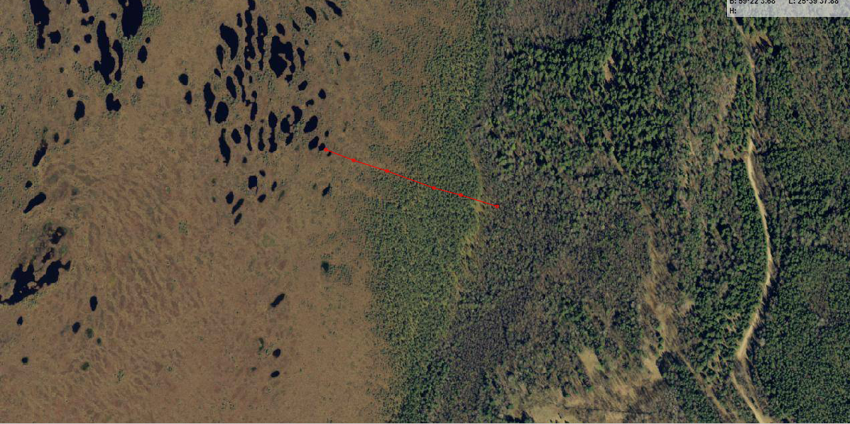
The study transect of 6 positions

Slide 5
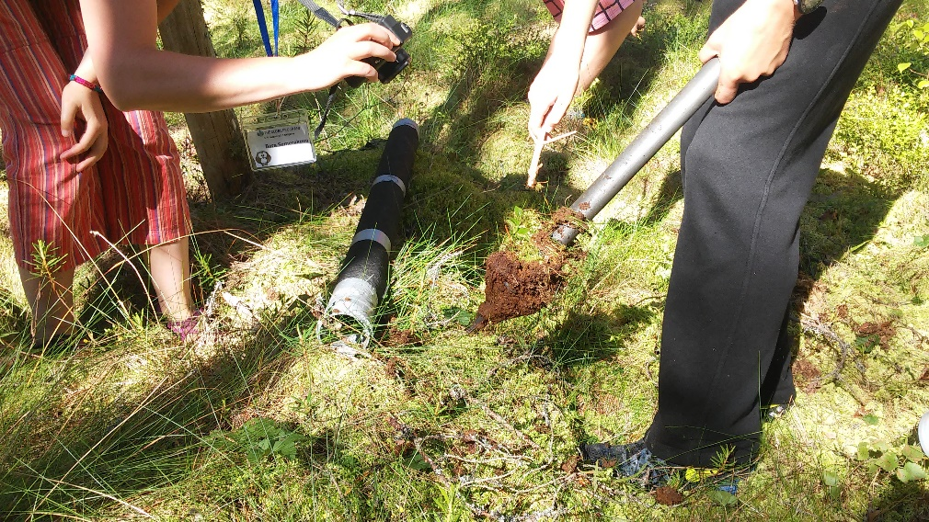
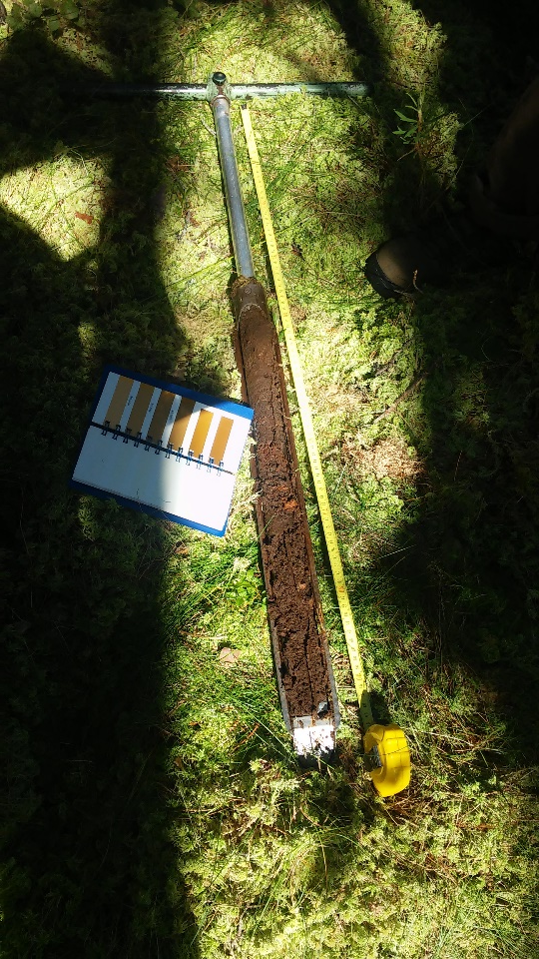
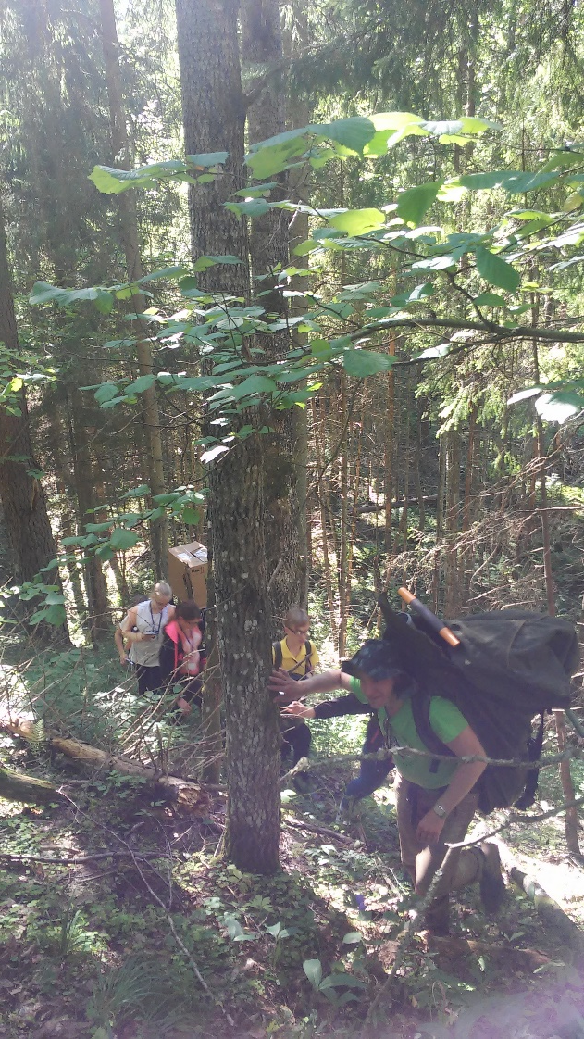
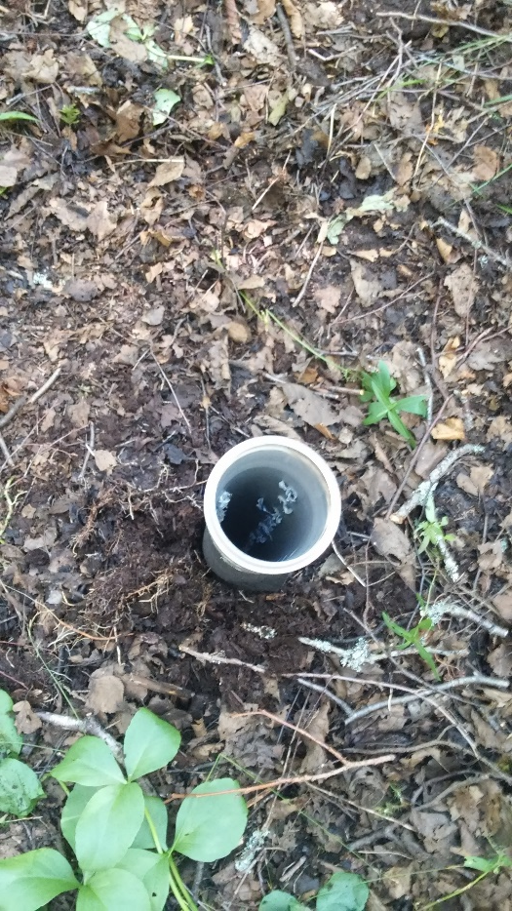
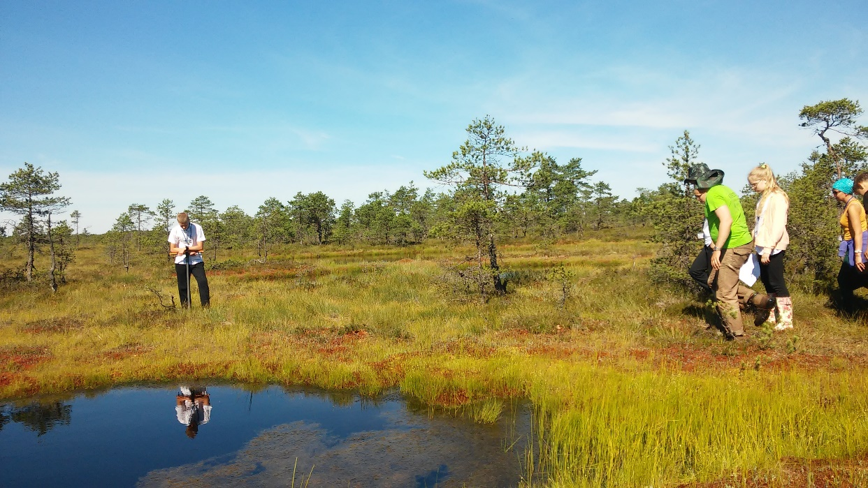
Working process
Position 2
Position 2
Position 1
Conquering the mountain
Position 6

Slide 6
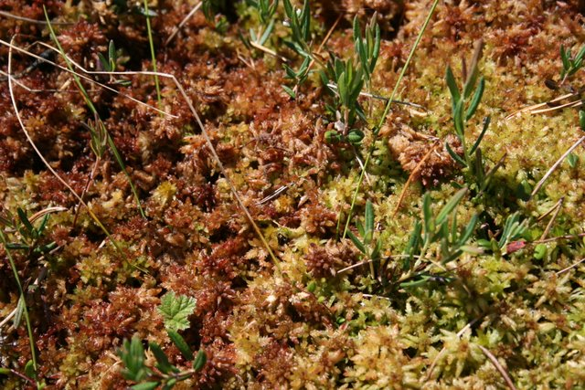
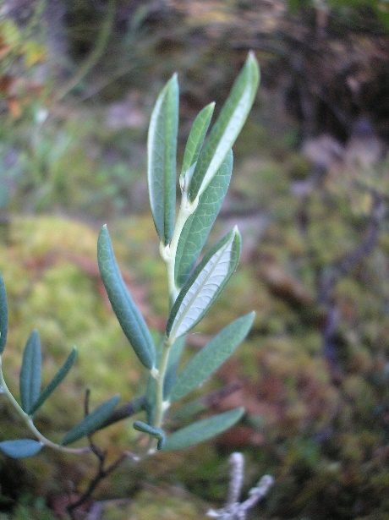
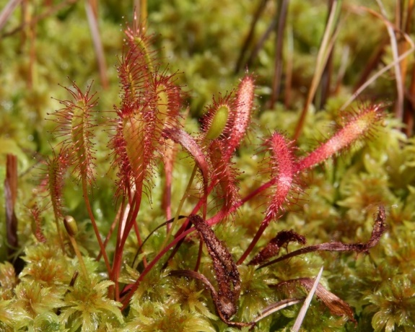
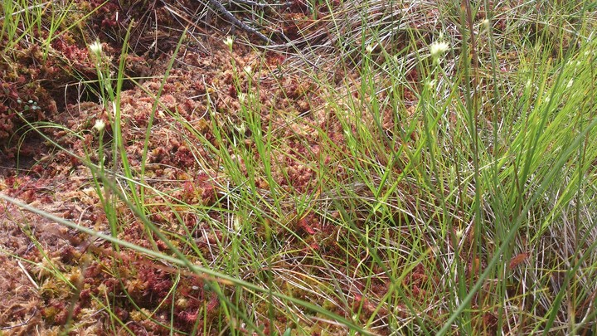
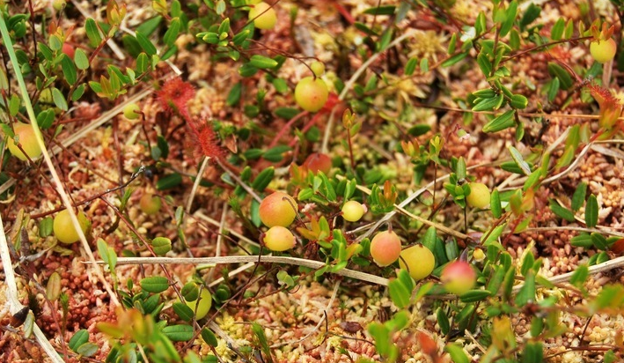
Bog hollow plants
Turbasamblad
Peat mosses
Sphagnum spp
Pikalehine huulhein
English sundew
Drosera anglica
Küüvits
Marsh andromeda
Andromeda polifolia
Valge-nokkhein
White beak-sedge
Rhynchospora alba
Harilik jõhvikas
Cranberry
Oxycoccus palustris

Slide 7
The deeper groundwater the more characteristic bog hollow species (according to Paal 1997)
Share of bog hollow species
Groundwater depth [cm]

Slide 8
The less canopy the warmer peat
Temperature at 40 cm depth [°C]
Canopy cover

Slide 9
The more sunlight availability the more bog hollow species
Share of bog hollow species
Canopy-free area

Slide 10
Conclusion
Groundwater level and sunlight availability are the main causes of vegetation differences in the Koitjärve raised bog.

Slide 11
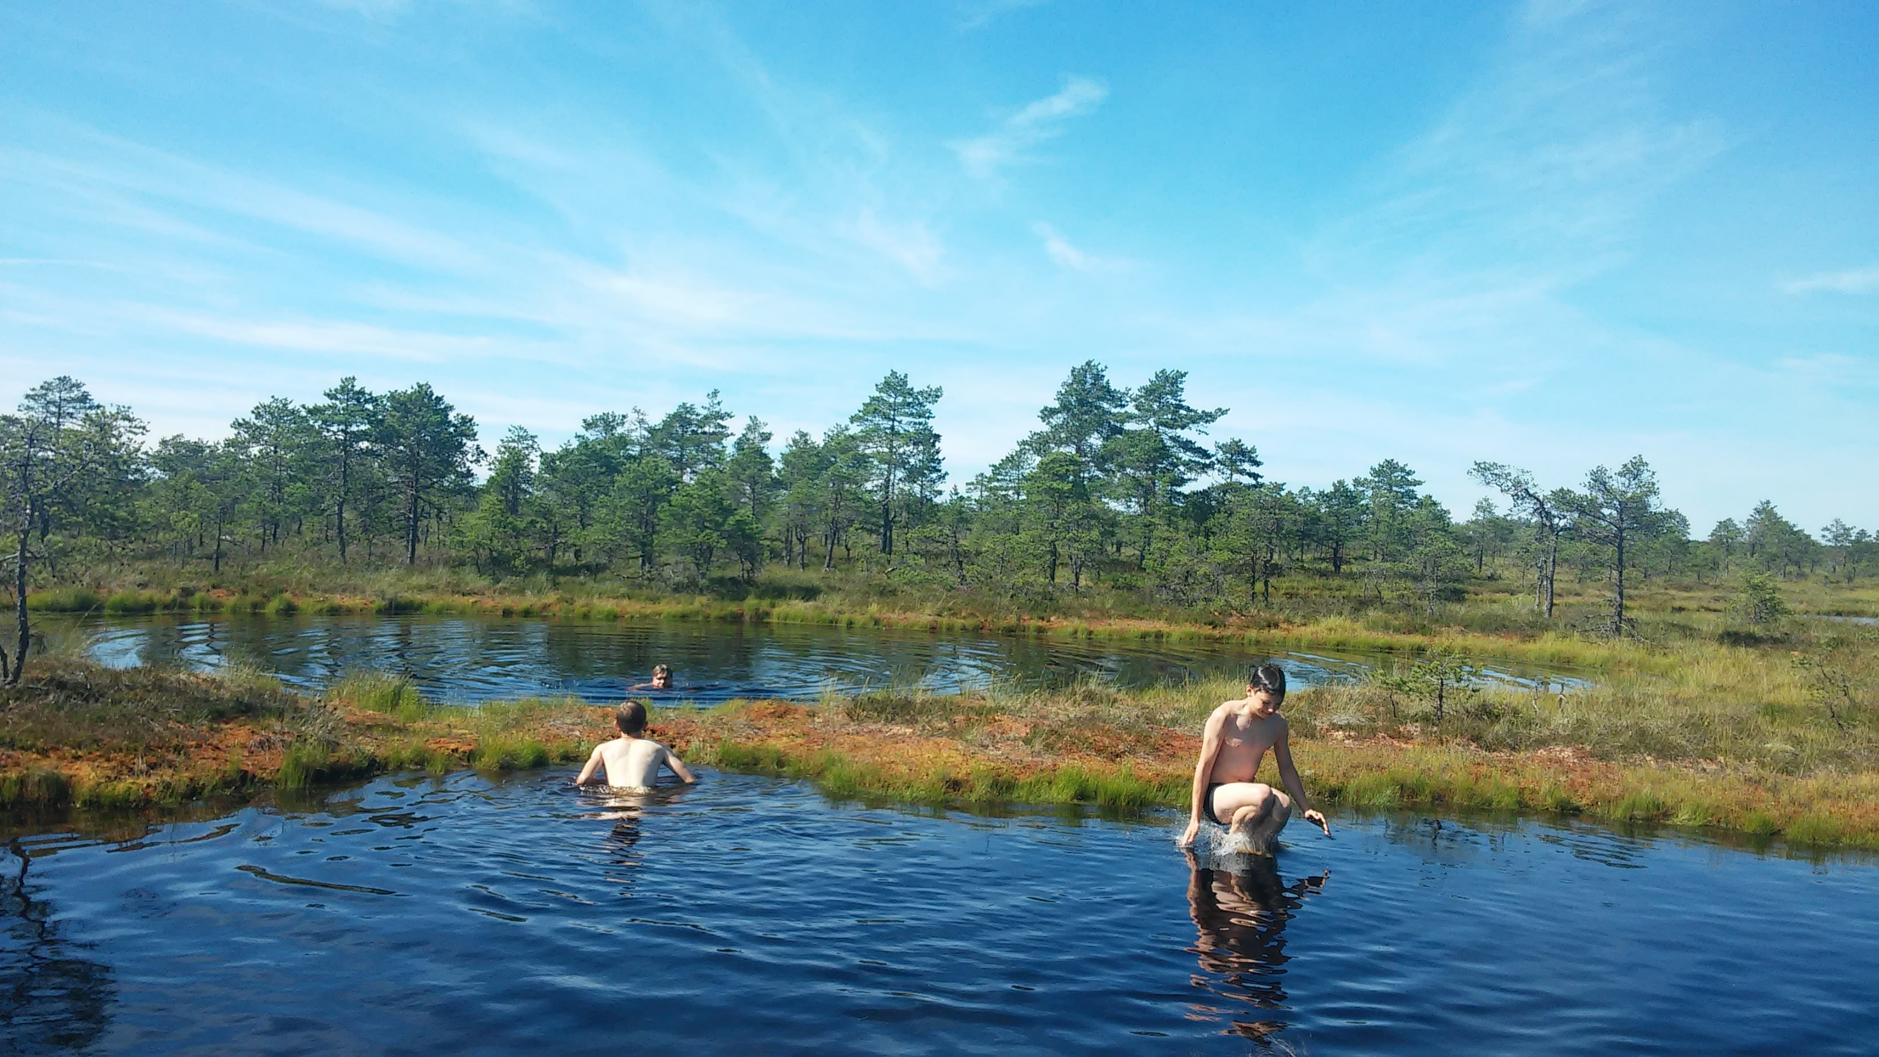
Questions?

