Slide 1
The Temperatures in freshwater, air and soil
Made by: Suvi-Mari Parts, Katariina Koemets, Kevin Varzin, Jarko Nassar, Helina Hirv, Nika Kulik, Mariia Vasylenko, Annabel raudkivi, Eda Koskor, Tatjana Sedova,
SUpervisor: Johanna Raudsepp
Nelijärve 2015

Slide 2
introduction
We researched lakes and the temperature around them.
WE WENT TO VIKERJÄRV, URBUKSE LAKE, AHVENAJÄRV, PURGATSI LAKE
Hypothesis: We think that water and air temperatures correlated.
Hypothesis: We think that soil temperature is affected by air and water temperature.

Slide 3
Research methods
WE USED VERNIER data-logger and sensors, THERMOMETERs, infrared thermometer, humidity sensor, trubidity sensor, plastic cups, ruler, shovel, anemometer and map.

Slide 4
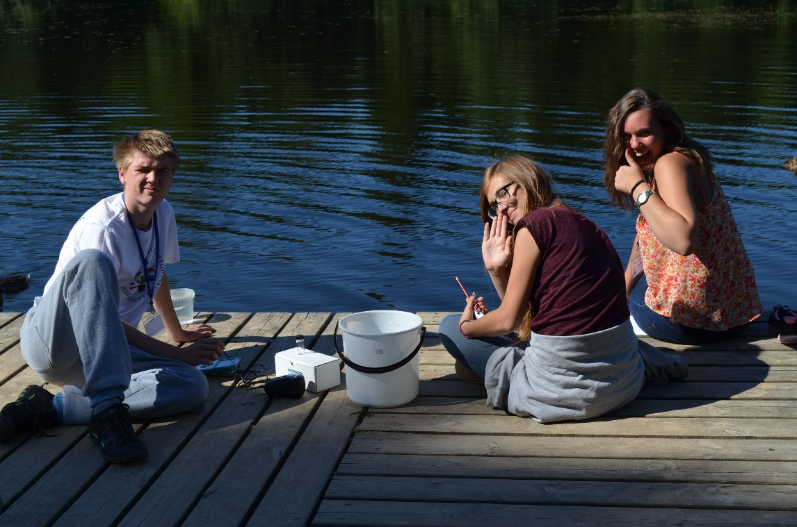
Nikerjärv
Clouds 2%
Plants covering 80%
Wind speed 0-3 m/S
Water plants covering 20%
intensity of light 10240 lux
turbidity 29,8 NTU
Humidity 32,6 %
We started at 10:51 and we finished at 11:17
Photographer: Mariia Vasylenko

Slide 5
Data from Nikerjärv
height | Air temperature
10cm | 23,4°C
130cm | 22,6°C
depth | Water temperature
At surface | 18,4°C
30cm | 19,4°C
60cm | 19,1°C
90cm | 19,0°C
depth | Soil temperature
At surface | 17,3°C
5cm | 13,4°C
20cm | 14,1°C
30cm | 14,2°C

Slide 6
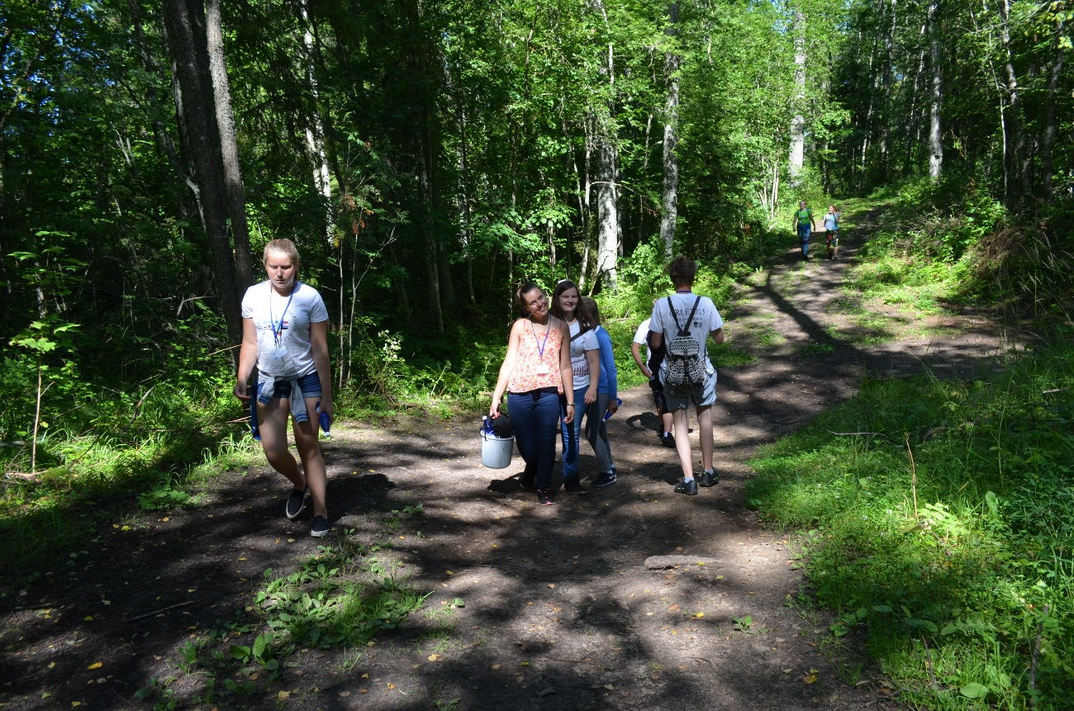
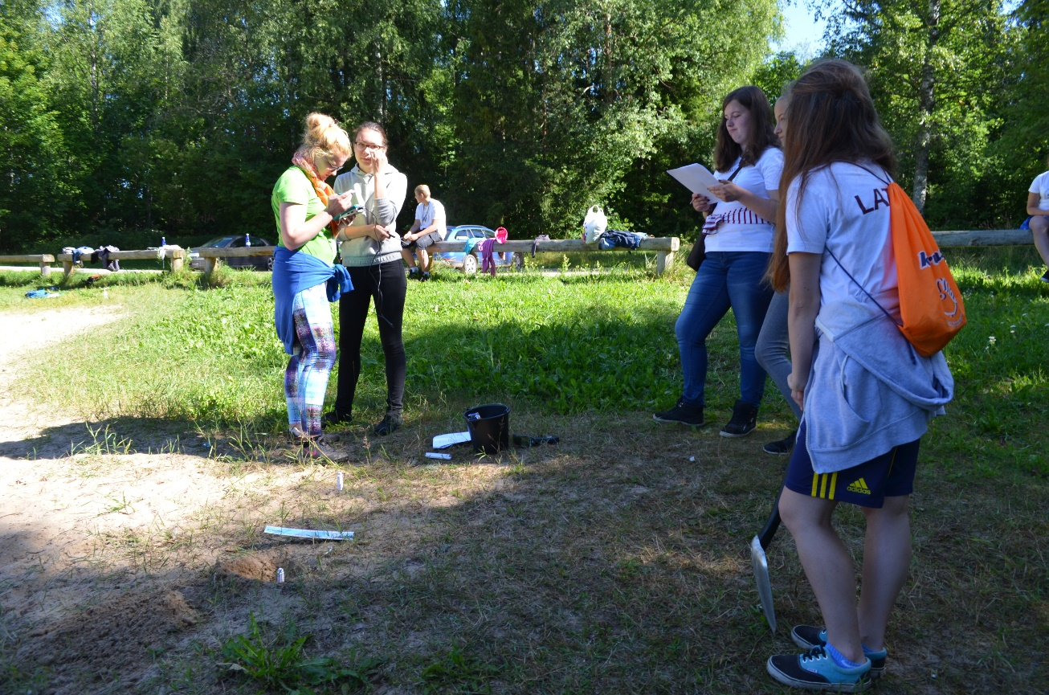
We got lost
Photographer: Mariia Vasylenko

Slide 7
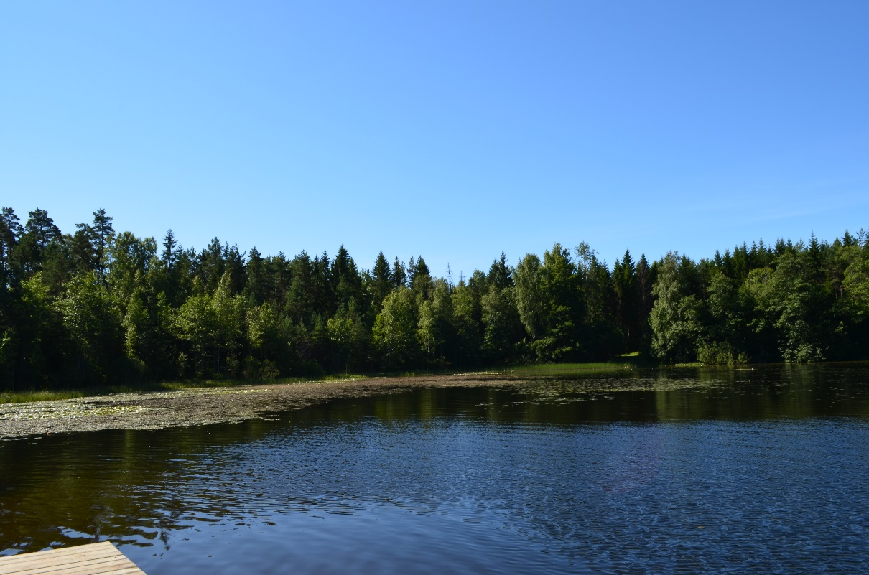
Urbukse lake
Clouds 0,5%
Plants covering 60%
Wind speed 2-7 m/S
Water plants covering 17%
intensity of light 8759 lux
Turbidity 23 Ntu
Humidity 38,8%
We started at 11:38 and we finished at 11:50

Slide 8
Data from urbukse lake
height | Air temperature
10cm | 22,7°C
130cm | 24,1°C
depth | Soil tempereature
At surface | 19,3°C
5cm | 15°C
20cm | 14,2°C
30cm | 14,3°C
depth | Water temperature
At surface | 22,6°C
30cm | 20°C
60cm | 20°C
90cm | 19°C

Slide 9
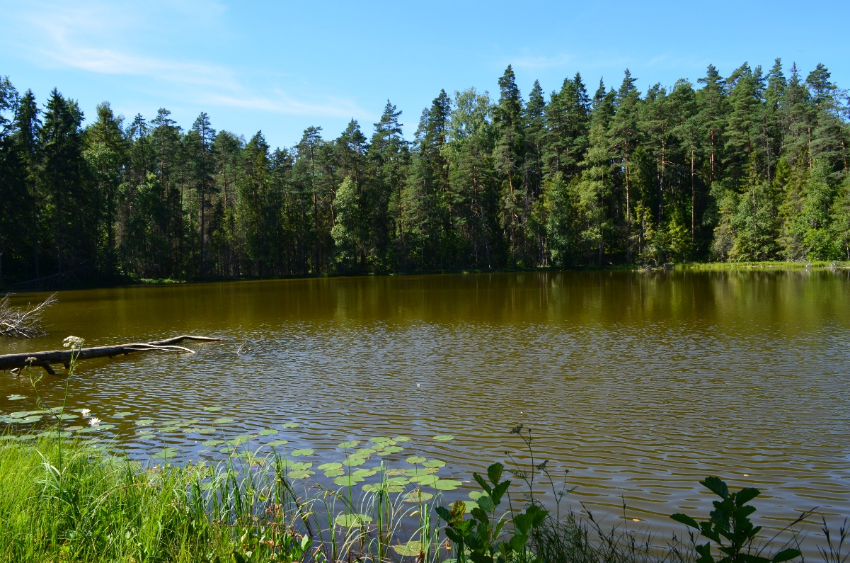
AHVENAJÄRV
Clouds 6%
Plants covering 85%
Wind speed 0-3 m/S
Water plants covering 5%
intensity of light 9857 lux
Turbidity 26,3 Ntu
Humidity 35,7%
We started at 12:15 and we finished at 12:30

Slide 10
Data from ahvenajärv
Height | Air temperature
10cm | 24,7°C
130cm | 24,7°C
Depth | Soil temperature
At surface | 18°C
5cm | 13,83°C
20cm | 14,8°C
30cm | 14,4°C
Depth | Water temperature
At surface | 19,7°C
30cm | 19°C
60cm | 18°C
90cm | 18°C

Slide 11
Purgatsi lake
Clouds 8%
Plants covering 60%
Wind speed 0-3 m/S
Water plants covering 5%
intensity of light 9869 lux
Turbidity 31 Ntu
Humidity 40,7%
We started at 13:36 and we finished at 13:45

Slide 12
Data from purgatsi lake
Height | Air temperature
10cm | 24, 73°C
130cm | 24,7°C
Depth | Water temperature
At surface | 22,63°C
30cm | 20°C
60cm | 19,5°C
90cm | 19°C
Depth | Soil temperature
At surface | 17,6°C
5cm | 16°C
20cm | 15°C
30cm | 14,5°C

Slide 13
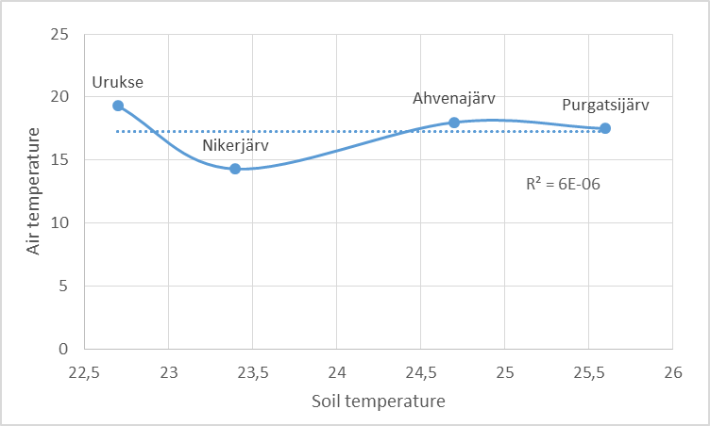
Comparison of Air and soil temperatures
The graph shows how air and soil temperatures relate to each other.

Slide 14
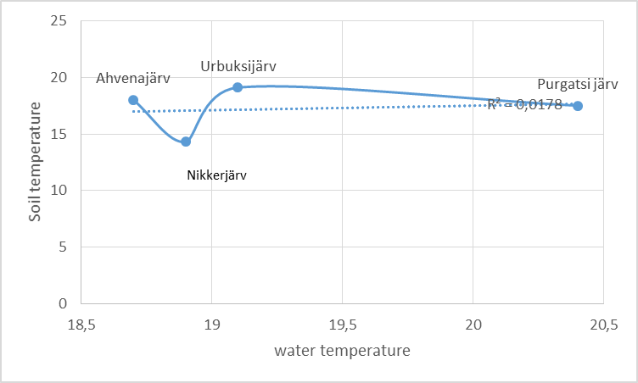
Comparison of soil and water temperatures
The graph shows how soil
And water temperatures relate to
Each other.

Slide 15
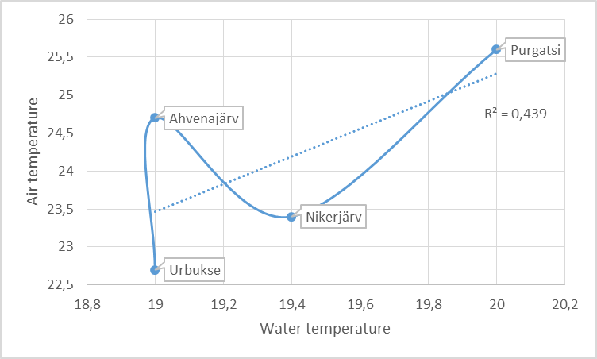
Comparison of water and air temperatures
The graphs shows how water and air temperatures in the lakes are related to each other.

Slide 16
conclusions
Results were similar in all lakes
Our Hypotheses were false according to our data.
Results can be improved
Suggested improvements:
Measure at equal distances
Anemometer
Light intensity sensor
Collect data at different times of the day or all at the same time
Does temperature change in different soils?
Collect more data values

Slide 17
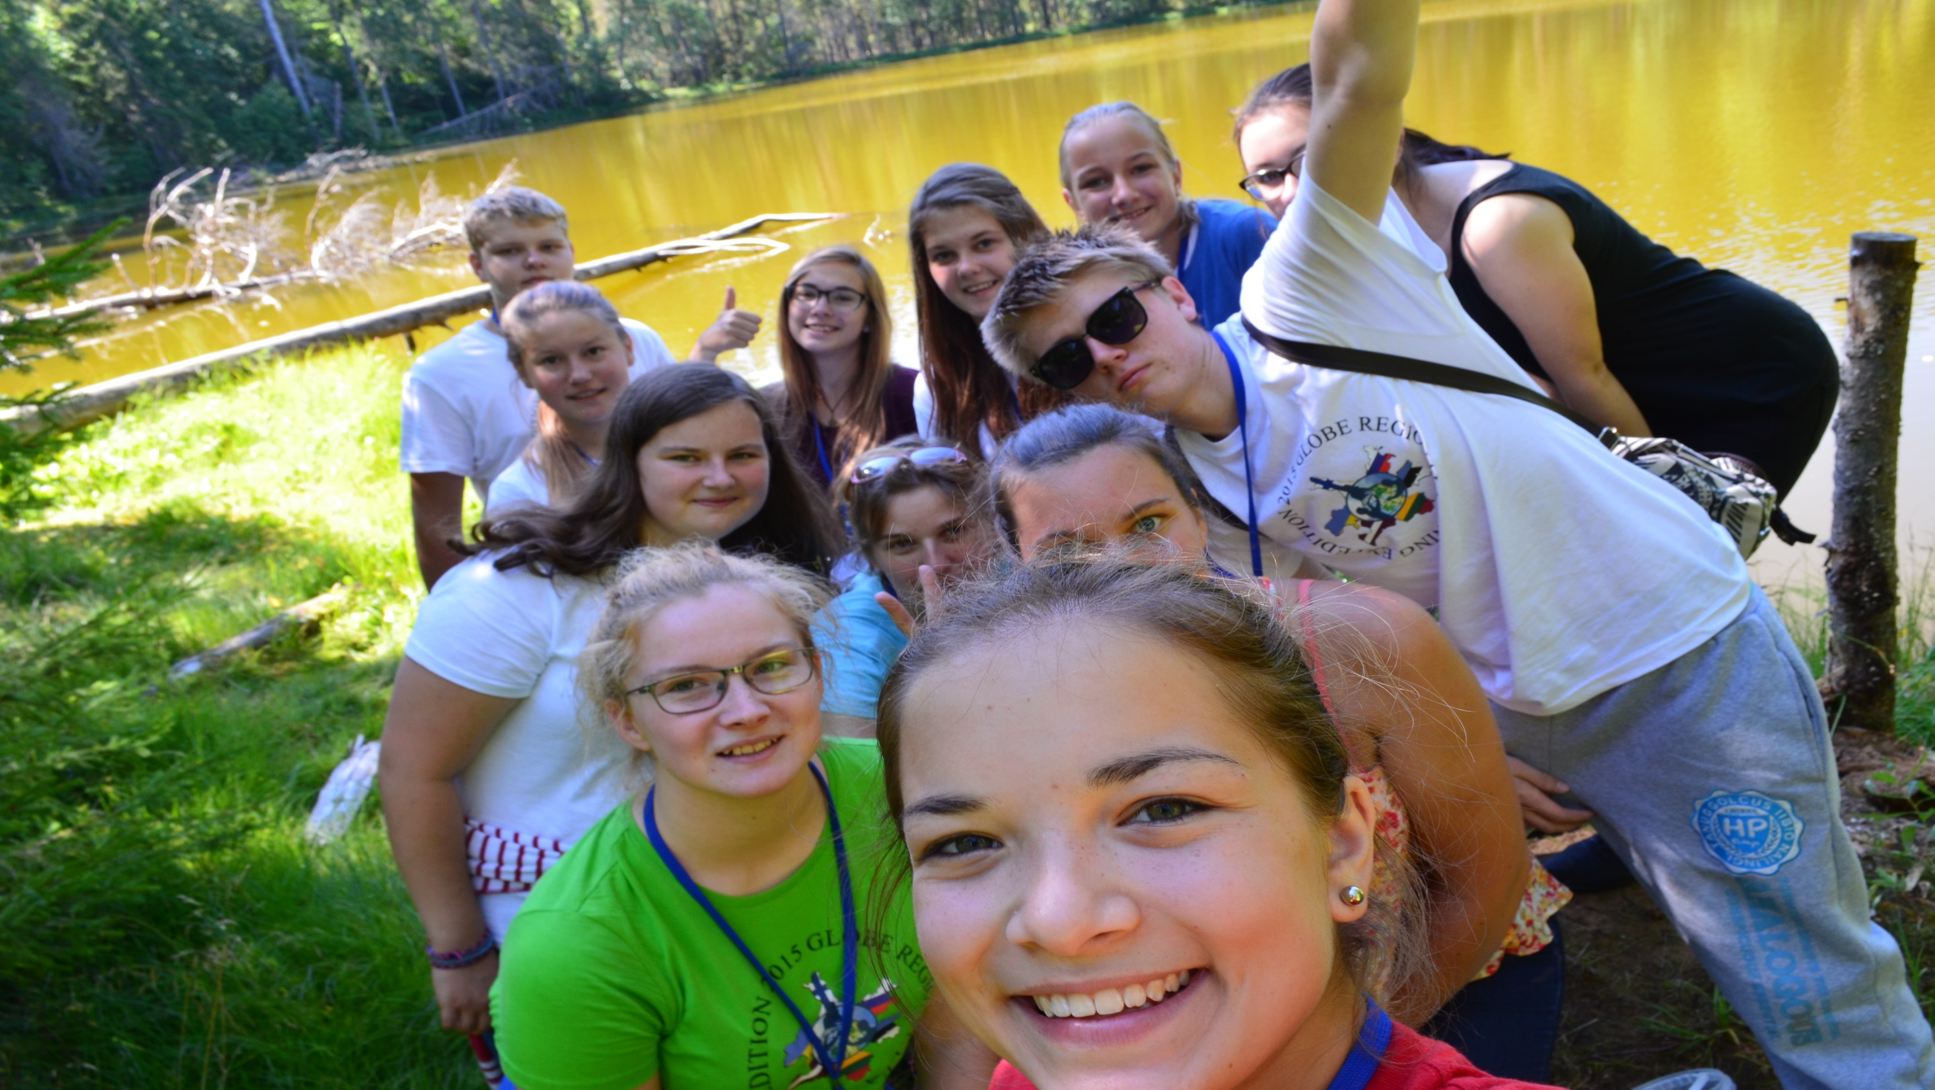
Thank You for your attention!

