Slide 1
Soil moisture calibration and measurements around Nelijärve
By the Frogs:
Uku, Martin, Urmas, Elis, Inga, Zanda, Rasa, Konstantin, Anne, Kristiina,
Mariin, Krišjānis, Mariann, Marje
Supervisor:
Kaupo Voormansik
05.08.2015
Nelijärve

Slide 2
Hypothesis and reasons to measure soil moisture
Hypothesis: Are the soil moisture levels suitable for growing crops?
How suspectable are the soil levels around Nelijärve to fire?
Reasons:
Soil moisture measurement is useful, because you can predict various disasters, food production and the weather.

Slide 3
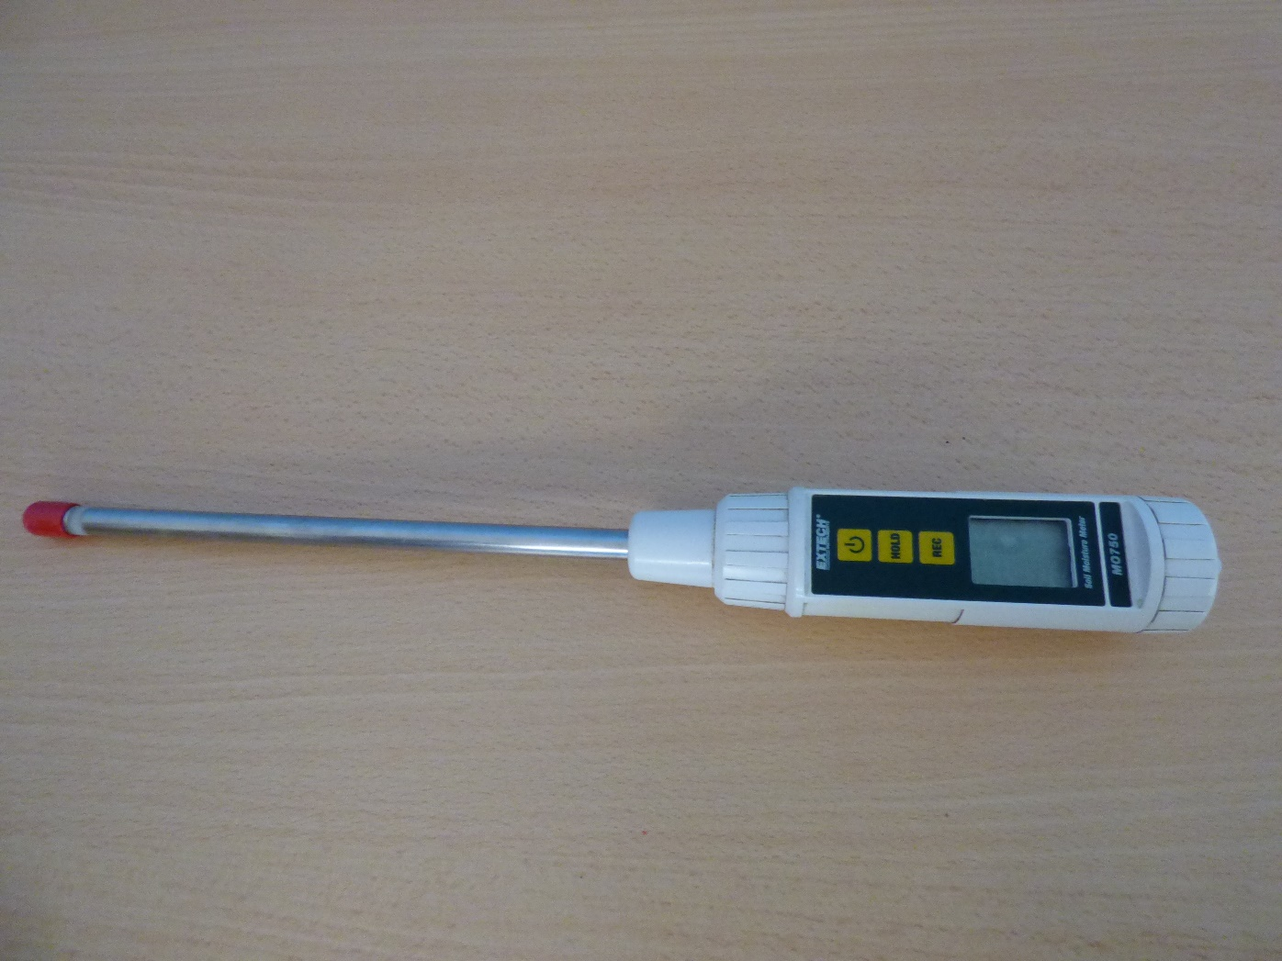
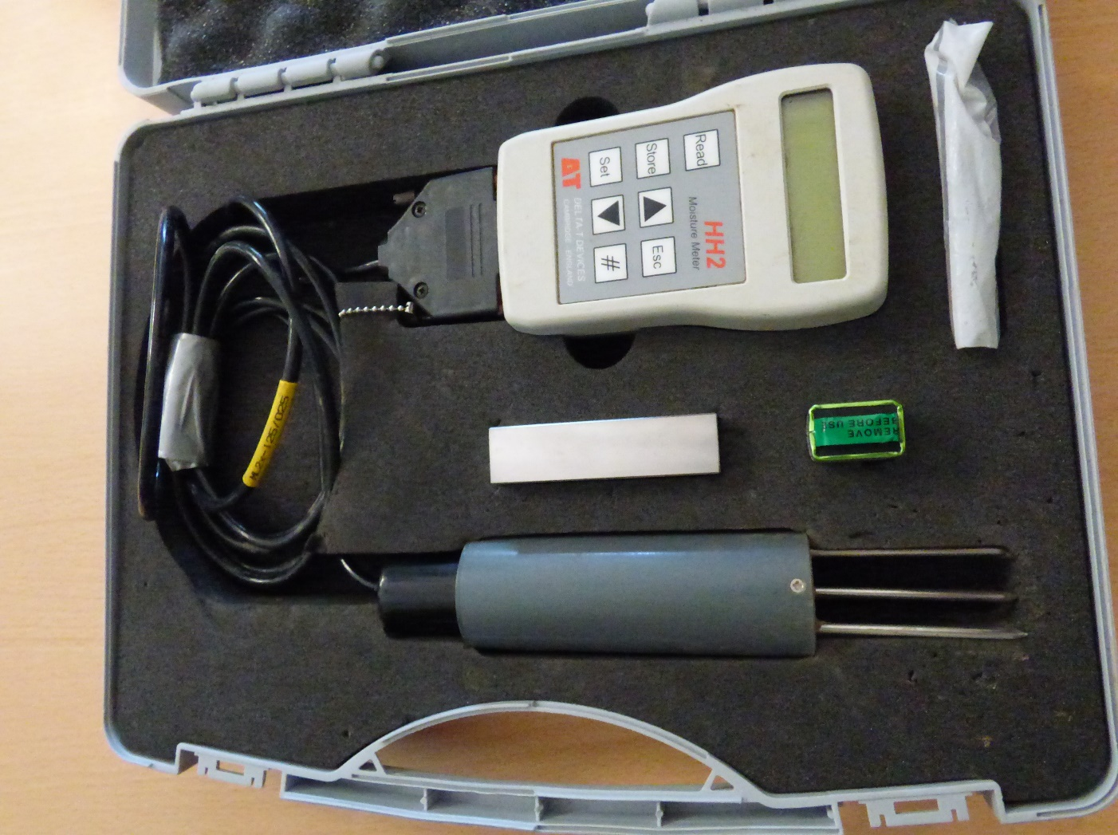
Tools
Extech
Delta-T

Slide 4
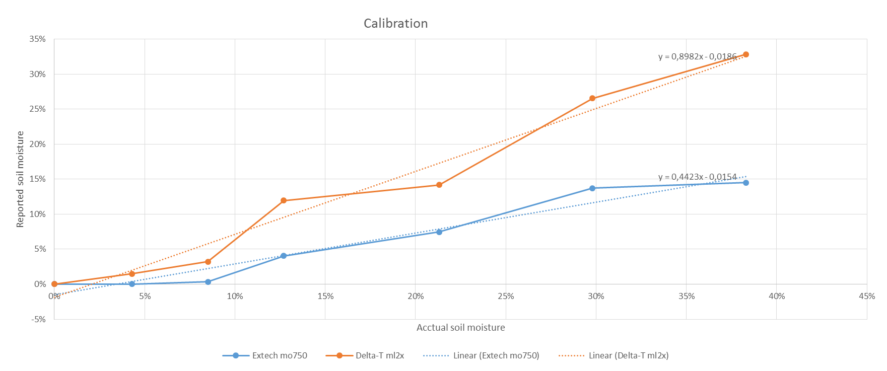
Calibration of the instruments
The Delta-T showed much higher and more excact values than the Extech.

Slide 5
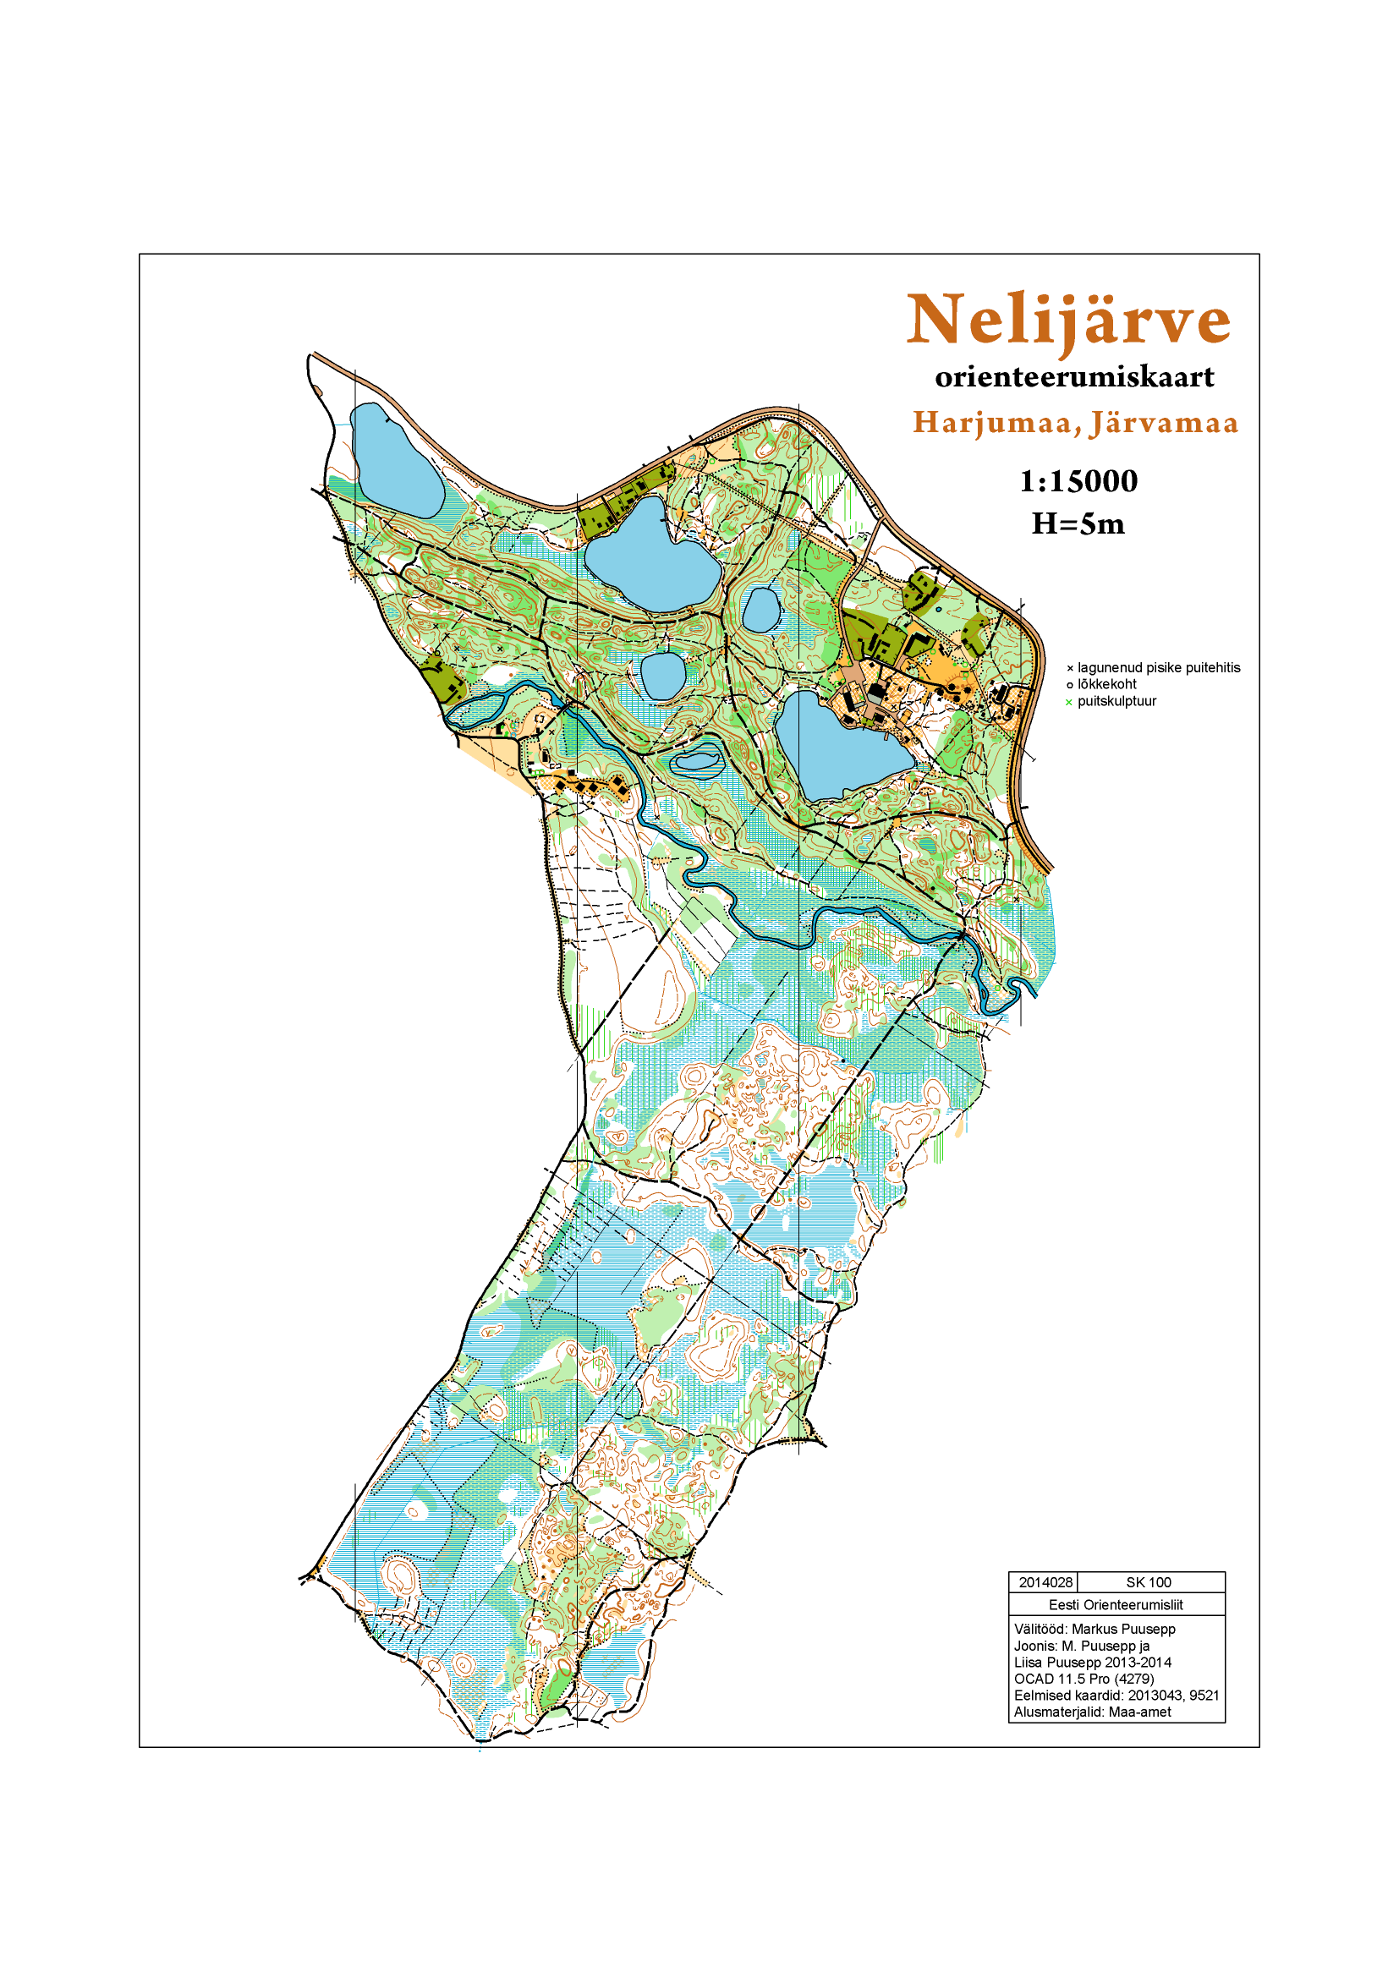
The map which we worked with
1
2
7
3
4
6
5

Slide 6
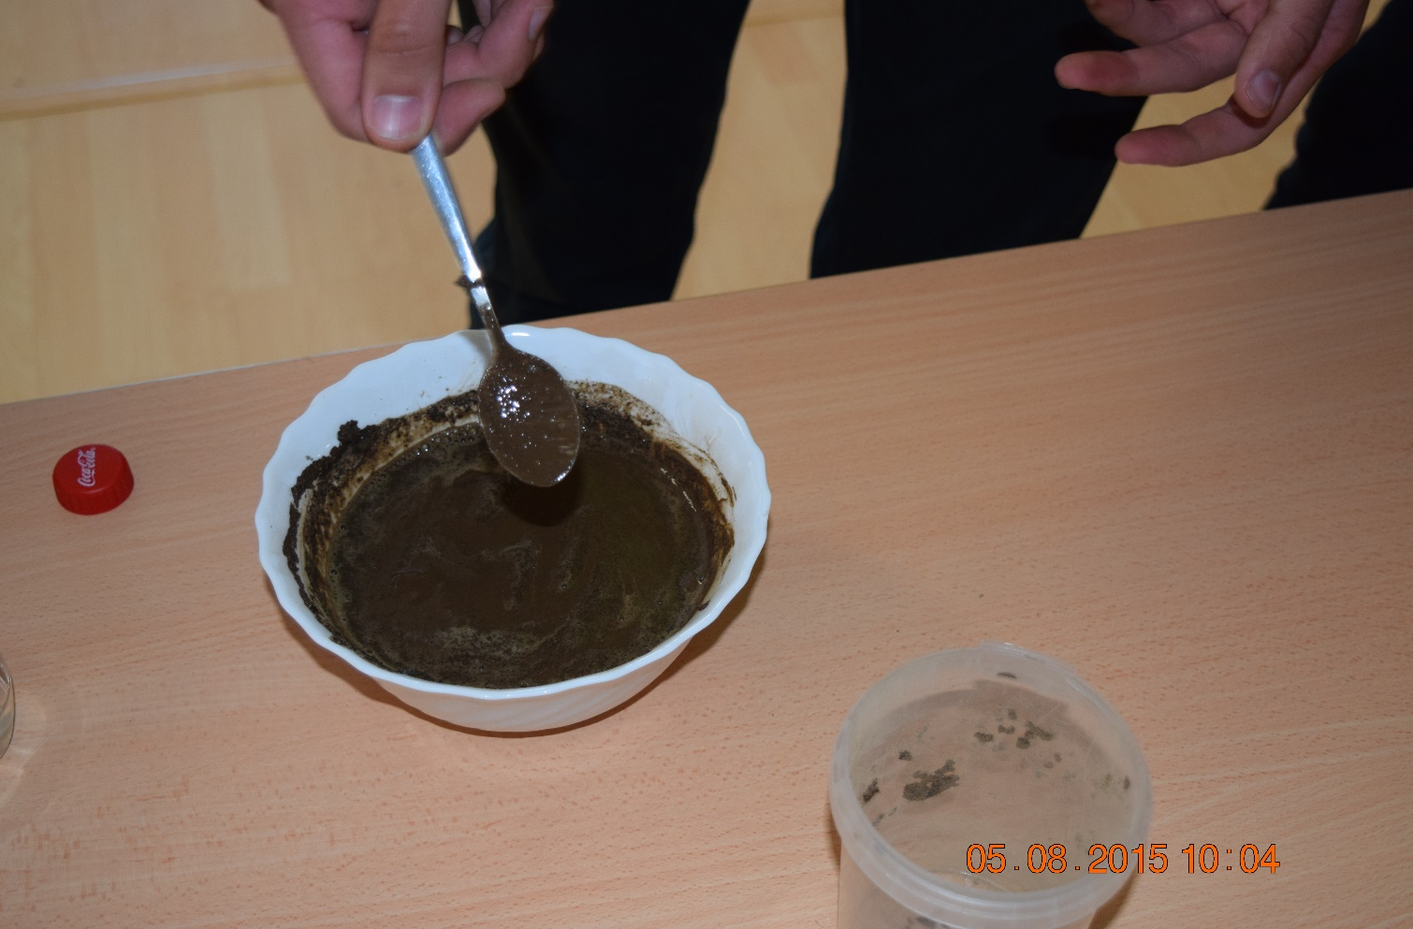
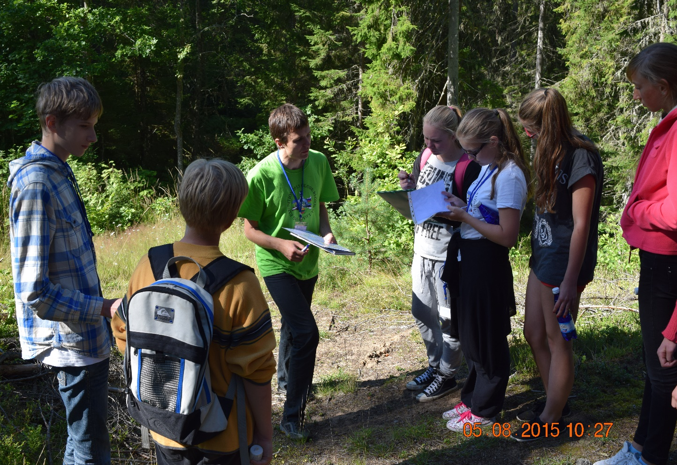
Calibration and First steps

Slide 7
The numbers from the field
 | point nr.1 | point nr.2 | point nr.3 | point nr.4 | point nr.5 | point nr.6 | point nr.7
Soil types | LI - Podzol | S – Transisional marshland | M - Mire | LP - Leptosol | LP - Leptosol | LK - Podzol | LK - Podzol
Extech | 0% | 10% | 4% | 6% | 5% | 4% | 8%
Delta-T | 10% | 45% | 14% | 25% | 23% | 20% | 23%

Slide 8
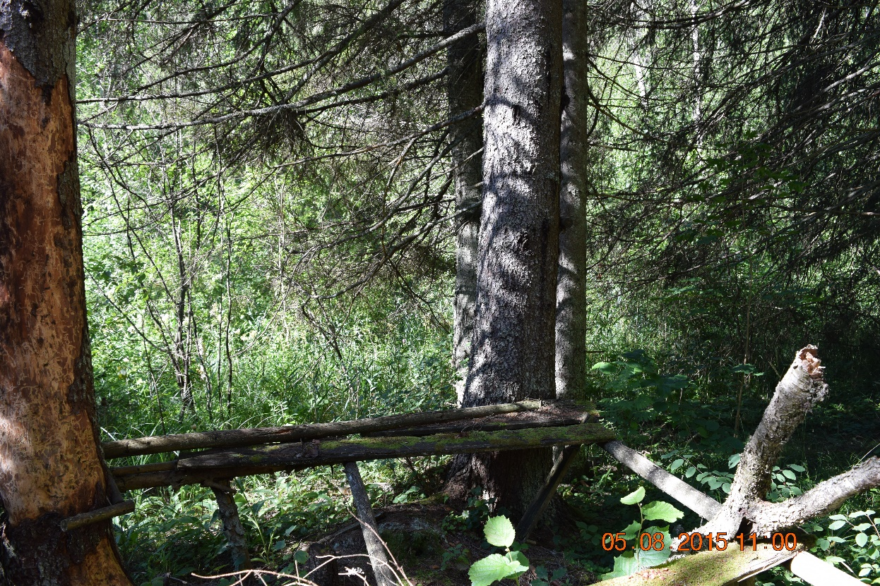
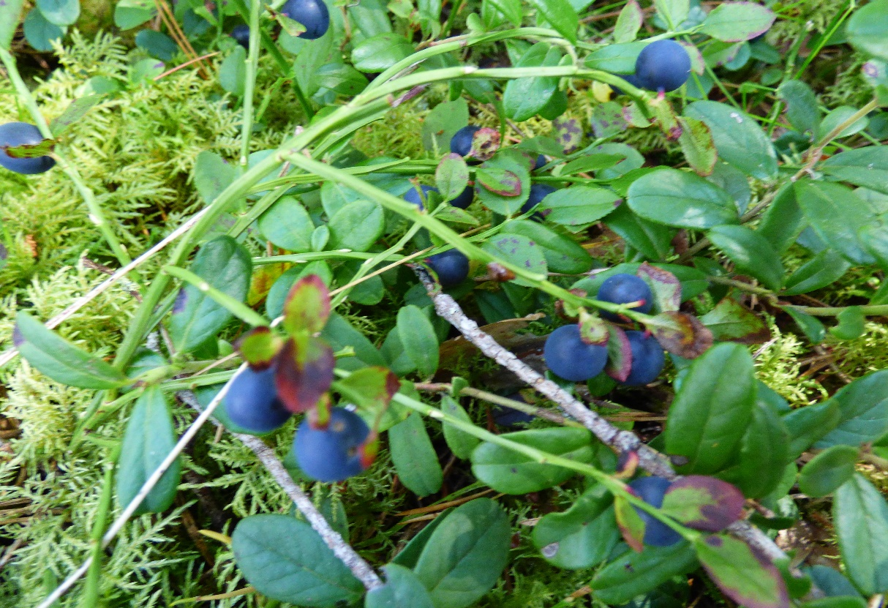
Some finds along the way

Slide 9
Conclusion
Points 2, 4, 5, 6 and 7 are suitable for efficiently growing crops*.
It is not dangerous to make fire in assigned areas, altough in unassigned areas the making of fire is prohibited due to trees and insufficient soil moisture.
*https://en.wikipedia.org/wiki/Water_content#Earth_and_agricultural_sciences

Slide 10
Thank you for listening.

