Slide 1
Expedition on 5 lakes of Nelijärve
5 August 2015
Giraffes

Slide 2
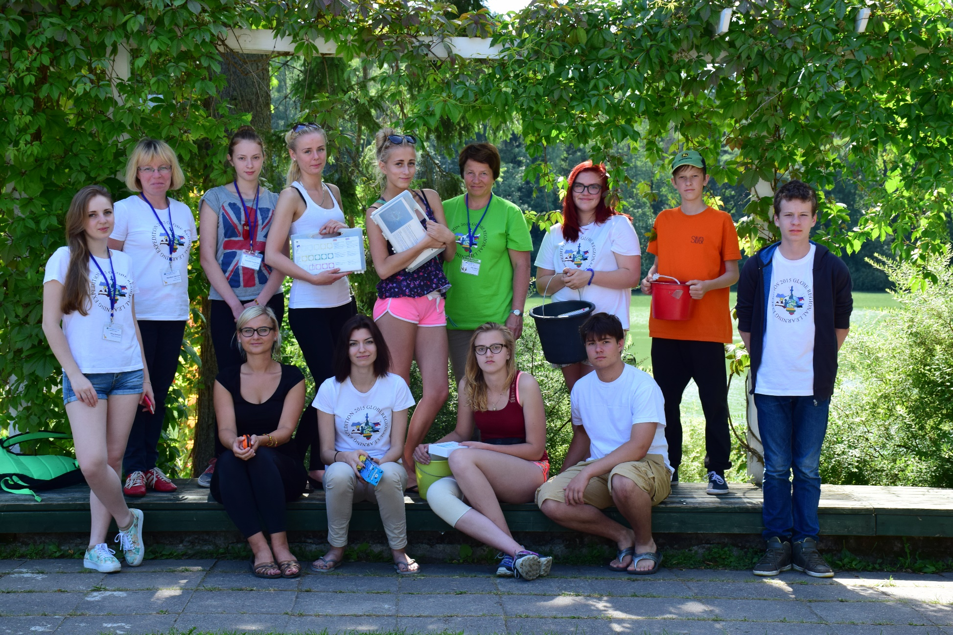
Silver Tatrik
Pille-Riin Karuse
Katarina Keerd
Jaroslav Bortsov
Triin Tetsmann
Ketlin Timusk
Kirill Lobossok
Viktoria Popova
Alina Granich
Nataliya Lobosok
Eimante Pundziute
Migle Simanaviciene
Helve Orusalu

Slide 3
Research questions
Why is lake Purgatsi so green?
Why is there algal bloom?
Is the water full of nutrients?
Is the water chemistry of the five lakes similar?

Slide 4
Research aim
Investigating water chemistry of five Nelijärve lakes
Hypothesis: All the five lakes have similar water.
All the five lakes have algal bloom.

Slide 5
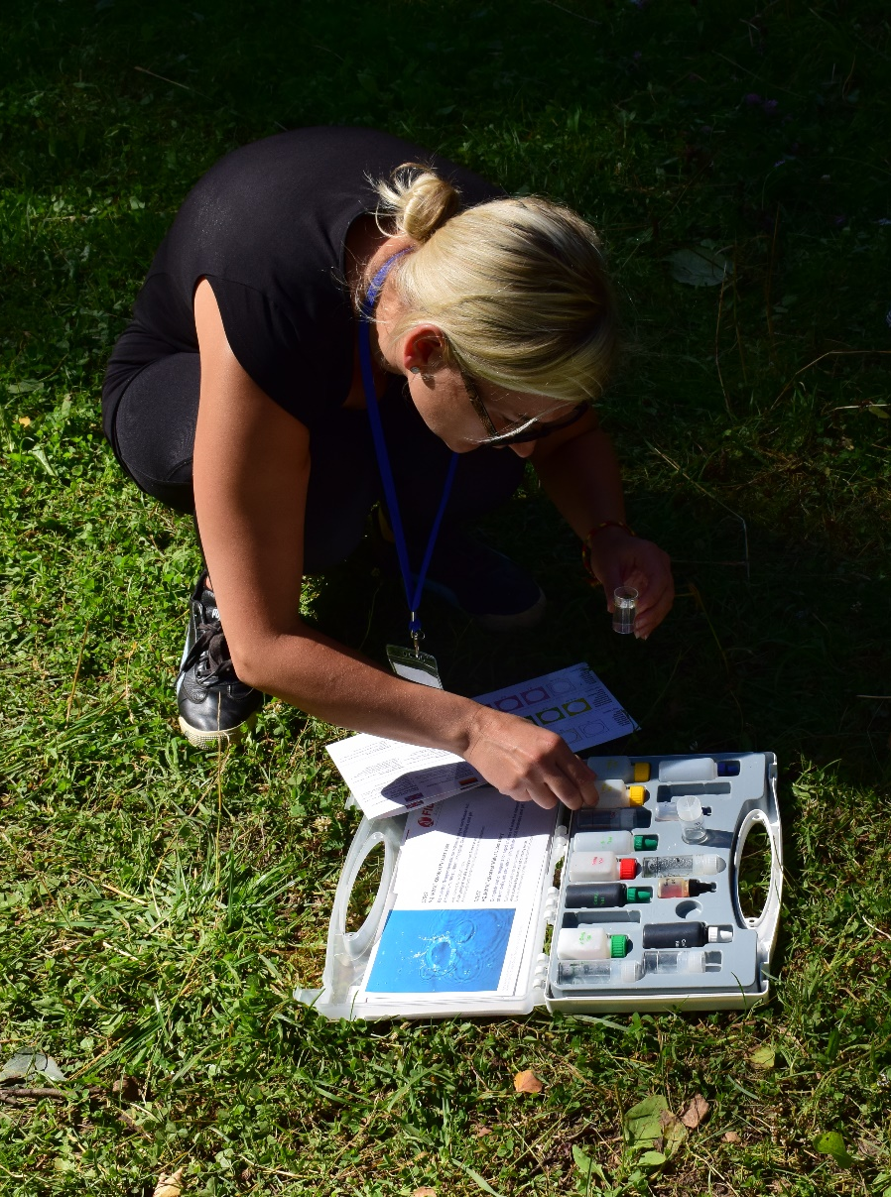
Material and methodology
Water analyses were taken on 5 August 2015 from
10 am to 1 pm
Investigations and equipment:
Temperature - Water thermometre (ethanol)
Phosphates, nitrates, ammonium - Aquanal Ökotest
Water Laboratory
Hardness - Visocolor HE Gesamthärte H 20 F
Conductivity - Milwaukee electrical conductivity meter
Dissolved oxygen - Visocolor HE Sauerstoff SA 10
pH - Martini instruments pH meter
Colour - visually

Slide 6
The lakes
Purgatsi
Ahvenajärv
Linajärv
Sisalikujärv
Urbukse
All of them are seepage lakes – no inflow or outflow, feed mainly on precipitation and ground water.

Slide 7
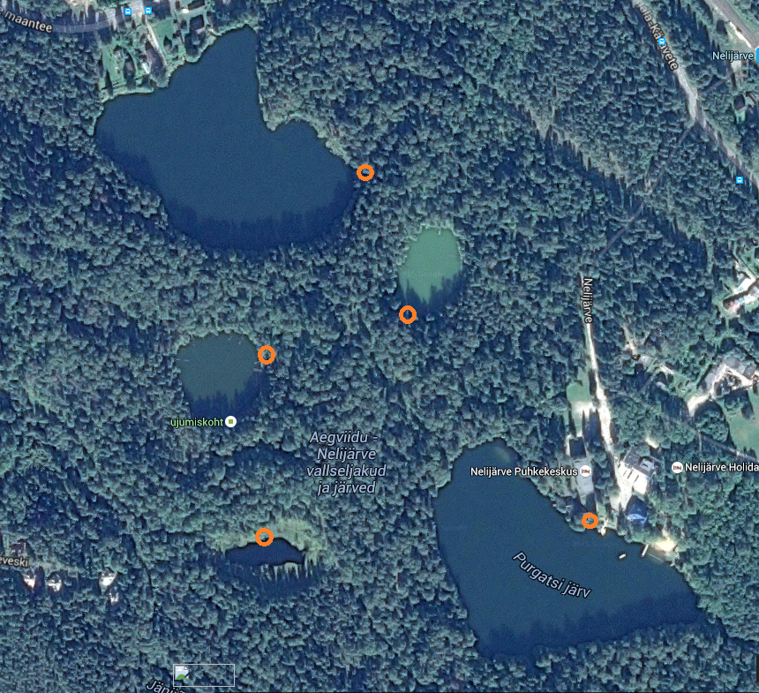
Urbukse
Sisaliku
Ahvena
Linajärv

Slide 8
Compared properties
Temperature
Colour
Dissolved oxygen
Conductivity
pH
Amount of ammonium, nitrates and phosphates
Hardness

Slide 9
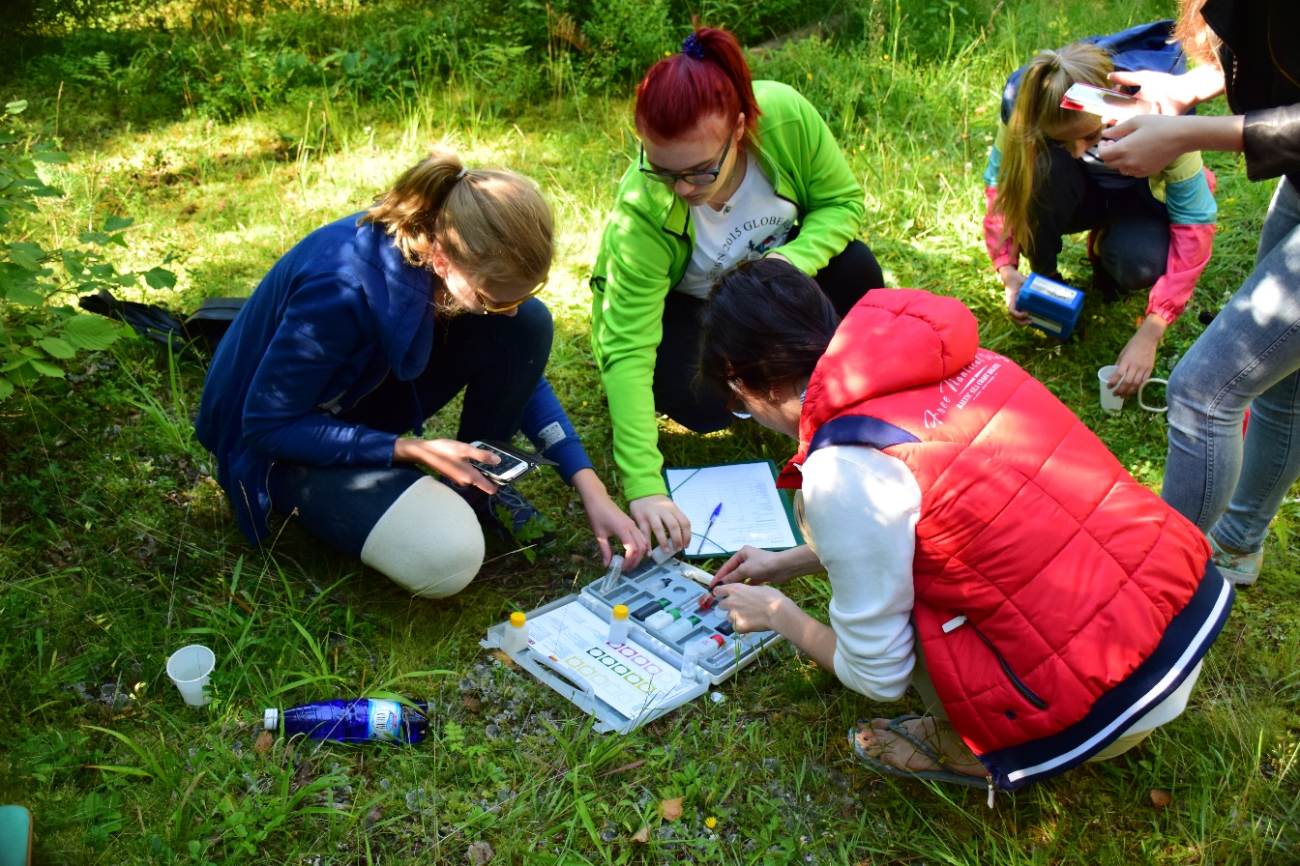
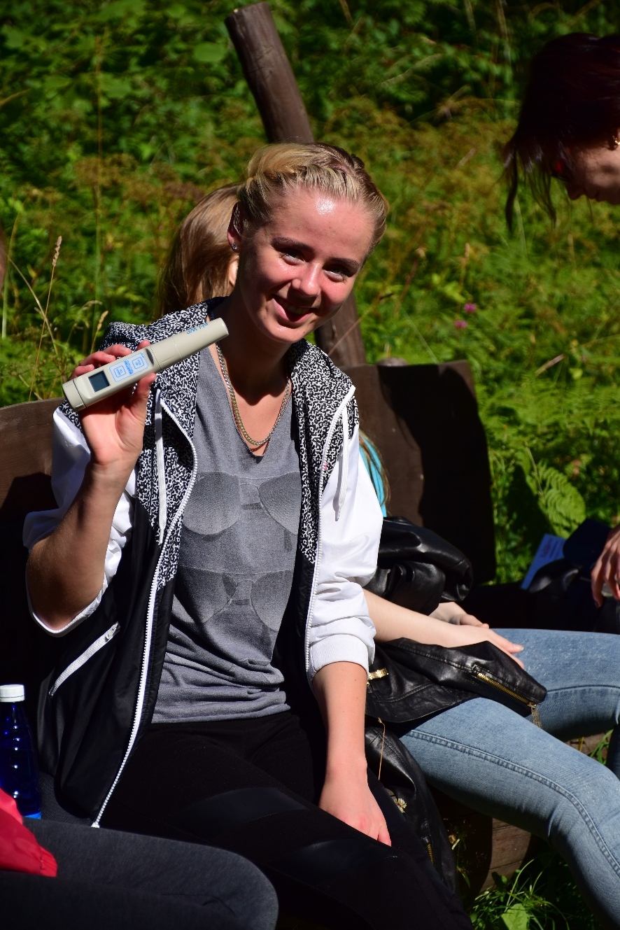
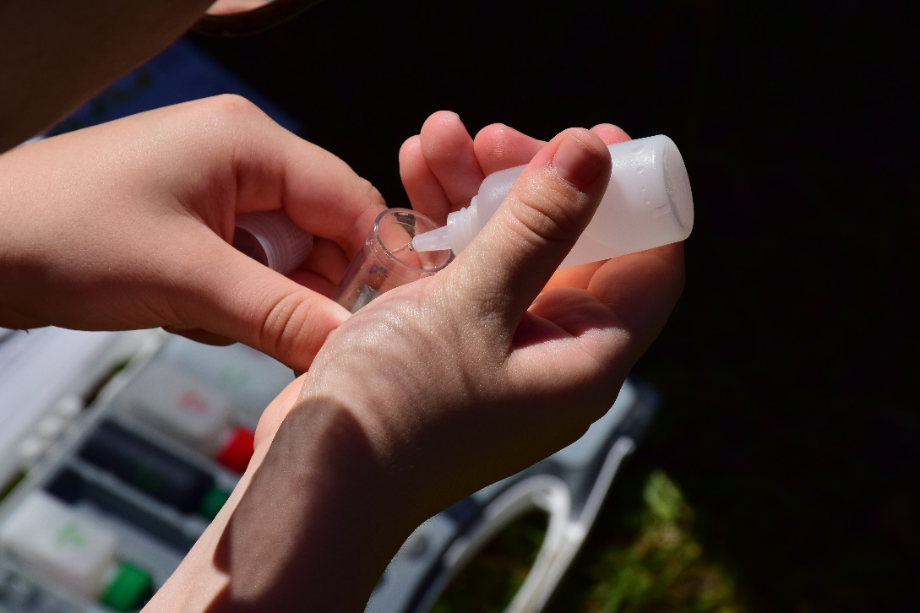
Work
Methods
Results

Slide 12
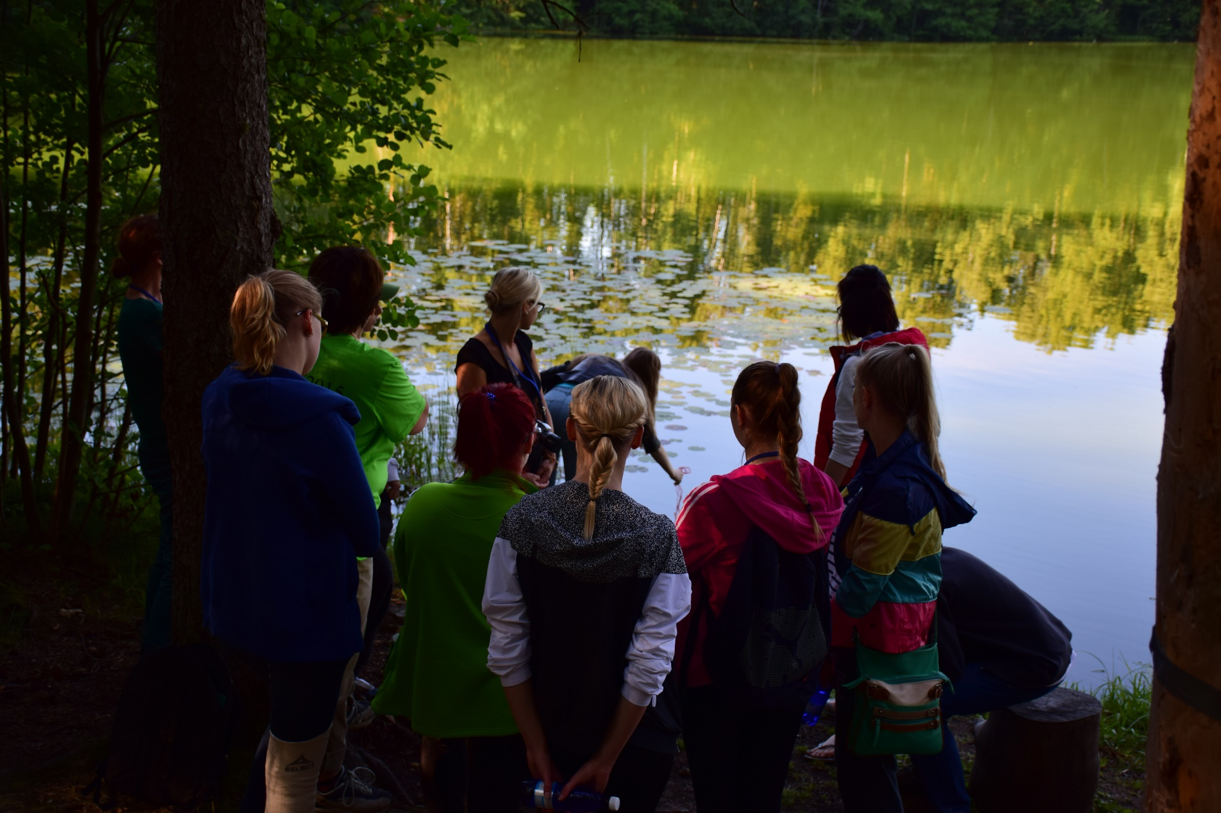
Colour of the lake
Purgatsi: green
Sisaliku: green/brown
Urbukse: green
Ahvena: brown
Linajärv: brown
Notes:
The water is green because of water blooming.

Slide 14
Phosphates
The key nutrient affecting the amount of algae and weed growth
Also important for plant growth
Key indicator of pollution
Nitrates
Ammonium

Slide 15
Very soft water (0,5 mmol/l or less) => few minerals
Conductivity very low (7-30 µS)

Slide 16
Conclusions
Lakes are green because of algal blooming (blue-green algae)
There is algal bloom because of enough nutrients
High levels of nutrients were not found
The 5 lakes are similar: very soft water, low conductivity, no phosphates found, low level of nitrates and ammonium.
pH different – 6,5 - 10
Lake Linajärv is surrounded by peat moss, it`s the most different lake (brown clear acidic water, no algal bloom)

Slide 17
Discussion
The five investigated lakes are endangered because they have very soft water, low level of minerals.
They used to be oligotrophic lakes but now they might be changing (eutrophication, algal bloom)
Very deep conclusions not possible – not enough data, test kits not sensitive enough

Slide 18
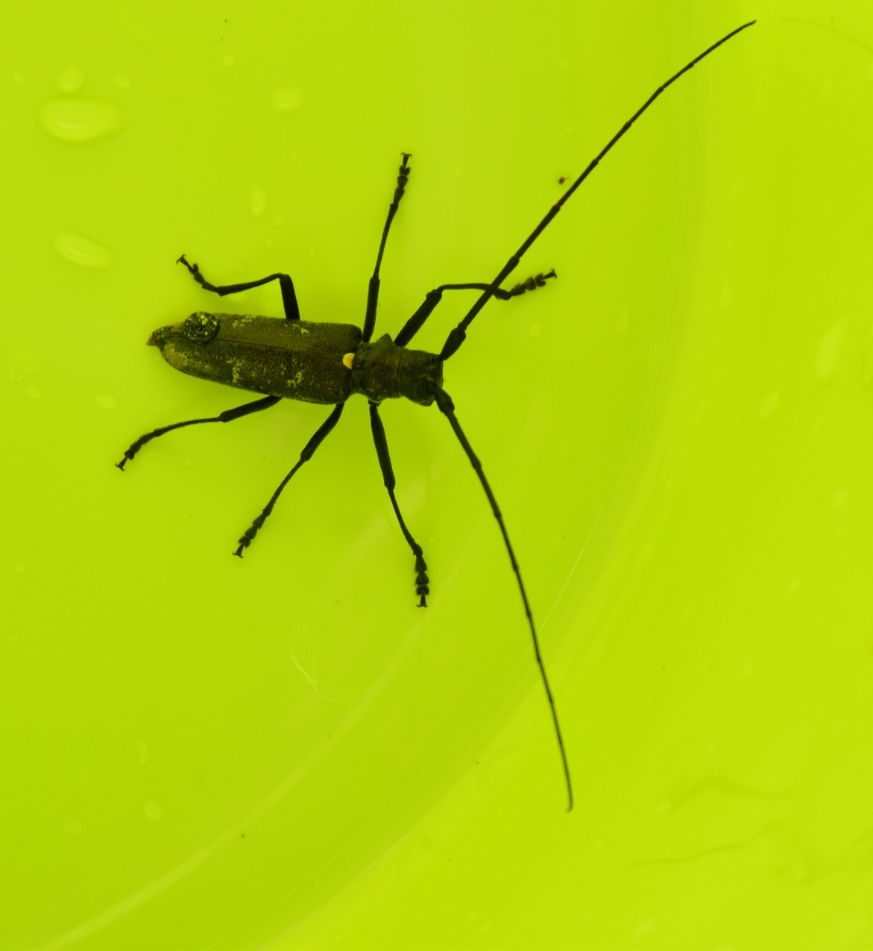
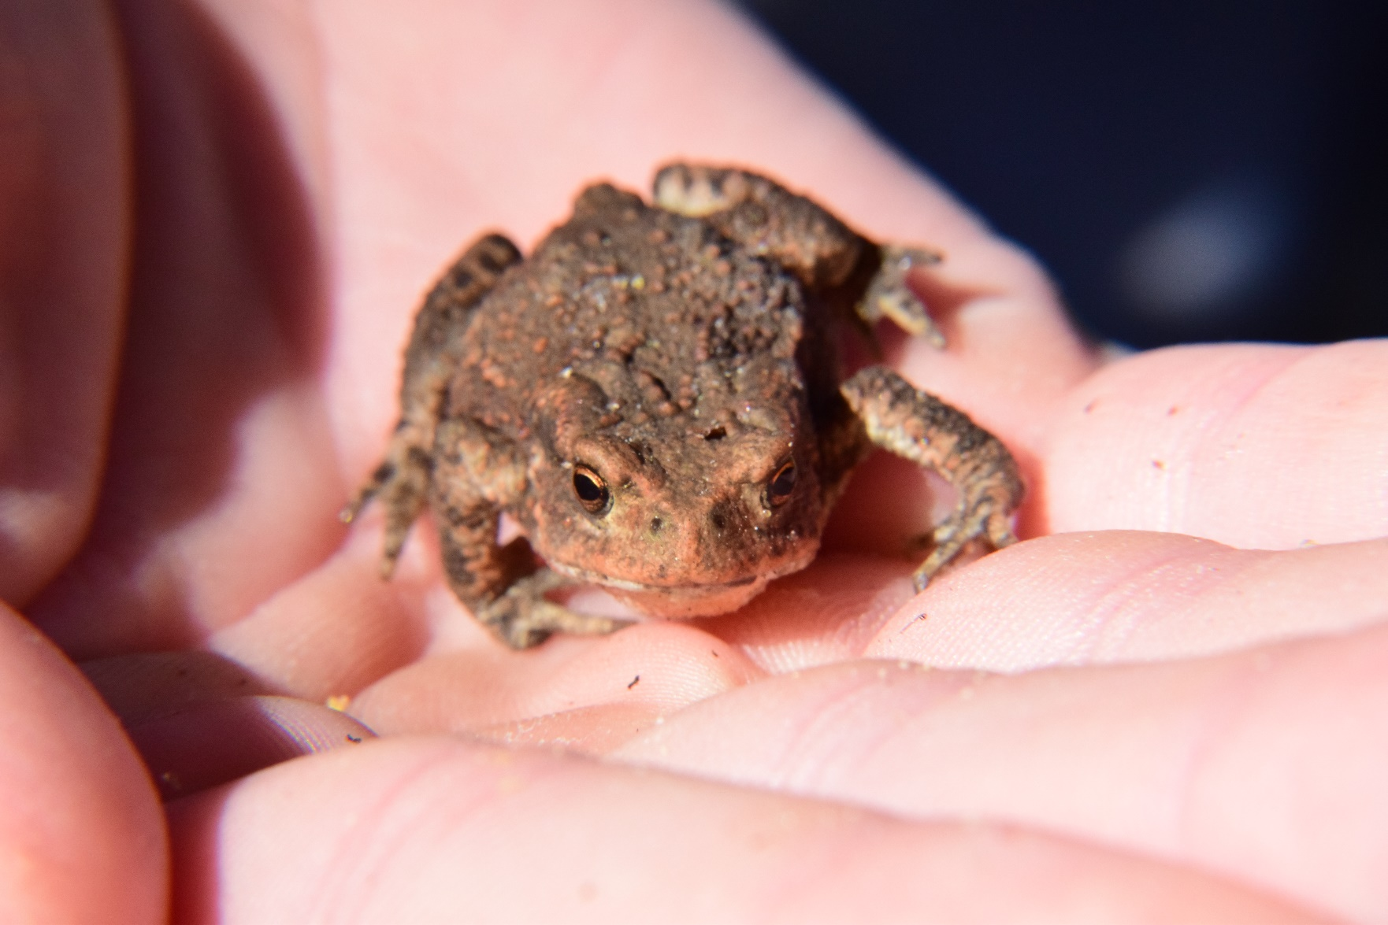
Animals we met

Slide 19
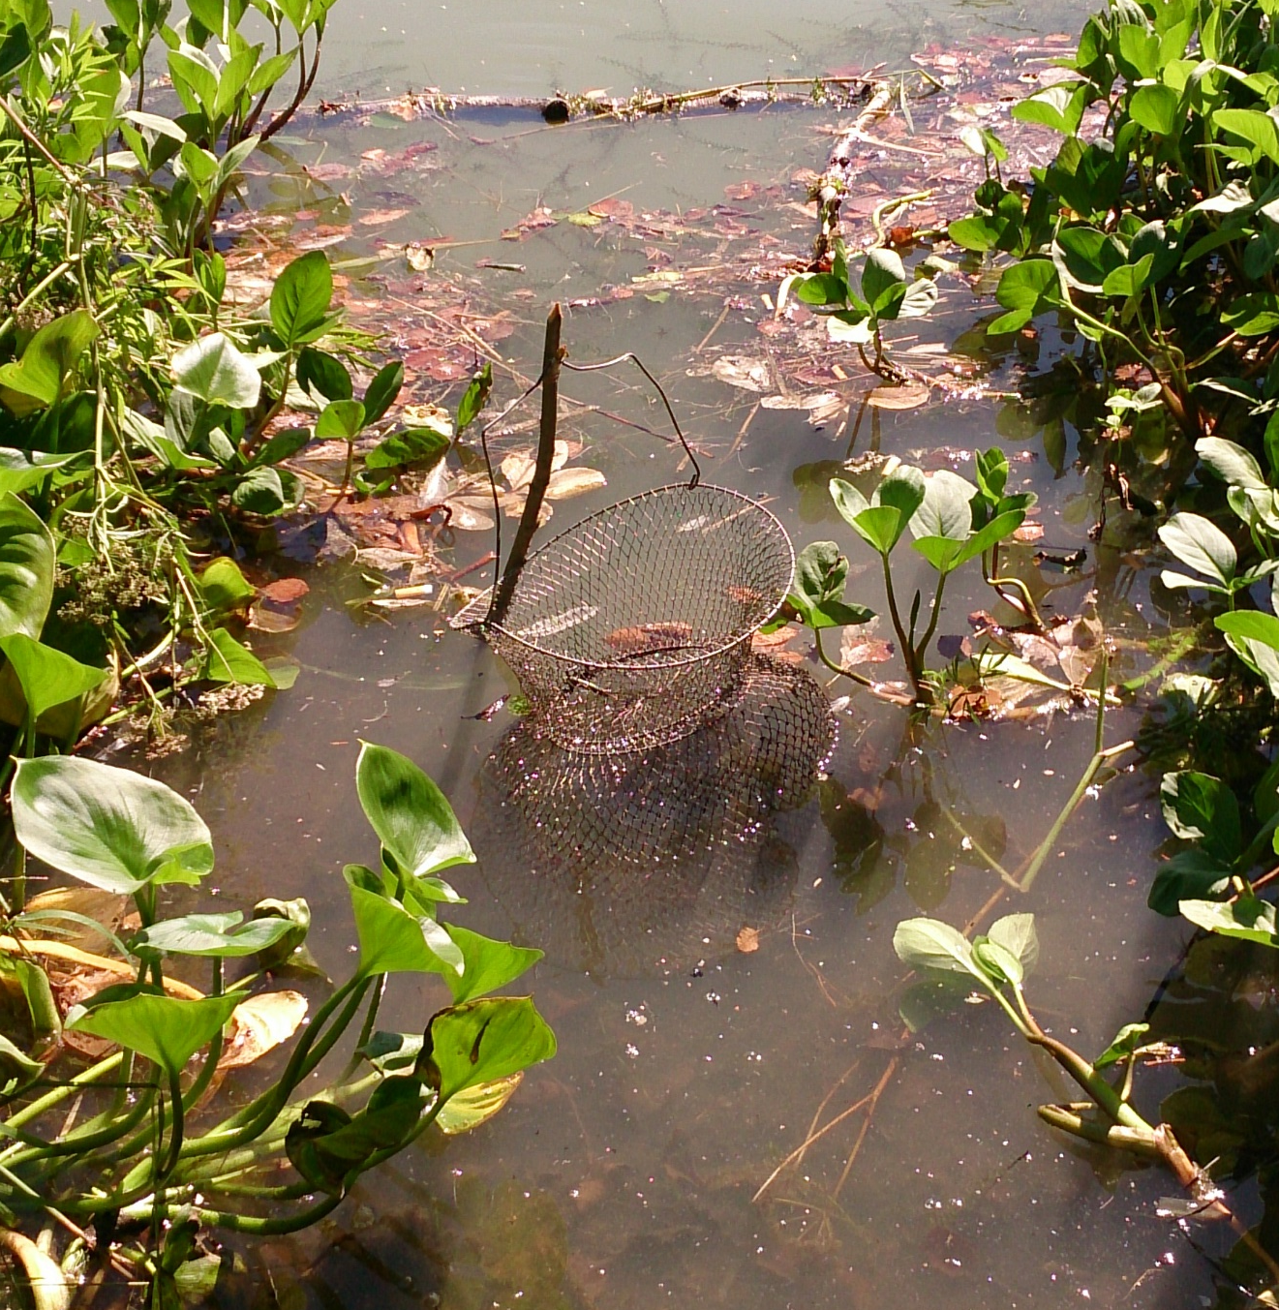
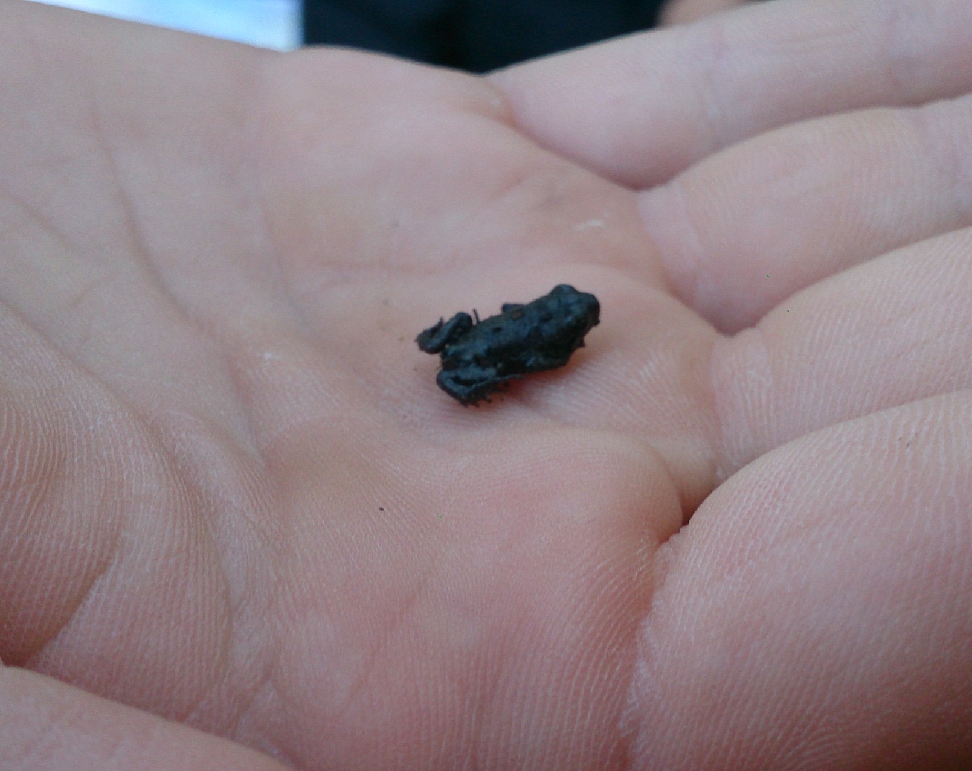

Slide 20
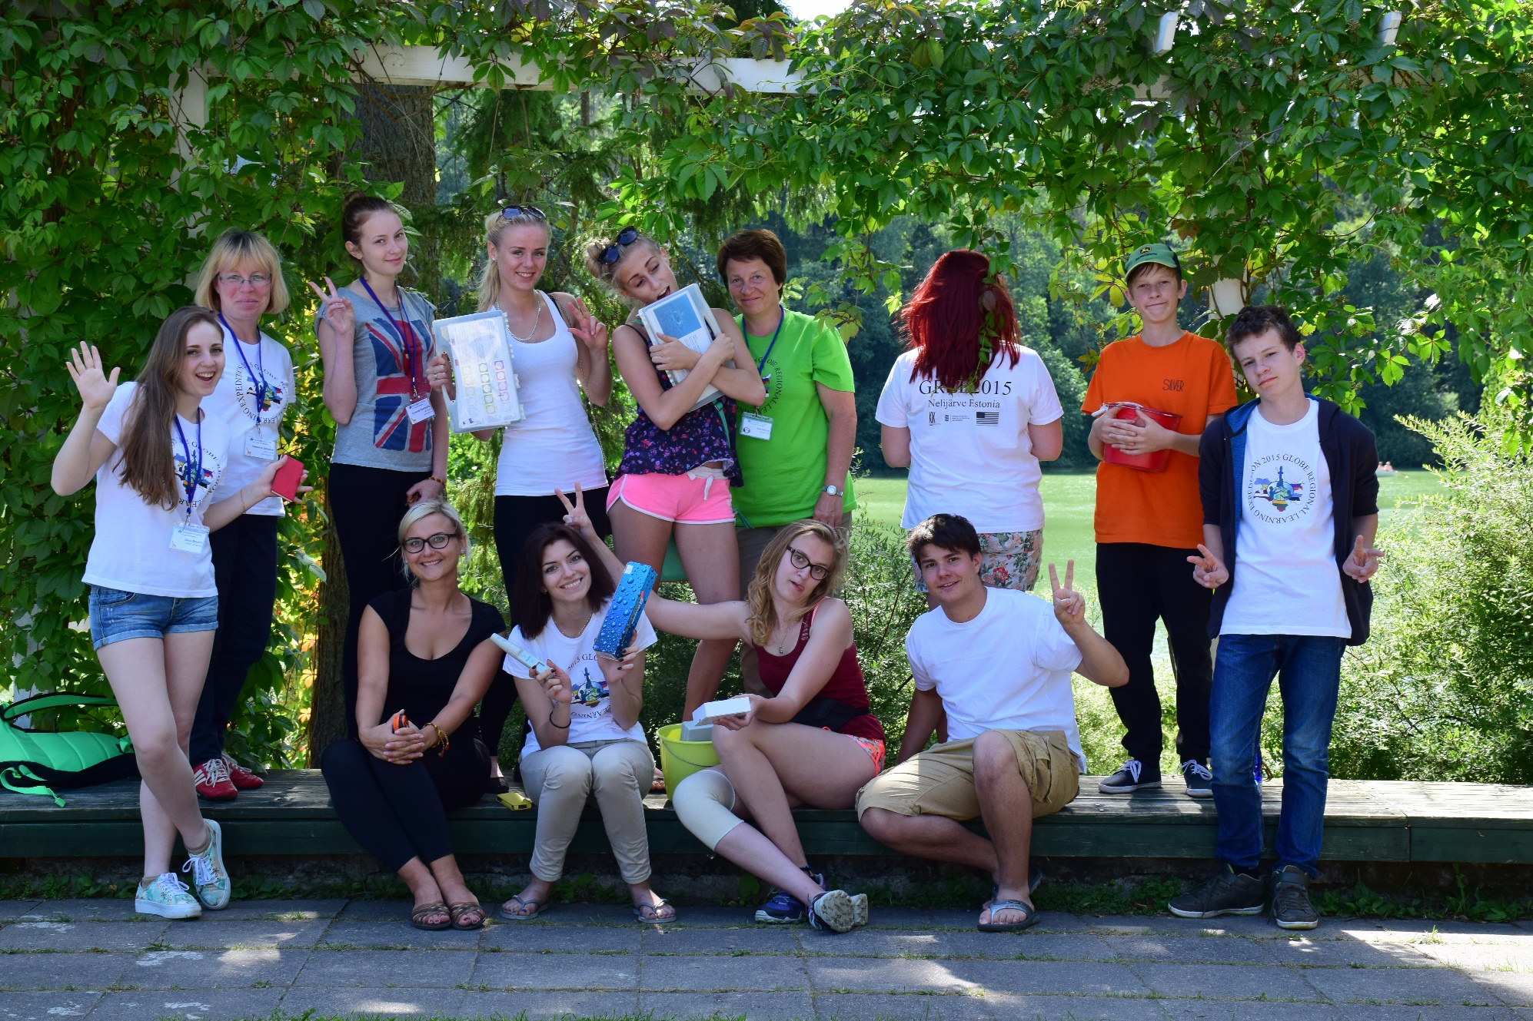
Thank you!

