Slide 1

Soil expedition
Monkeys group
GLOBE REGIONAL LEARNING EXPEDITION 2015, ESTONIA

Slide 2
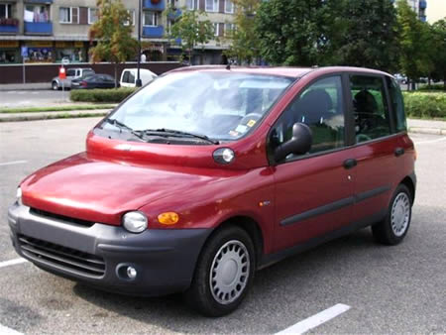
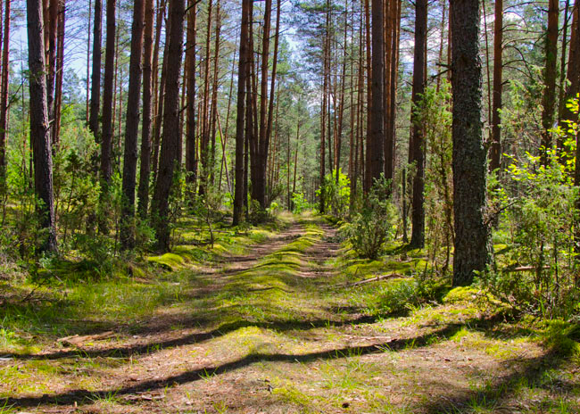
introduction

Slide 3
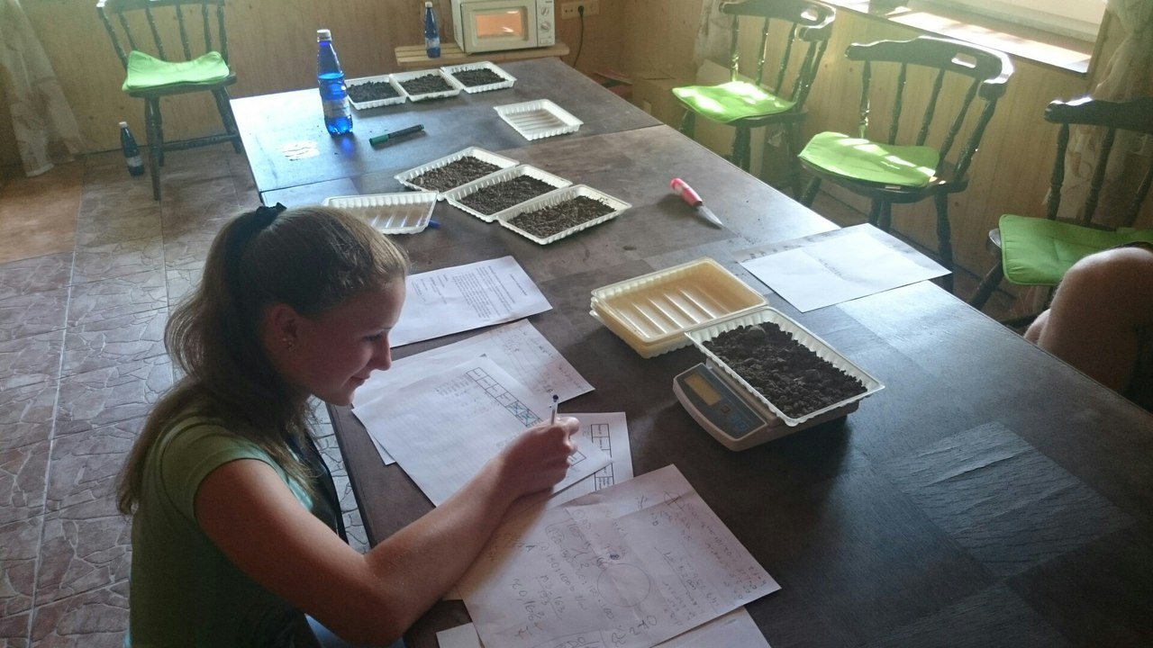
methods
On site
In laboratory
We dug a soil pit and take a samples at different depht.
We measured the water infiltration speed of the soil.
We judged the percentage of plant coverage.
We recorded size and abundance of the roots.
We determed the volumetric mass and water content of soil samples by drying.

Slide 4
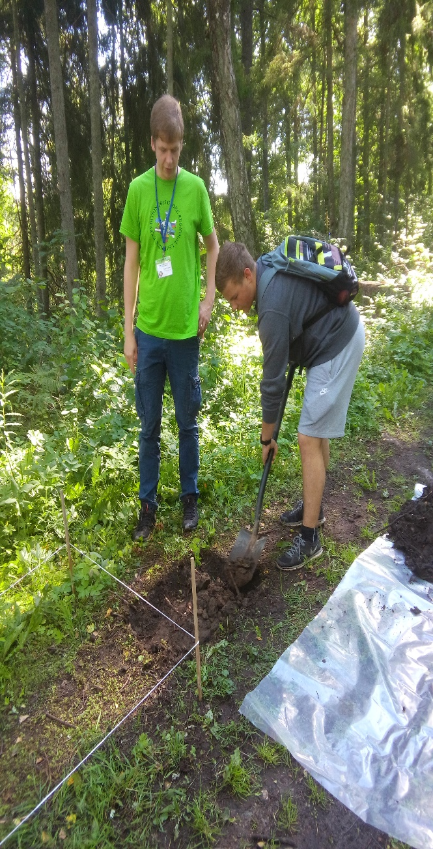
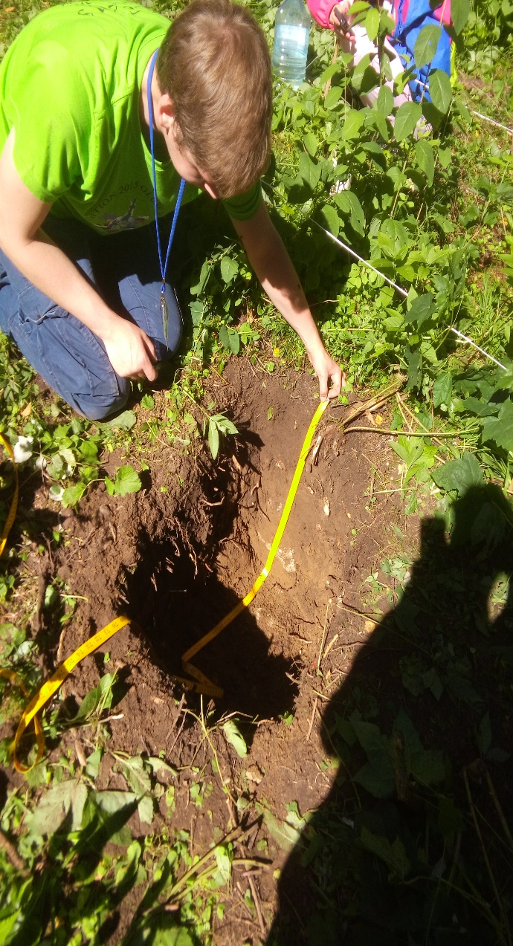
Soil profile description
Site 1.
Organic horizone thickness is 14 cm.
From 14 cm to the end is men made horizone.
Site 2.
Organic horizone thickness is 21 cm.
From 21 cm to 45 cm is illuvic and to the end sand.

Slide 5
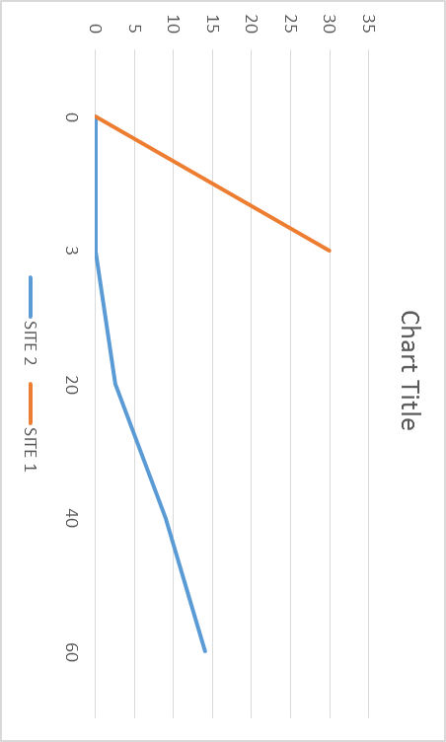
DETERMINATION OF
SOIL INFILTRATION rate
Site1- water can´t fastly go to underground because mineals pressed and there is not space for water
Site2- water go to underground faster than in site1 because there is more space, minerals and organic is not pressed.

Slide 6


1m² square plant coverage
97.03%
60.25%
ROOT ABUNDANCE IN ORGANIC HORIZON
Very many small and few big roots
Very few medium roots

Slide 7
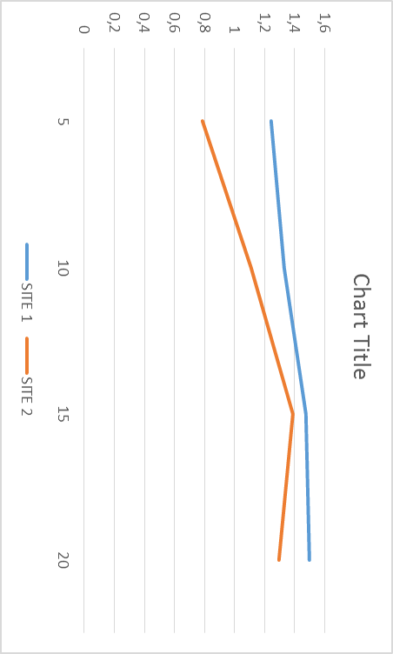
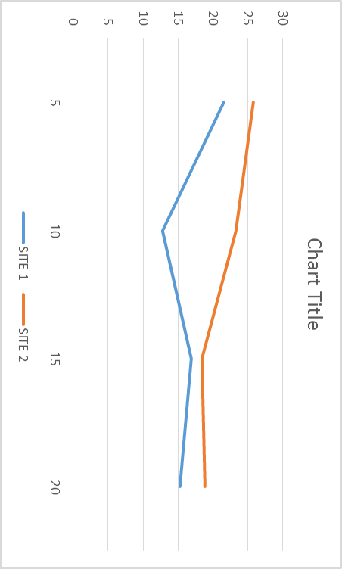
Soil volumetric mass soil moisture content %

Slide 8
conclusions
The pressed soil contains less water and air.
On the pressed soil life is harder for plants,
because of that cause there are less roots in that soil.
On the pressed soil there is no space for water when rains.
That meens that water runs on the ground and then there is risk for erosion.

Slide 9
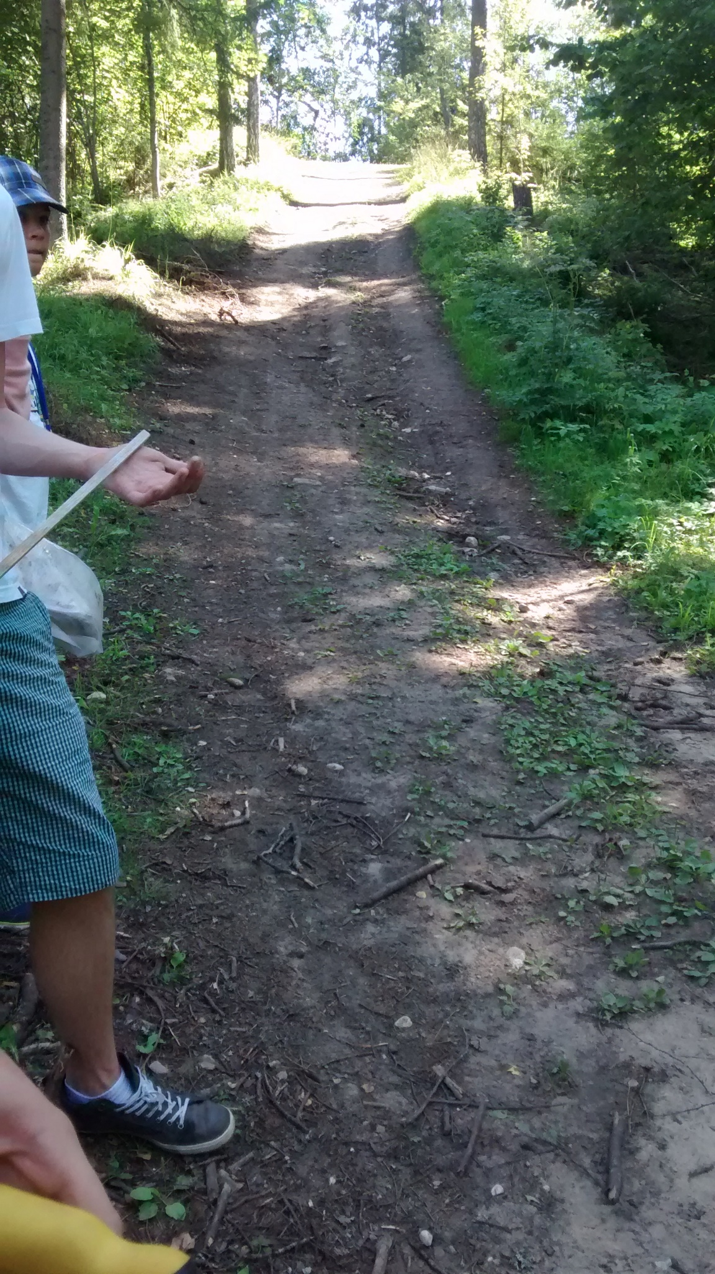

Slide 10
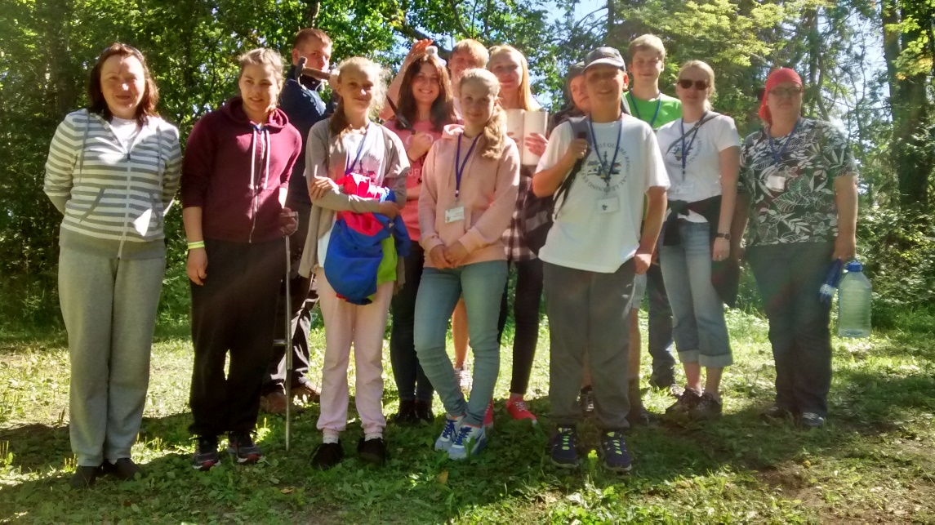
Thank you for your attention!

