Slide 1
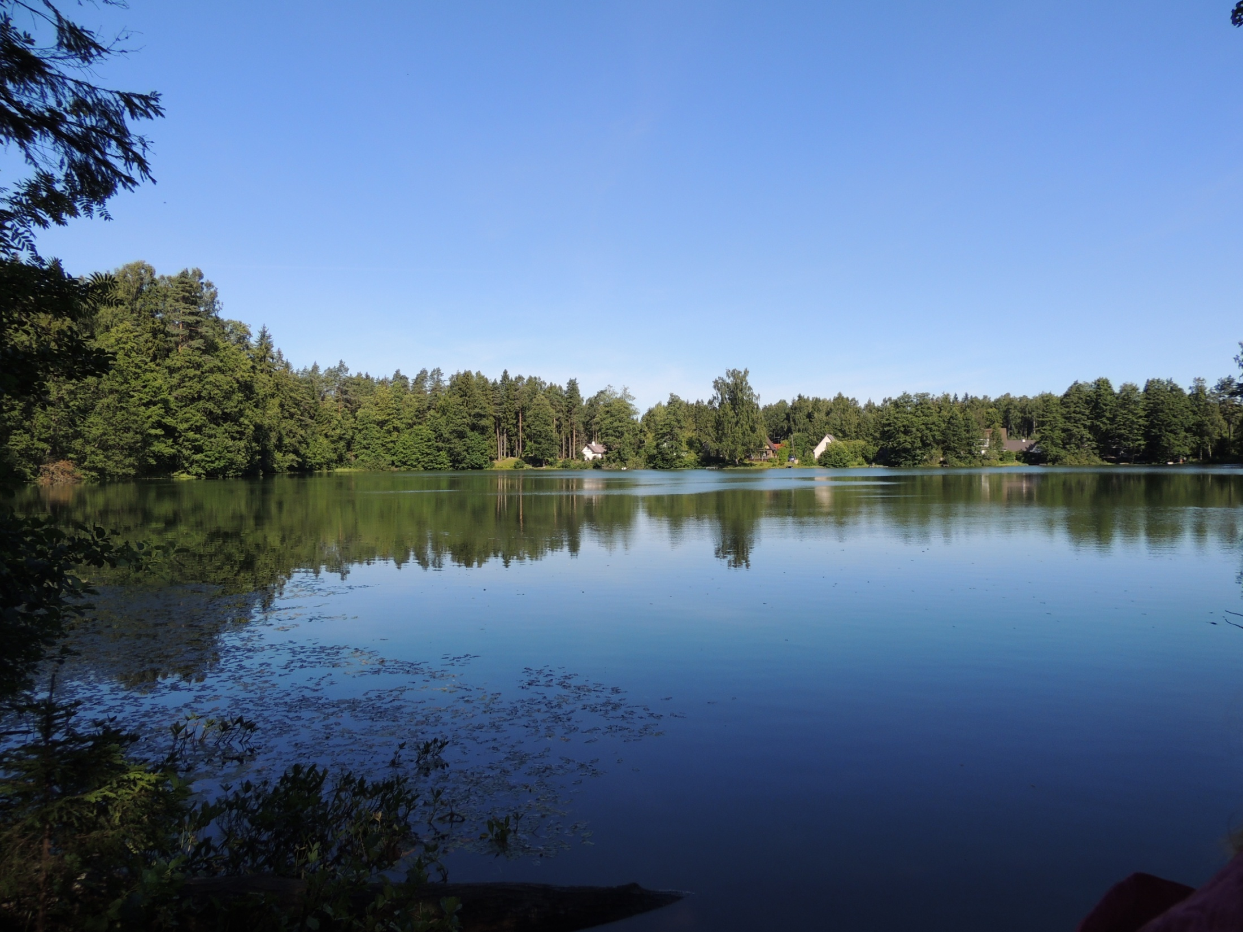

Globe 2015
Interactive worksheet
Marko Peterson
Evald Sepp
Krista Strode
Annika Prillop
Laura Koitsaar
Gariina Kudritskaja
Allan Rist
Aldis Janis Pivars
Anna Misnik
Prochuvailova Ekaterina
Chaikina Elina
Selena Joesuu
Elsa Triin Raidla
Regina Jakstoniene
Ruta Kondrotaite

Slide 2
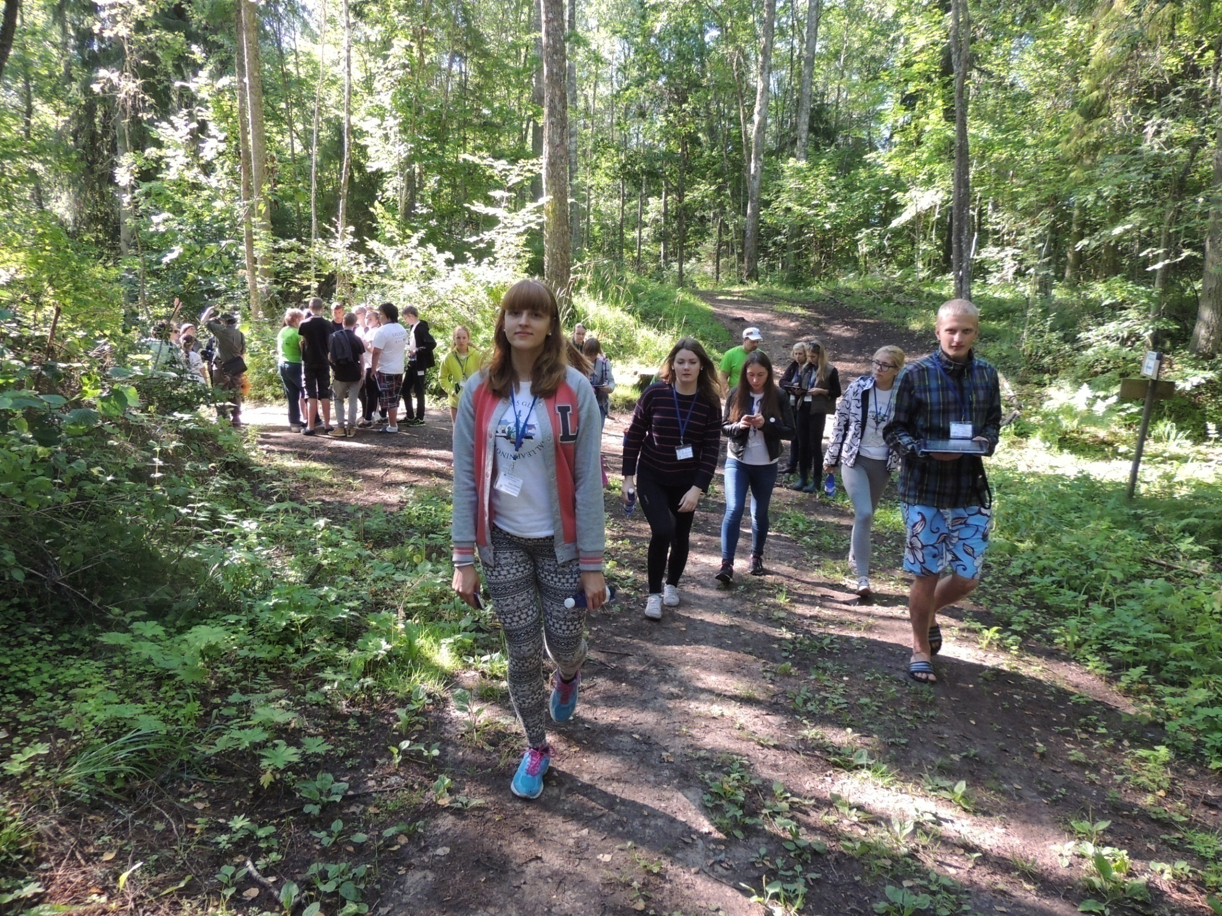
Our super team

Slide 3
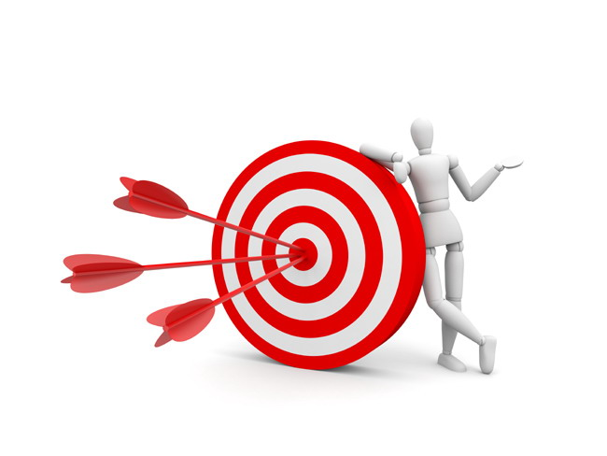
Our expedition
Purpose - getting experience in researching of environment by combining measuring tools, creating new content, and using mobile application, which resulted with new interactive worksheet.

Slide 4
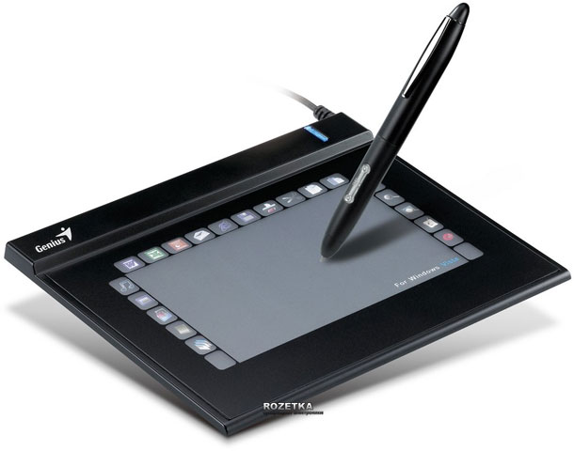
Tools and devices
Tablet
  Outdoor studying mobile application
  GPS
  Map of the area
  Camera
  Insert data
  Supportive applications

Slide 5
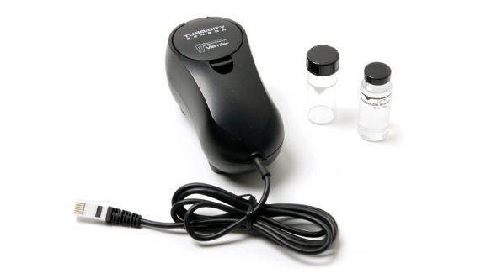
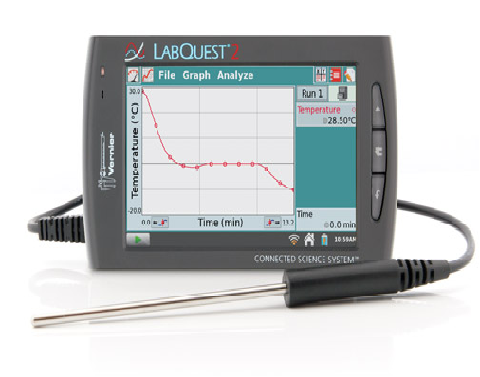
Tools and devices
Data-collection device (Vernier):
Temperature probe
Turbidity Sensor

Slide 6
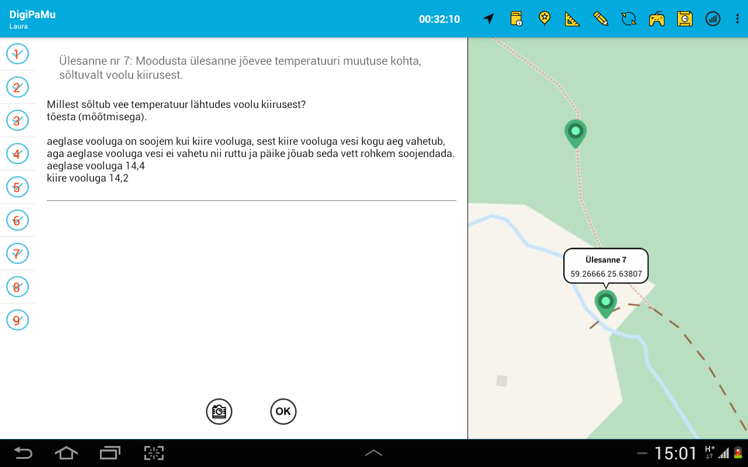
Expedition application

Slide 7
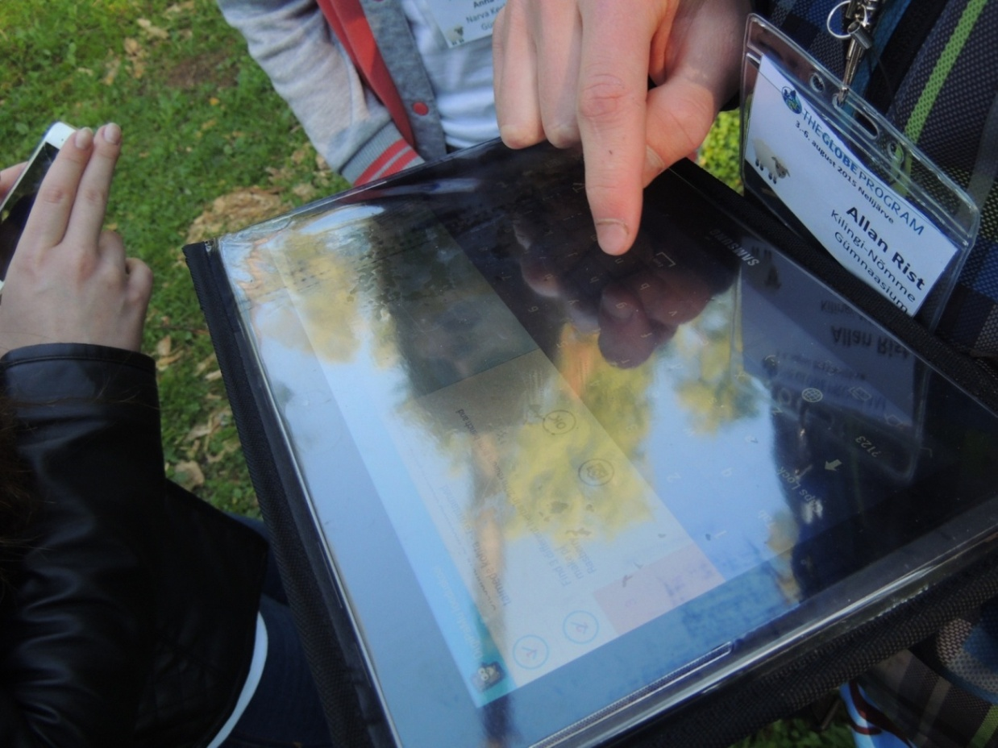
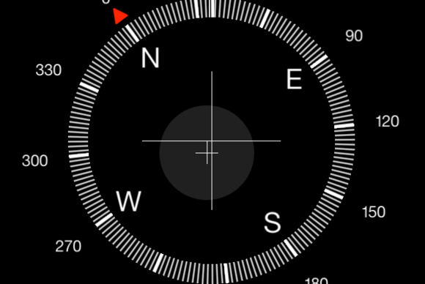
First point of expedition was navigation and distance

Slide 8
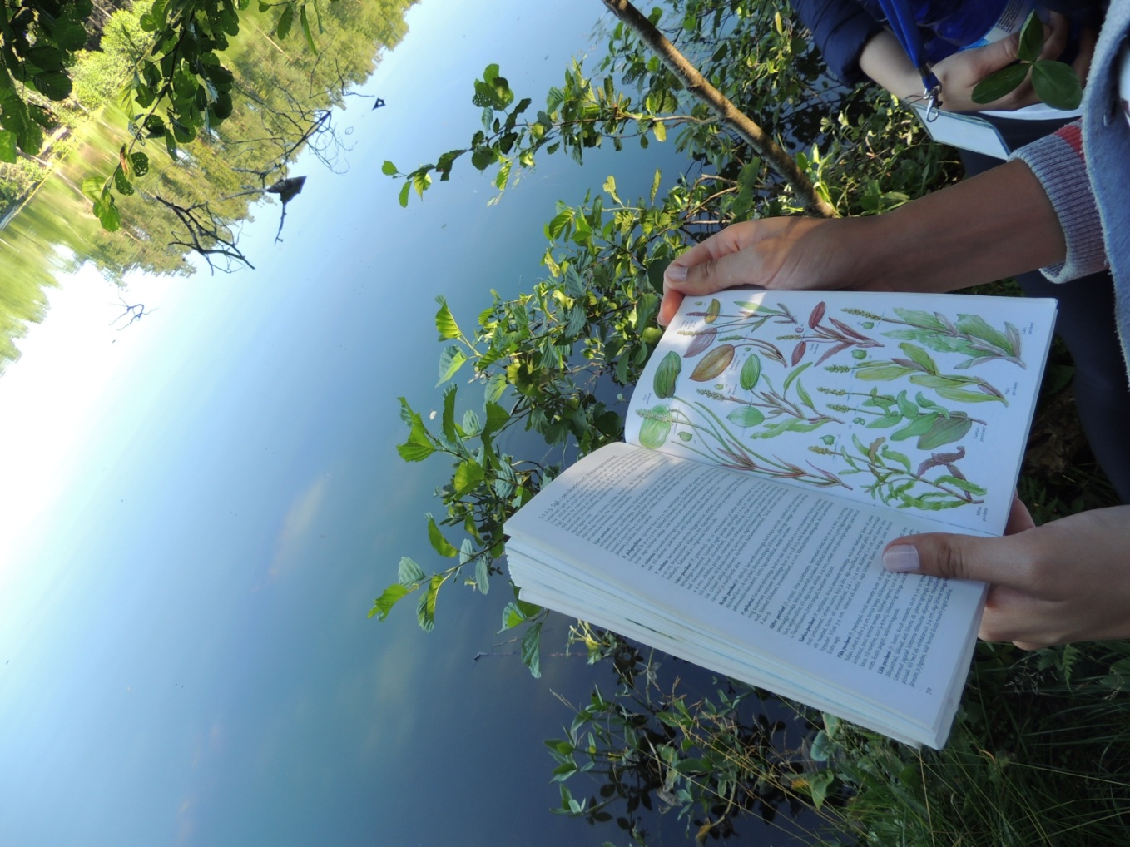
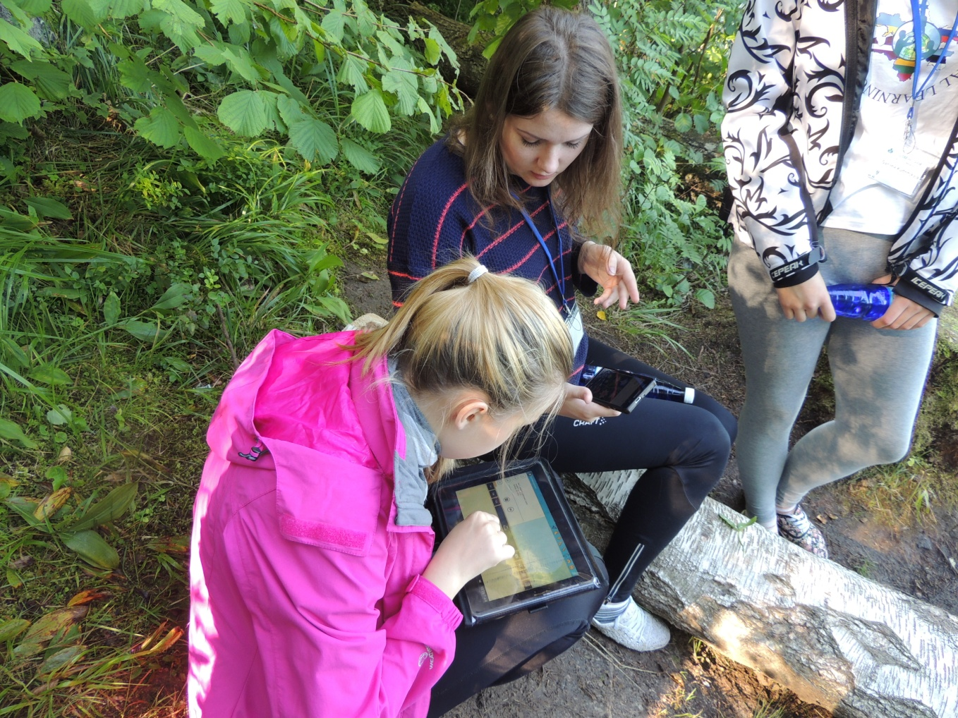
Urbukse järv
We describe plants

Slide 9
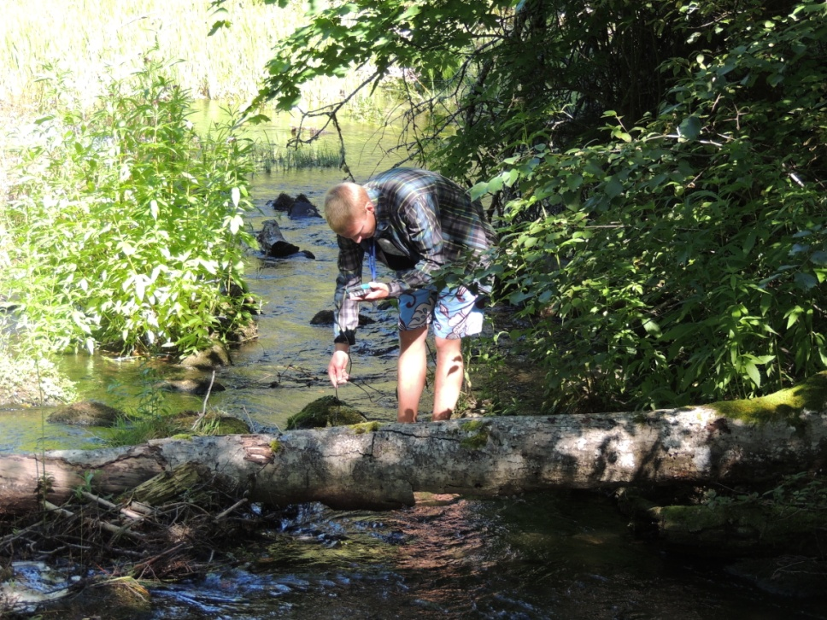
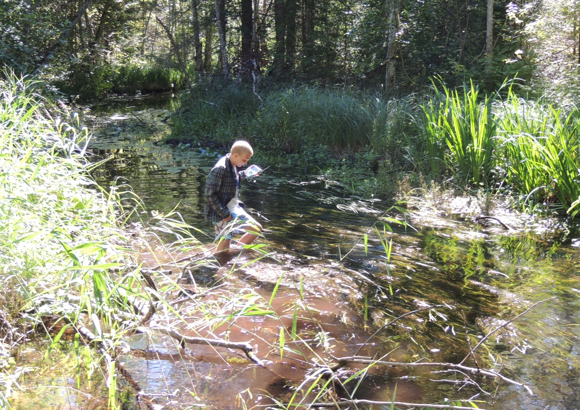
Nothing couldn't stop us

Slide 10
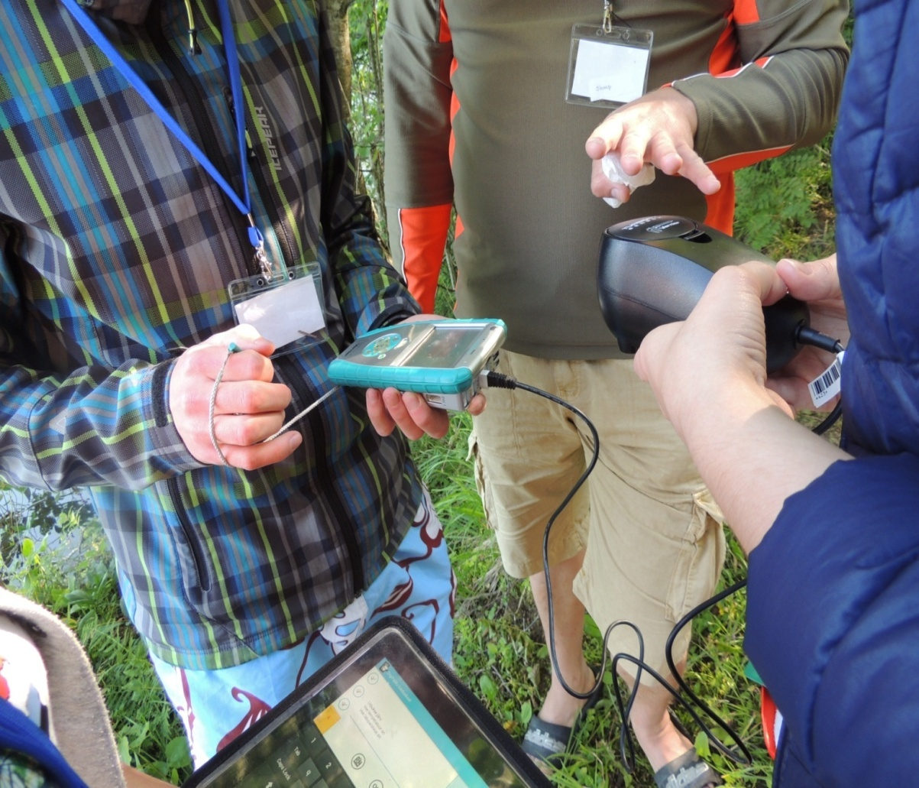
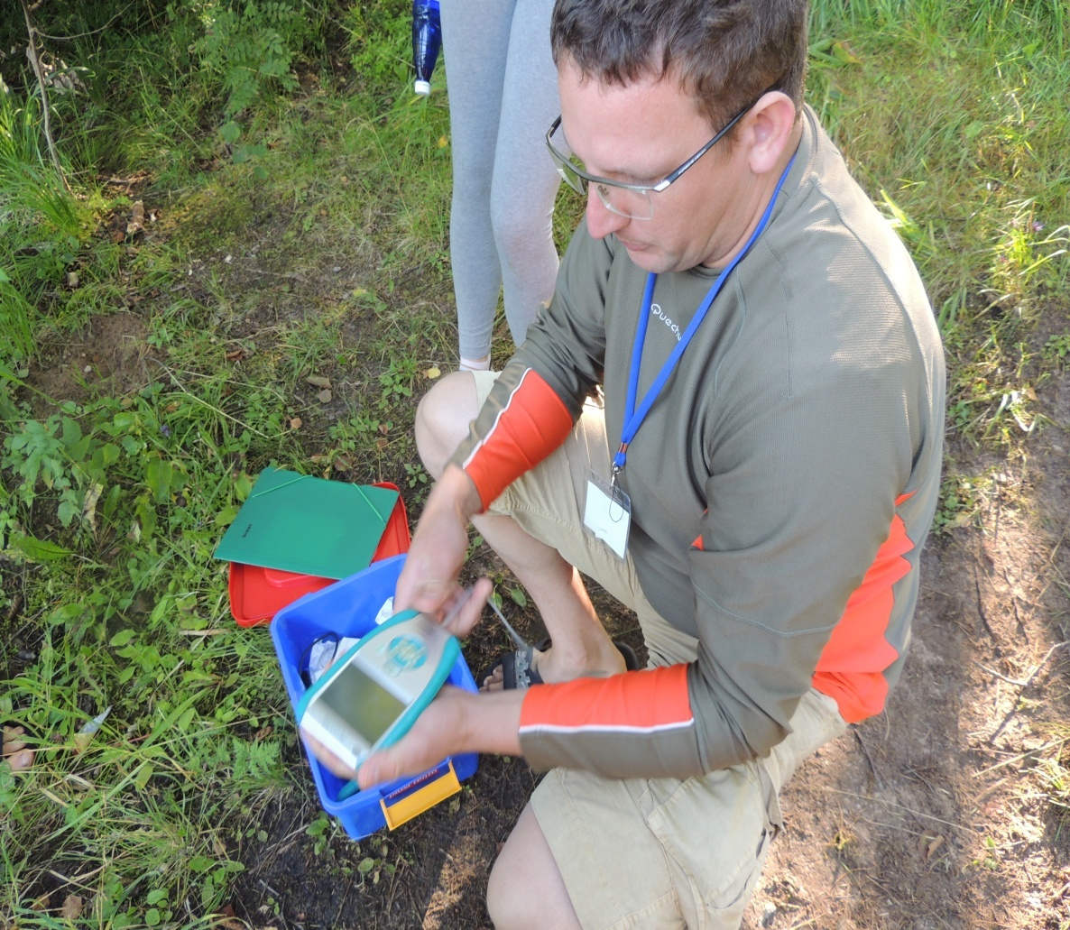
Turbidity measuring in process

Slide 11
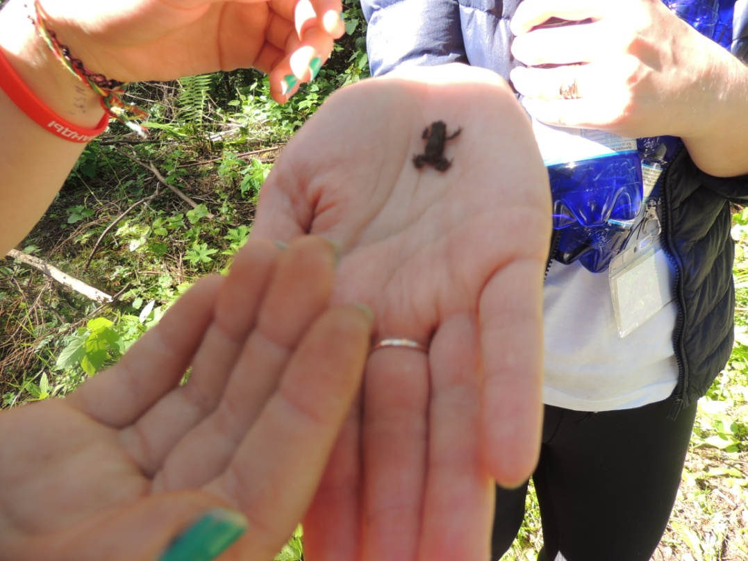
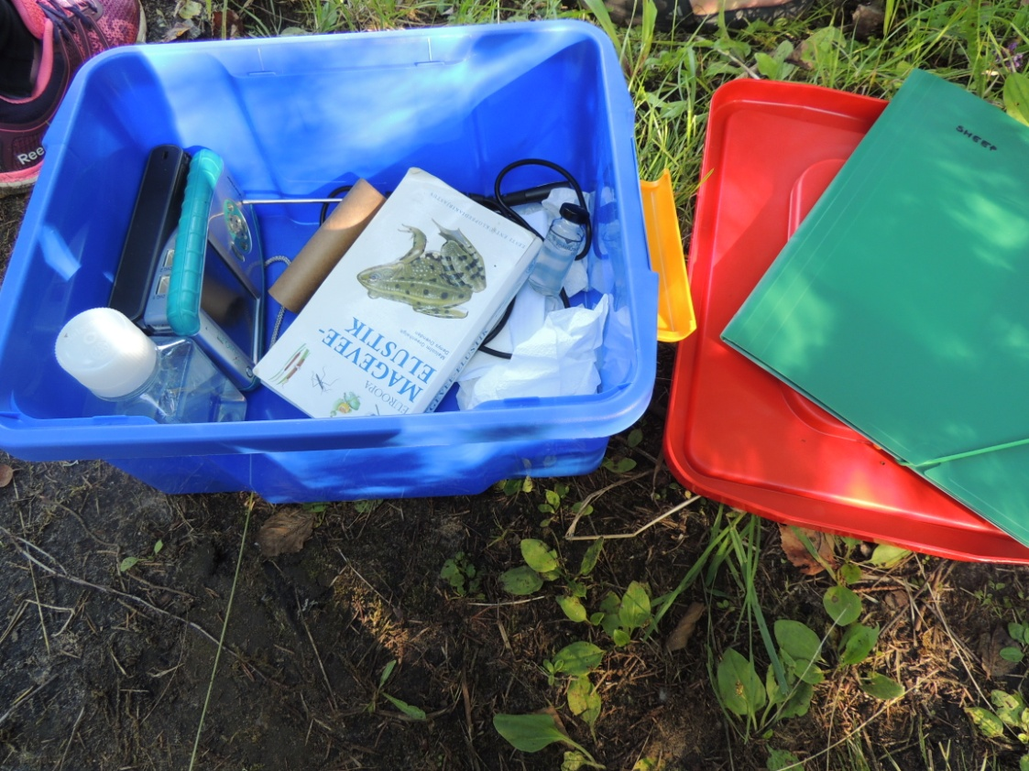
We met different animals and plants
Frog, spider, jay and mosquitoes…

Slide 12
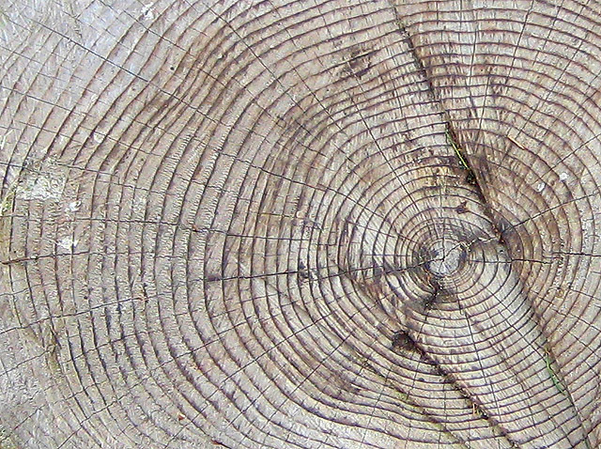
Thank you
for
attention

