Slide 2
Land Cover Tour
Team Turtles and Veljo Kimmel

Slide 3
Introduction
The 1st question for determining land cover type is – is it developed or natural site? In most populated area this is not easy task to answer since most of grasslands and forest are developed or influenced by human.

Slide 4
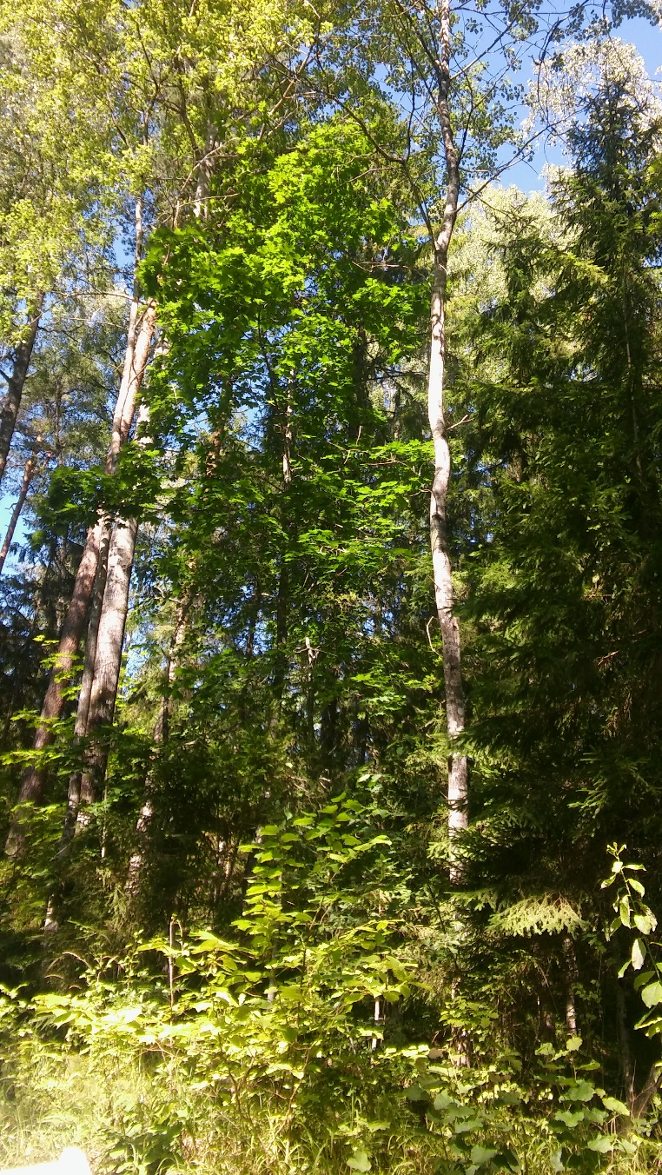
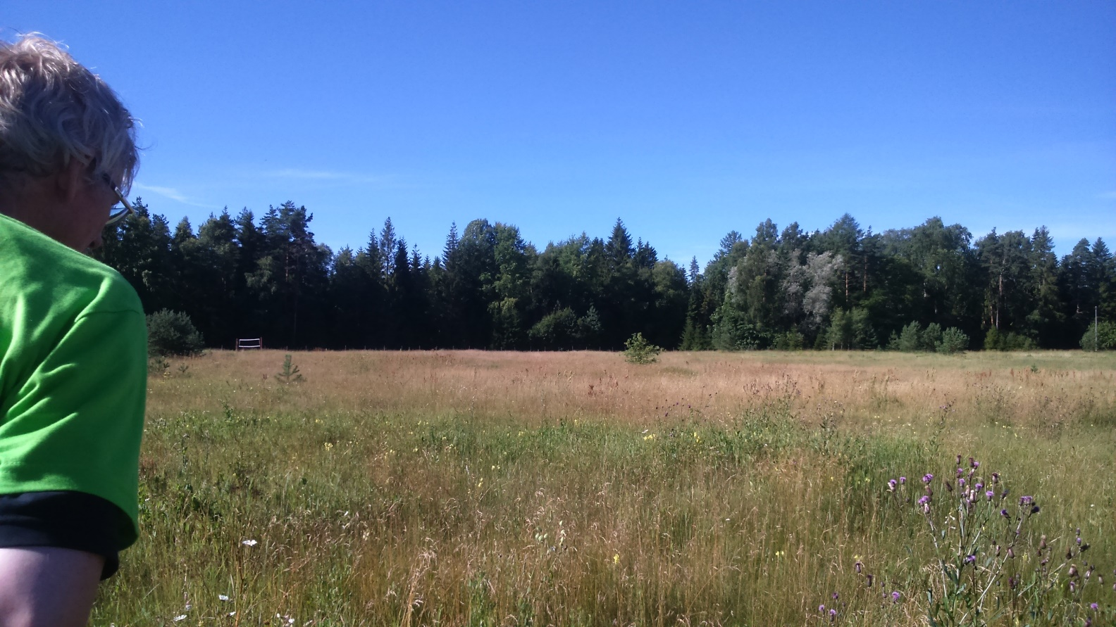
Mainly land cover type is determined by species available there, their density, richness etc.
Methodically we select two types of sites: 1)forest, 2)grassland.

Slide 5
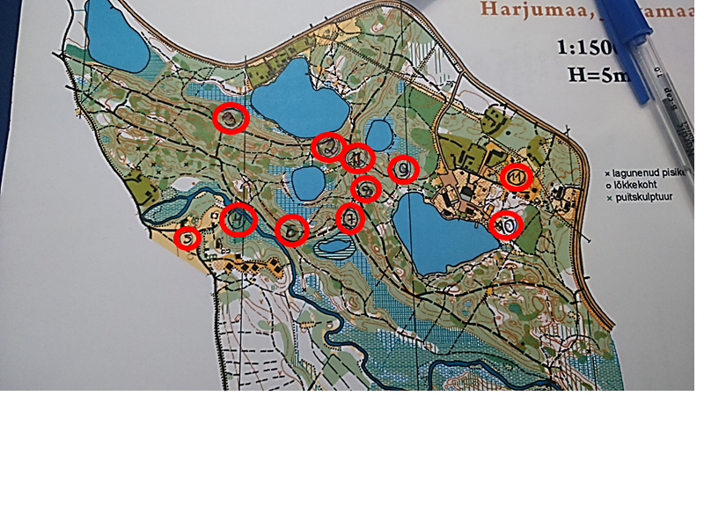
We made stops in 9 forest locations, which are given on map. For grasslands, we made two stops.

Slide 6
Number of sites
Trees | Number of locations
Birch (Betula pendula) | 9
Common Spruce (Picea abies) | 9
Pine (Pinus sylvestris) | 7
Rowan (Sorbus) | 7
Aspen (Populus tremula) | 6
Maple (Acer platanoides) | 5
English oak (Quercus robur) | 2
Small-leaved lime (Tilia cordata) | 1
Ash (Fraxinus excelsior) | 1

Slide 7
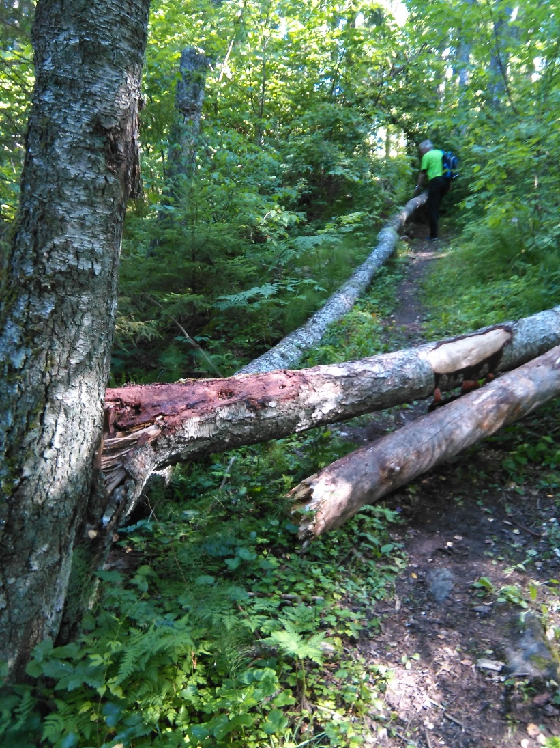
The human influence is not only determined by species themselves, but also their patterns – distance between trees, availability-absence of dried-dead trees etc.

Slide 8
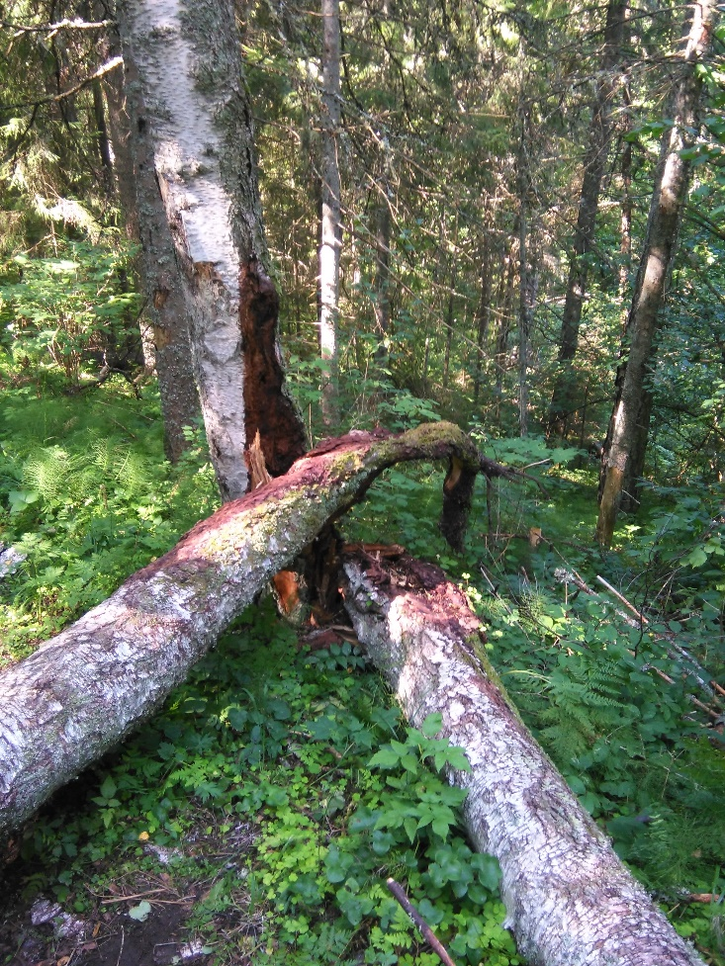
To sum up
Here in natural and managed forest are different trees.
Human influenced forests are cleaner.
There are fallen trees in natural forest.
Satellites do not know if long trees are natural or not - quite often park is not different from forest.
At grasslands only 1 plant was same from 5-7 existing.
We had lots of fun!

Slide 9
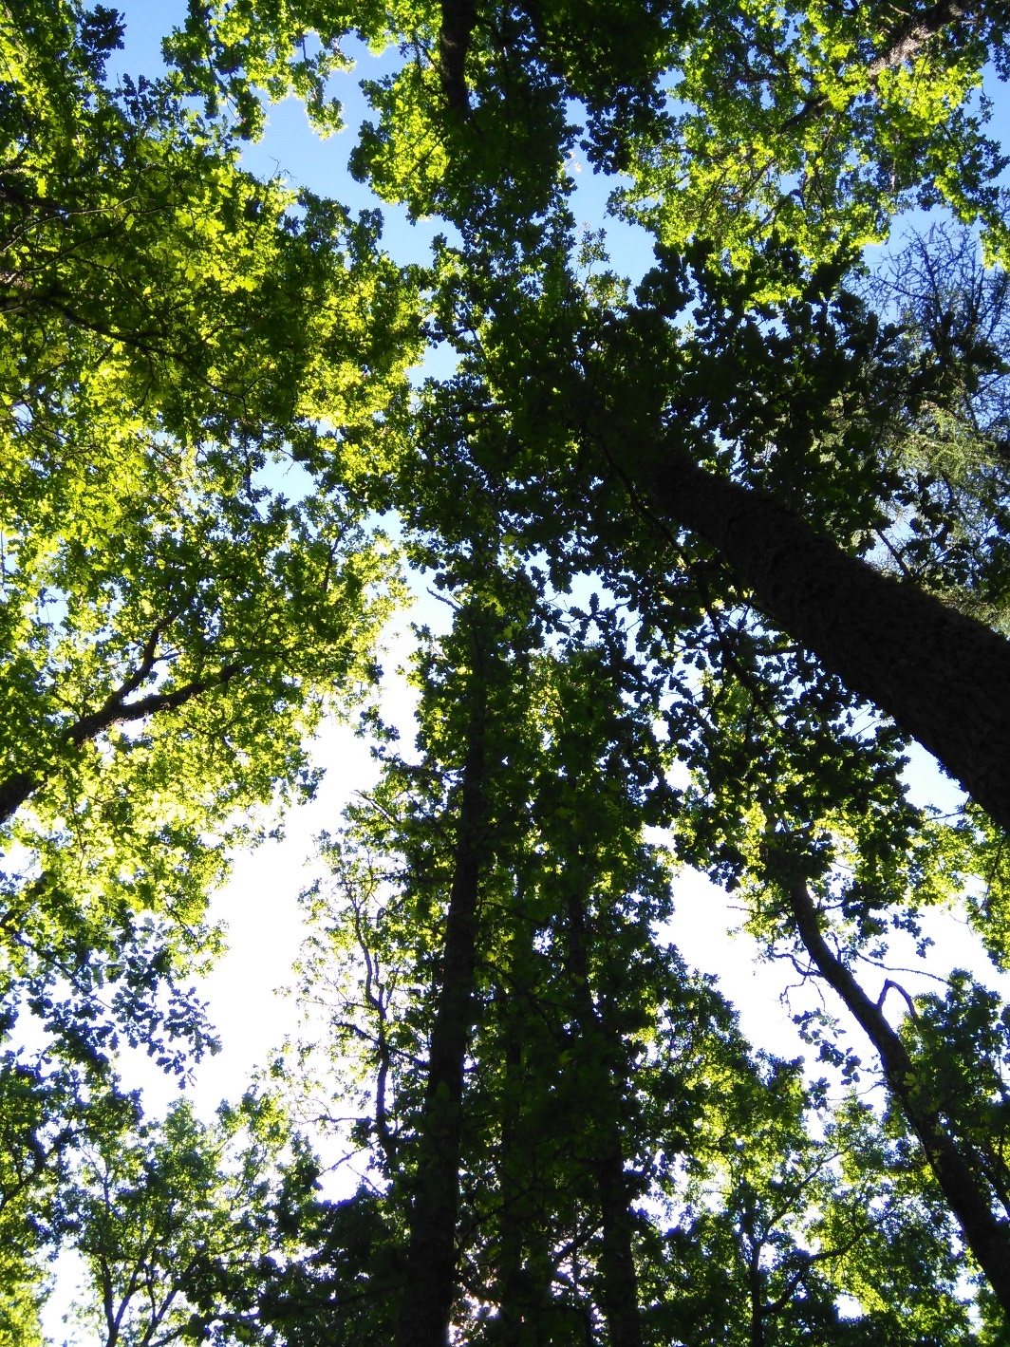
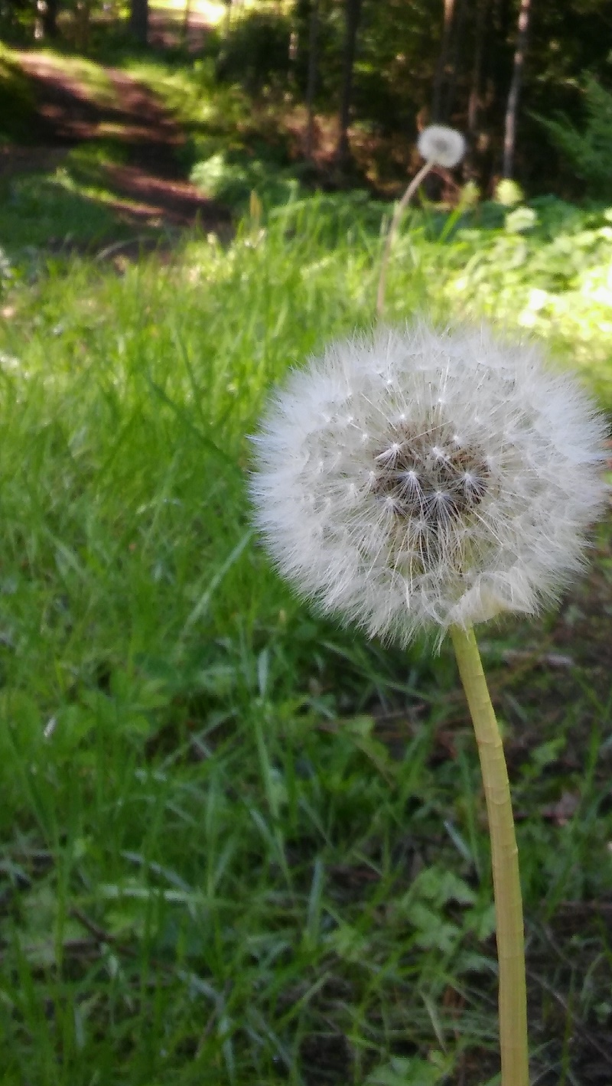
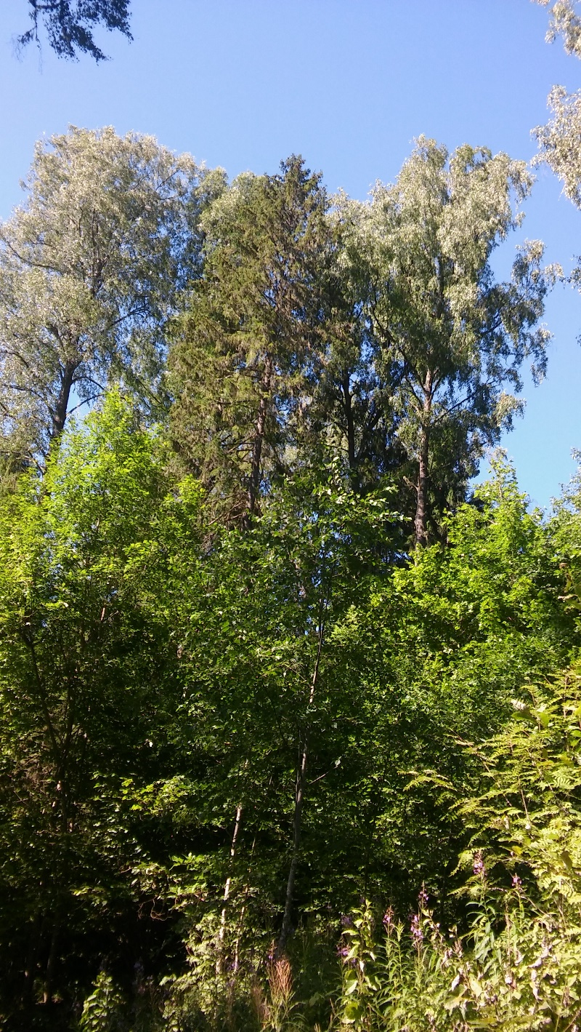

Slide 10




TEAM TURTLES
Maksim Vassin (EST)
Triine-Mirell Ämarik (EST)
Oona Salmirinne (FIN)
Siiri Holappa (FIN)
Robert Tõnisson (EST)
Elina Arnautova (EST)
Siim Kaljuorg (EST)
Roosi Ahas (EST)

Slide 11
THANK YOU LISTENING
FOR
!
TÄNAN KUULAMAST!
KIITOS, ETTÄ JAKSOITTE KUUNNELLA!

